Slide 1
Mizuho Macroeconomic Outlook
- USD and VND
Photo Credits: Shutterstock, FT
November 2024

Slide 2
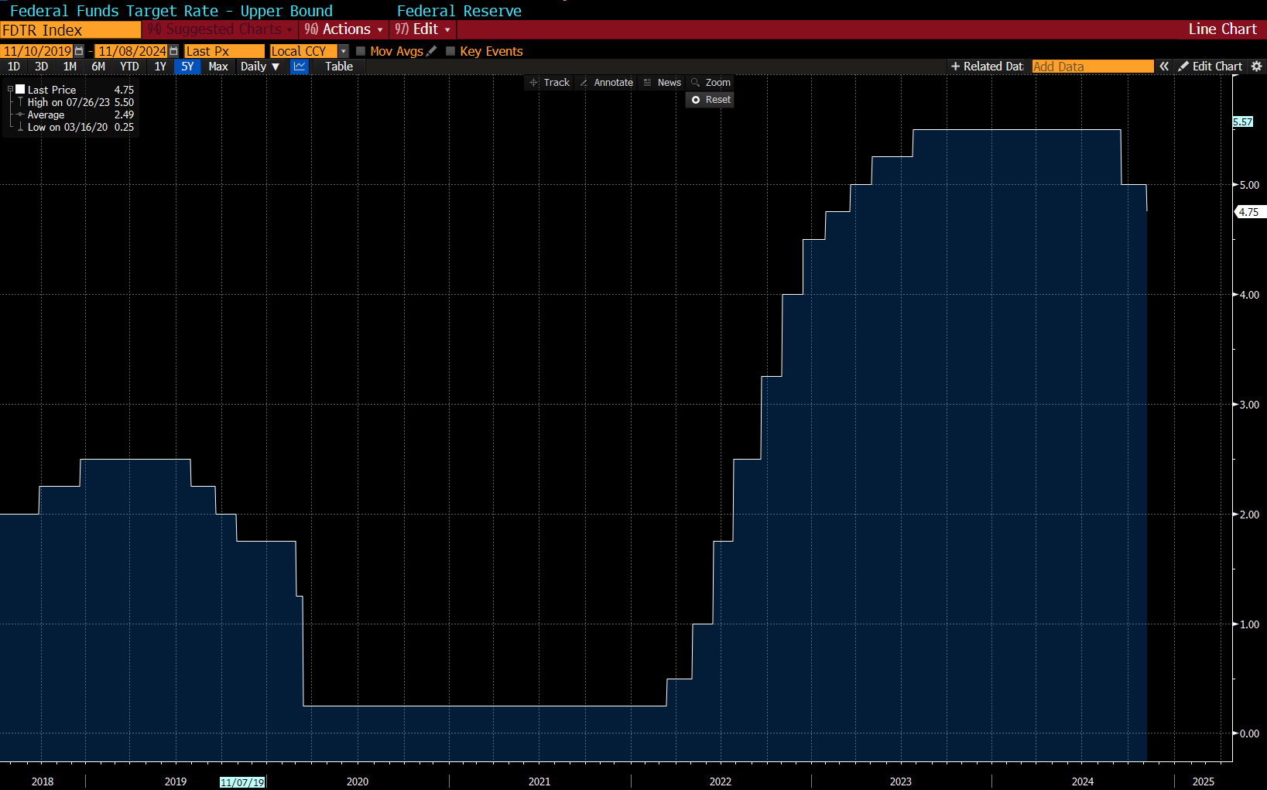
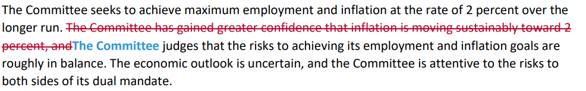
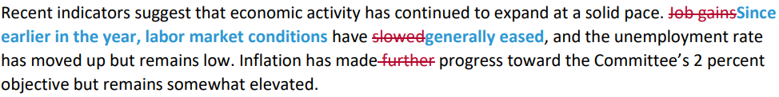
1a. Takeaways from November FOMC - Statement

Slide 3



1b. Takeaways from November FOMC – Press Conference
Economic activity has continued to expand at a solid pace
Labour market conditions are less tight than before the pandemic
It is not permitted under law for the President to remove the Fed Chair. He would not resign if asked to leave.
Thinking about slowing the pace of rate cuts
Doesn’t rule in or out a December rate cut
We don’t know what the timing or substance of economic policy changes going forward. The Fed is not going to assume or guess what’s going to happen. In the near term, the election will have no effect.
We don’t guess, we don’t speculate and we don’t assume.

Slide 4
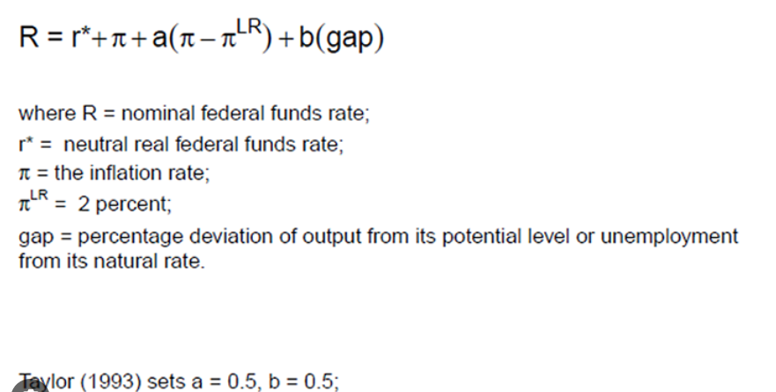
2a. Conditions are Exceptionally Tight – Taylor Rule Does Not Require Such Restriction
1.75%-2.25%
1.8%
3.7%
←2019
Policy is restrictive in real terms and in policy calculus
Objective: Ample room to cut
Subjective: Past experiences shape policy actions as well

Slide 5
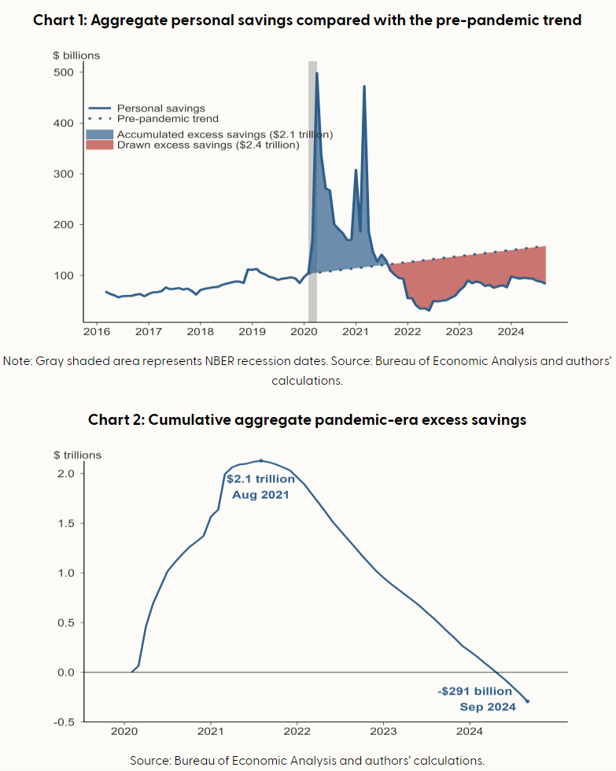
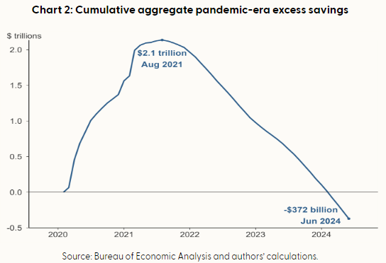

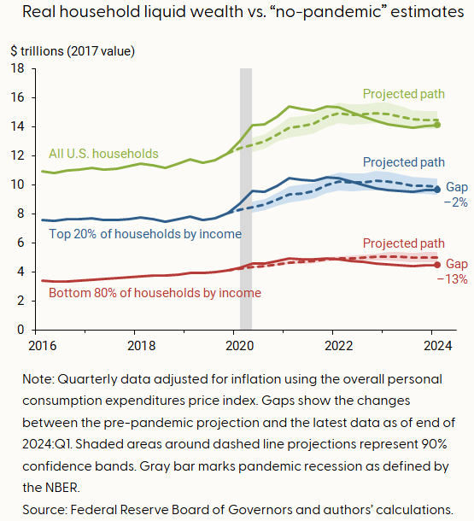
2b. Looking Ahead: State of the US Consumer: Grinch or Santa

Slide 6
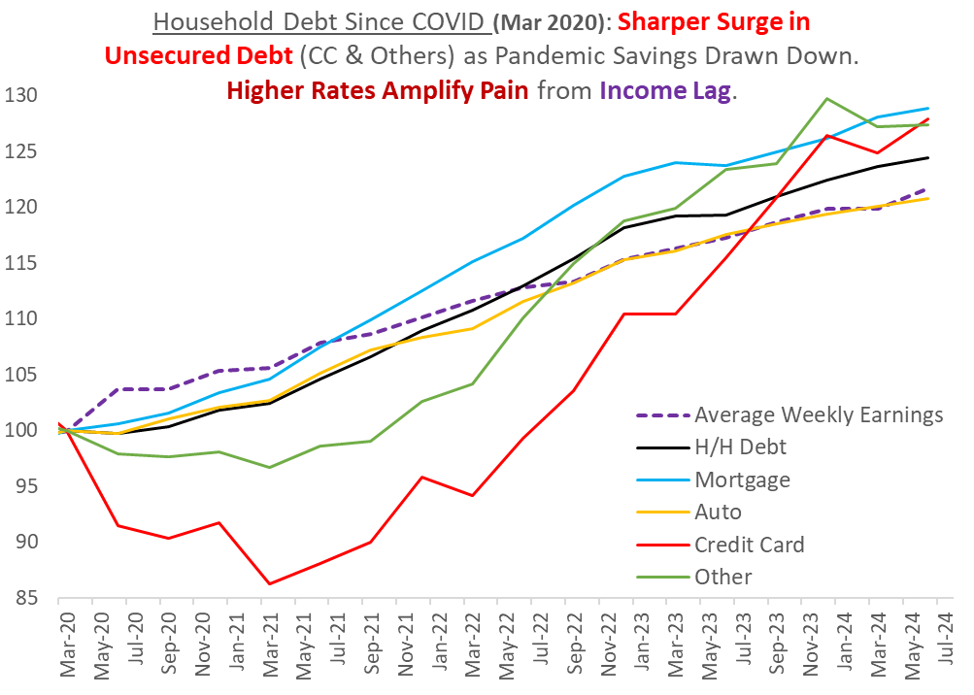
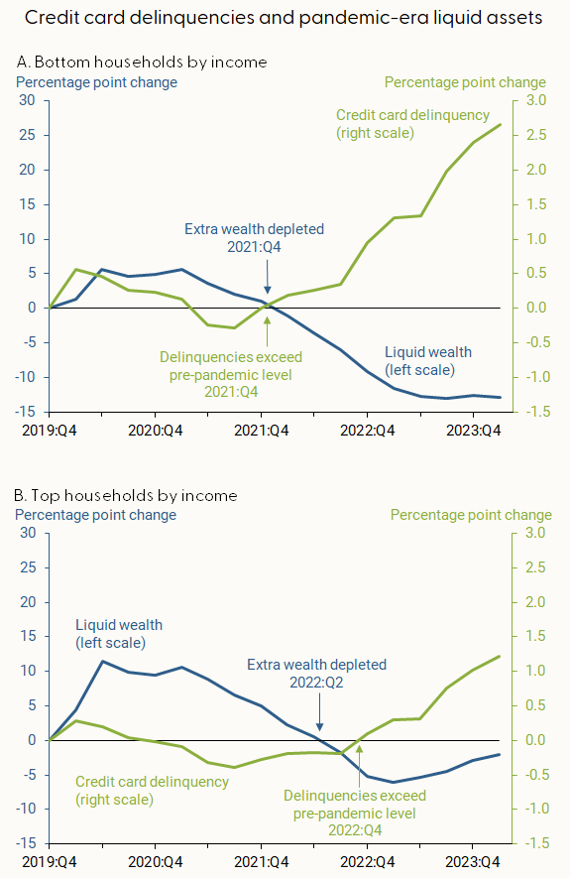
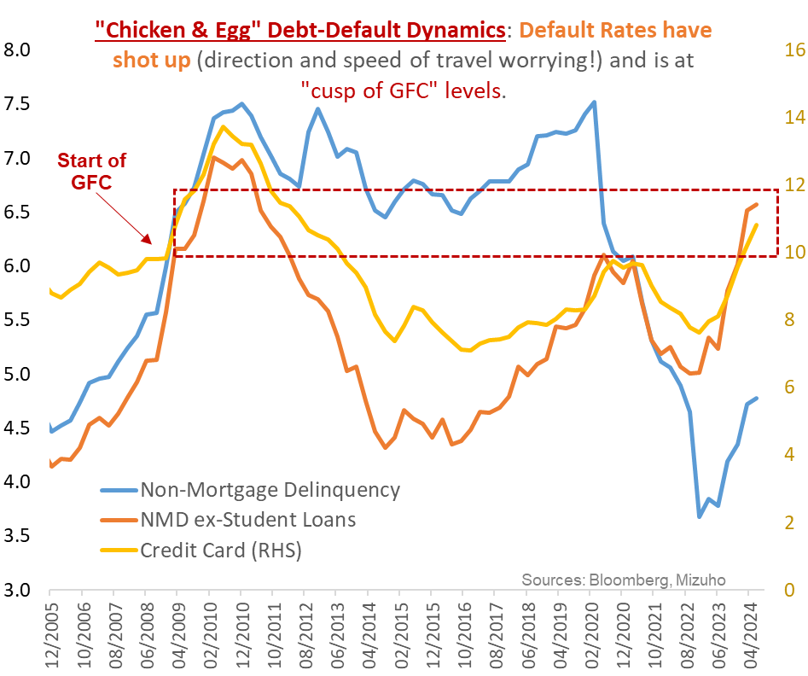
2c. December FOMC: Grinch or Santa

Slide 7
2d. December FOMC: Remaining Signposts to Watch - Santa's Elves or Grinch Spirit
Labour Market
Softening in recent months (Oct: +12k)
NFP Rebound Expected on 6 Dec
Prior Revisions to be Watched for
Strikes – Boeing
Hurricanes (Milton and Helene)
Needs Driven vs Supply Driven
US Consumer - Tightening Cash-flows
Drawdown of savings, increased credit (and attendant servicing burden) and softening wage gains translate into tighter consumer cash-flows.
In turn the hit on demand will have negative multiplier effects at the margin, which significantly dampen growth outcomes; even if an outright recession is averted.
For a Fed that is decidedly not setting out to break something, this will be a jolt out of the Type 2 error resulting from the earlier Type-1 error.

Slide 8
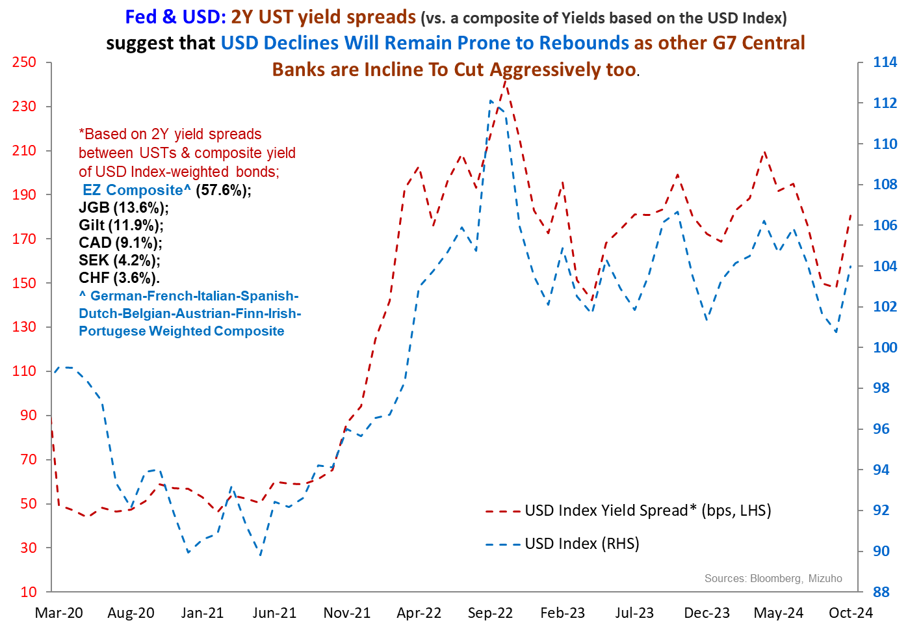
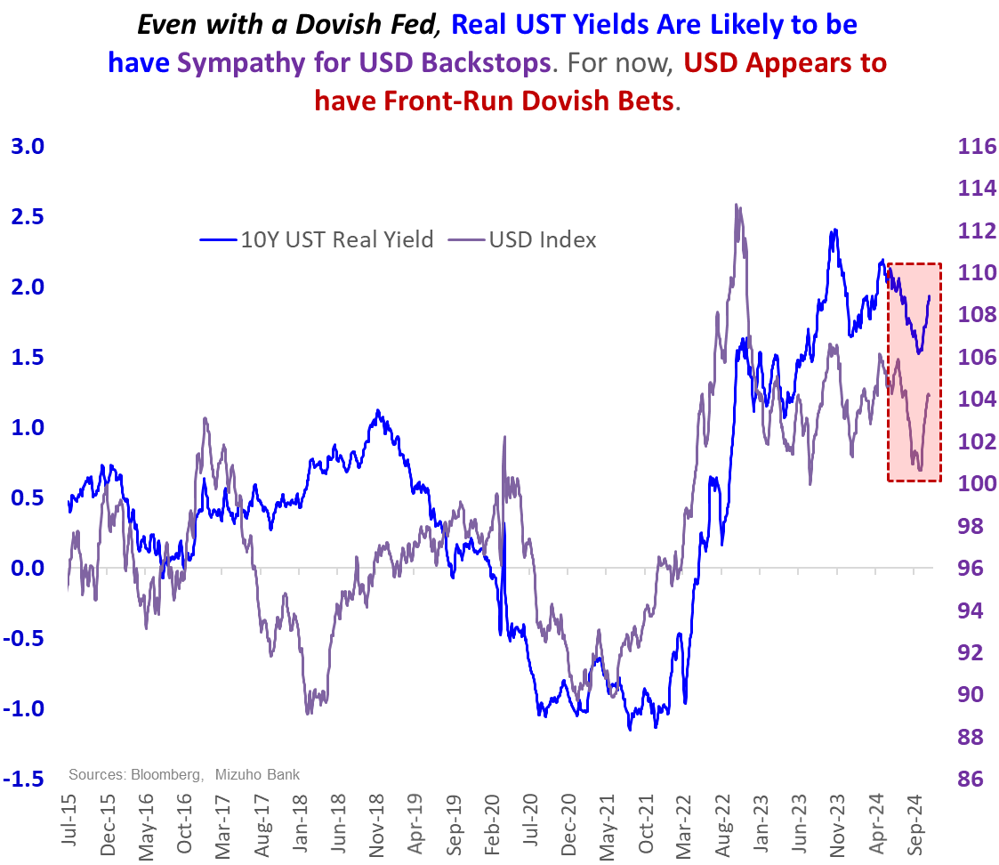
3. USD Outlook: Yield Spreads & Real Yields Suggest Backstop, USD Resiliency On Sharper Dips

Slide 9
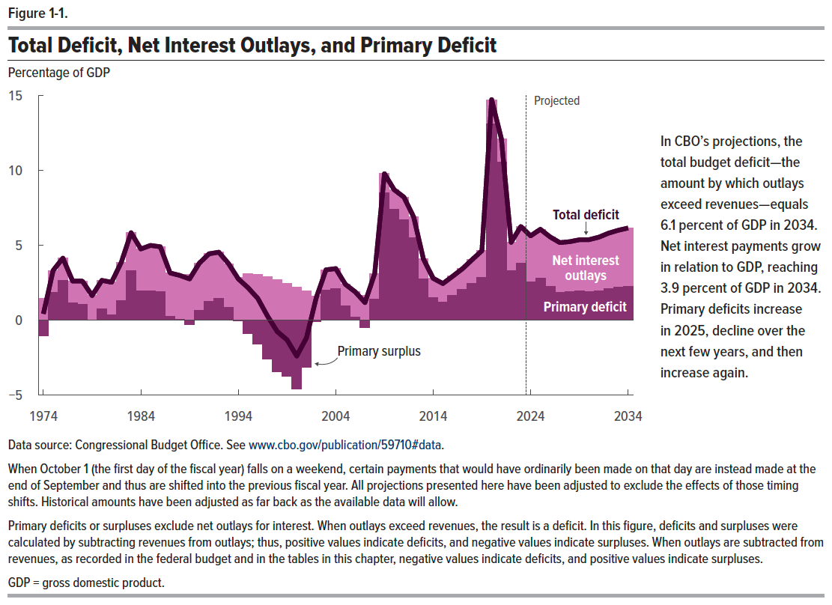
3. USD & Steeper Curve: Why Our Fiscal & Yield Curve Views are Agnostic to Politics
Partly because of obscured political projections.
Not only is it difficult, but arguably misguided, to holistically pin down candidate-dependent fiscal policies in a vacuum.
But mostly, because our base case, limited view is that neither the Democrats nor the Republicans have the fiscal high ground.
Instead, it is merely the nature of their “fiscal sins” that differ (spending vs. tax cuts).
Hence, defaulting largely rely on the CBO’s estimates for fiscal deficit is a good start.
And the projections for fiscal deficit to be in the ballpark of 5.5-6..0% for the next decade (2025 through 2035) are reasonable, albeit worrying.
Crucially, net interest payments (NIP) starting to become the dominant source of fiscal burden (see the CBO Figure 1.1 below), necessarily limits fiscal options and imposes harsher constraints.
Notably, NIP is set to make-up 60-65% of total deficit in from 2025-2034 compared to just over a quarter of total fiscal deficit from 2010 to 2014 when fiscal deficit averaged a comparable 6.1%).
This means two things, that underpin a worrying fiscal trajectory with increasing incentive to term out debt.
First, incremental, policy-driven variations in primary deficits (ex-NIP) will have diminished sway on total fiscal deficit and the attendant bond issuances required.
Second, the incentive to term out debt issuances grows as interest rate burden crowds out current budget spending requirements.

Slide 10
3. USD - Politics: Trump 2.0: Bracing for Geo-economic Blows
Weaker CNH, AXJ & MXN
Weaker EUR
Elevated Global Threats
Near-term USD Resilience
Trump 2.0
Trade (Tariffs)
Energy/Oil
Remove Restrictions
Impose Higher China/wider Tariffs!
Infrastructure [Fiscal]
Tax Cuts [Fiscal]
Ukraine [Conflict]
Gaza [Conflict]
Pull/Cut Aid
Uncertain Israel-Saudi Dynamics
Ramp-up Spending?
Extend Tax Cuts
Higher Inflation?
Tempers
Higher Yields
Higher Term Premium

Slide 11
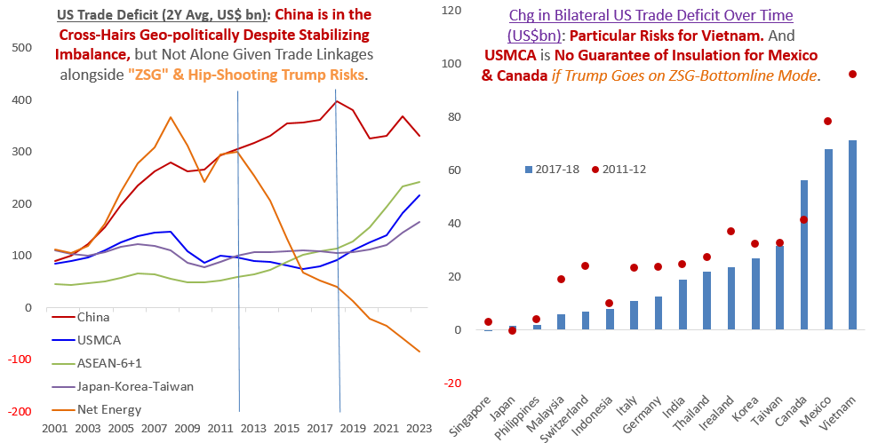
3. Trade & China: Risks Go Well Beyond China
*ZSG: Zero Sum Game

Slide 12
4a. VND: China +1 in the Cross Hairs

Slide 13
4b. VND: Depreciation Risks Despite Fundamental Allure

Slide 14
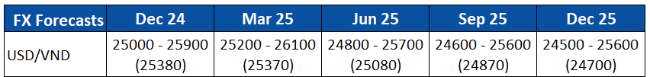
4c. VND: Depreciation Risks Despite Fundamental Allure
US Treasury (15 Nov): authorities conveyed credibly to the Treasury that net sales of FX from July 2023 to June 2024 was 1.5% of GDP (US$6bn)
Asymmetric VND Outlook
Low buffers in depreciation episodes during USD strength
Need for FX accumulation weakens potential for relative VND appreciation

Slide 15
Disclaimer
Important Information
This publication has been prepared by Mizuho Bank, Ltd. (“Mizuho”) and represents the views of the author. It has not been prepared by an independent research department and it has not been prepared in accordance with legal requirements in any country or jurisdiction designed to promote the independence of investment research and is not subject to any prohibition on dealing ahead of the dissemination of investment research.
Disclaimer
Unless otherwise stated, all views or opinions herein are solely those of the author(s) as of the date of this publication and are not to be relied upon as authoritative or taken in substitution for the exercise of judgement by any recipient, and are subject to change without notice.
This publication has been prepared by Mizuho solely from publicly available information. Information contained herein and the data underlying it have been obtained from, or based upon, sources believed by us to be reliable, but no assurance can be given that the information, data or any computations based thereon are accurate or complete. This publication provides general background information only. It is information in summary form and does not purport to be complete. This publication has been prepared for information purposes only and is not intended by Mizuho or its affiliates to constitute investment, legal, accounting, tax or other advice of any kind and all recipients of this publication are advised to contact independent advisors in order to evaluate the publication, including, without limitation, the suitability of any security, commodity, futures contract or instrument or related derivative (hereinafter, a “financial instrument”), product or strategy herein described. This publication is not intended to be relied upon as advice to investors or potential investors and does not take into account investment objectives, financial situation or needs of any particular investor. It is not intended for persons who are Retail Clients within the meaning of the United Kingdom’s Financial Conduct Authority rules nor for persons who are restricted in accordance with US, Japanese, Singapore or any other applicable securities laws.
This publication has been prepared for information purposes only and is not intended by Mizuho to market any financial instrument, product or service or serve as a recommendation to take or refrain from taking any particular course of action or participate in any trading or other strategy. This publication is not an offer to buy or sell or a solicitation of any offer to buy or sell any security or any of the assets, businesses or undertakings described herein, or any other financial instrument, nor is it an offer to participate in any trading or other strategy, nor a disclosure document under applicable laws, rules, regulations or guidelines. Nothing contained herein is in any way intended by Mizuho or its affiliates to offer, solicit and/or market any financial instrument, product or service, or to act as any inducement to enter into any contract or commitment whatsoever. Neither the author, Mizuho nor any affiliate accepts any liability whatsoever with respect to the use of this publication or its contents or for any errors or omissions herein.
Mizuho and its affiliates, connected companies, employees or clients may take the other side of any order by you, enter into transactions contrary to any recommendations contained herein or have positions or make markets or act as principal or agent in transactions in any securities mentioned herein or derivative transactions relating thereto or perform or seek financial or advisory services for the issuers of those securities or financial instruments.
All of the information contained in this publication is subject to further modification without prior notice and any and all opinions, forecasts, projections or forward-looking statements contained herein shall not be relied upon as facts nor relied upon as any indication of future results. Opinions stated in this publication are subject to change without notice. Future results may materially vary from such opinions, forecasts, projections or forward-looking statements. The information contained in this publication may not be current due to, among other things, changes in the financial markets or economic environment. Mizuho has no obligation to update any information contained in this publication. Past performance is not indicative of future performance.
This is a strictly privileged and confidential publication. This publication contains information addressed only to a specific individual and is not intended for distribution to, or use by, any person other than the named addressee or any person or entity in any jurisdiction or country where such distribution or use would be contrary to law or regulation. Save with Mizuho’s prior written consent, you may not disclose, divulge, reproduce or furnish any information contained herein to any other party. Please notify the sender immediately if you have mistakenly received this publication.
Singapore: Mizuho is licensed as a bank under the Banking Act (Chapter 19) of Singapore, and is regulated by the Monetary Authority of Singapore.
Japan: Mizuho is authorised and regulated by the Financial Services Agency of Japan.
United Kingdom / European Economic Area: In the UK, Mizuho is authorised by the Prudential Regulation Authority and subject to regulation by the Financial Conduct Authority and limited regulation by the Prudential Regulation Authority. Details about the extent of MHBK's regulation by the Prudential Regulation Authority are available upon request. This publication may also be distributed by Mizuho International plc (“MHI”). MHI is authorised by the Prudential Regulation Authority and regulated by the Financial Conduct Authority and the Prudential Regulation Authority.
United States: This publication is not a “research report” as defined in Commodity Futures Trading Commission (“CFTC”) Regulations 1.71 and 23.605. The content of publications distributed by Mizuho Securities USA Inc. (“MSUSA”) is the responsibility of MSUSA. The content of publications distributed directly to US customers by Mizuho is the responsibility of Mizuho. US investors must effect any order for a security that is the subject of this report through MSUSA.
© 2014 Mizuho Bank Ltd.

Slide 16
Appendix: US Political Landscape
 | In Charge of | Nomination | Remarks
Energy Secretary | Nuclear Weapons Program Manages energy infrastructure and oil stockpile Funds energy research | Chris Wright | Runs oil and natural gas fracking company Public paper to conclude that climate change is far from world’s greatest threat to human life
Secretary of Defense | Head of defense departments and subject only to orders of the President Army, Marine Corps, Navy, Air Force | Pete Hegseth | Fox News Host
Treasury Secretary | Financial Stability Oversight Council (Recent issues: Crypto, Climate) Debt Management International economic diplomacy | Scott Bessent | Found of Macro Hedge Fund 3% Growth, 3% fiscal deficit, +3mpd/barrels of oil Acknowledges USD Policy Inconsistencies
Secretary of State | 4th in line to Presidential Succession, ranked Second in Cabinet Supervise foreign services and immigration policy. | Marco Rubio | China hawk Sanctioned by China
Commerce Secretary | Promote American commerce | Howard Lutnick | Alliance with Tether Holdings (Crypto) Alludes to “anti-competitive” global trade elements
Health & Human Services Secretary | Health programs Oversees FDA, CDC… | Robert F. Kennedy, Jr | Vaccine Skeptic
Ambassador to UN |  | Elise Stefanik | Says UN corrupted, defunct and paralysed.
Border Czar (no Senate confirmation needed) | - Oversight of immigration, maritime and aviation security | Tom Homan | Criticised for separating migrant families.
National Security Adviser |  | Michael Waltz | China hawk Encourage military buildup

Slide 17
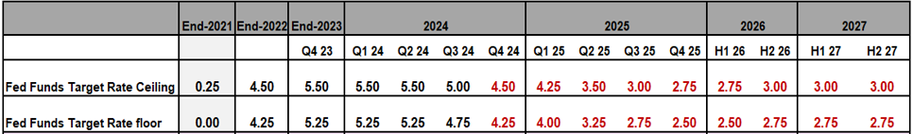
Appendix: US Policy Outlook
Flying Start, But 50 Not the New 25 …
In Sep, Fed Chair Powell went out of his way to convey not to expect outsized 50bp cuts as the norm.
In fact, since then (with another 25bp cut in Nov), he has suggested slowing the pace of cuts.
Our sense is that the Fed sees sufficient front-loaded “insurance” cuts..
Mostly Following the (Dot) Plot for 2024 …
Barring significant data surprises, the Fed will pause either in Dec or Jan (Dec cut is a coin toss).
But 2025 pace of, and propensity for, cuts is now the main watch.
Rate Cuts to Gather Pace in H1 2025
Expect faster cuts into mid-/Q3-2025, with some 125bp on the cards, to lower rates to ~3.00%.
Trump 2.0 execution to determine timing and depth. Risks to soft-landing persist and real rates remain elevated.
More Distinctly Dovish Leg diminished, But Not Ruled Out, by Trump 2.0
Scope for distinctly dovish Fed in 2025 if jobs/demand deteriorate sharper than SEP* “controlled landing”.
Premise: Consumer Slowdown, Not Crisis
Brisker cuts are premised on sharper consumption slowdown amid tightening cash-flows ➔ Not so soft landing
And not a crisis from a balance sheet shock – for which far deeper and larger rate slashing will be required.
Outcomes: Lower Yields + Distinctly Steeper Curve + Long-end “Trump 2.0” Volatility

