Slide 1
Mizuho Asia Quarterly - September FOMC and Beyond: The First Step ?
Photo Credits: Shutterstock, FT
September 2024
Notes:
Good afternoon. First and foremost, thank you for your time to tune in.
It was an eventful week…
Once again, I am BH, I am one of the macro economist, Asia Oceania Treasury Department of Mizuho Bank.
For those who joining us for the first time, thank you for joining me today and for those who are tuning in after our June update, welcome back as well.
During this webinar, I will be giving a quick update on the upcoming FOMC next week, while I am allocated

Slide 2
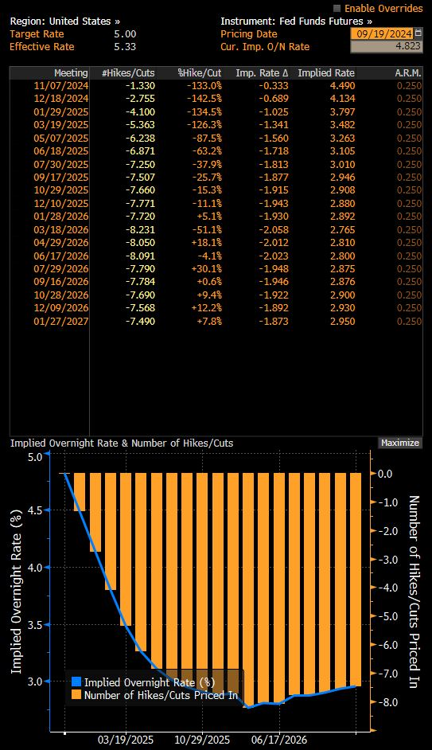
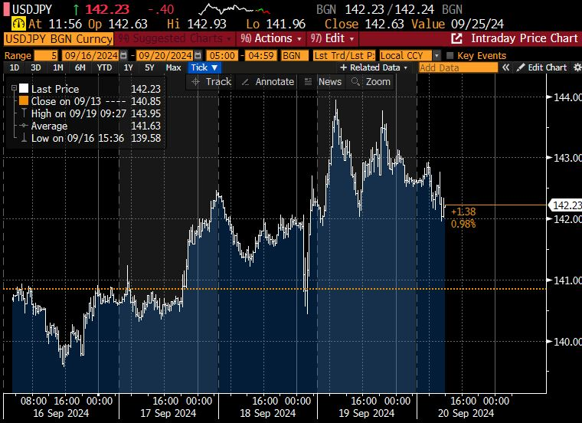
September FOMC: The First Step: Quantitative (Dot Plot) and Qualitative (Rhetoric) Easing Signals: Goldilocks and No More Bears?
September FOMC: -50bp
2024: 2 Cuts
2025: 4 Cuts
Projections
GAP
Rhetoric
Notes:
Last Wednesday, we saw the Federal Reserve cut the Fed funds rate by 50bps which was slightly bigger than what markets expected. Markets were pricing in about 70% chance of a 50bps cut right before the decision. Technically, some people was saying that the Fed had a dovish cut given that they cut more than expected.
However, if we look at market reactions, for FX, we saw that after an initial plunge in the USD, for example the USD/JPY plunge and quickly rose to offset losses, and the USD continued to strengthen post FOMC.
This underscores our take that it was not a “go big or go home”, high-roller, all-in, dovish game-book. Instead, a closer look suggests a one-off, “go big, and then go home”, insurance plan.
Or at least that was what the Fed appears to be attempting to convey.
From the Dot Plot, we see that the Fed is envisaging that there are 2 more 25bp cuts left in 2024 and only 4 cuts left in 2025. (4.375-3.375)
So while we see that the end point is slightly lower for the September dot plot compared to the previous ones, the pace of cuts is in fact the same 100bps cut which was shown in June 2024 (5.125-4.125)
This conveys to us a message that they are frontloading the rate cut with their 50bp cut last week rather than a dovish cut rates at all cost.
This is not surprising given their intentions to anchor stability and picture a soft landing.
Aside from the Dot Plot’s own changes across time, it is the gap between markets that led to a more buoyant USD, because markets were expecting more than 240bps of cuts in 2025 which is more than double compared the Fed’s Dot Plot, markets had to readjust and as such UST yields went up and USD was stronger.
We can look at the top right chart for the adjustments, now the market is pricing in a total of 190bps of cuts by end-2025, last Tuesday it was a staggering 240bps.
If we take the 190bps of cuts by end-2025 and compare it to the Dot plot, there is still a gap because the Dot plot is saying 2+4 cuts which is 150bps of cuts, but this gap of 40bps is way smaller than before the Fed meeting. As such, we can see why a larger than expected 50bps cut did not result in a weaker USD because the markets were already very aggressive in pricing in rate cuts and as a result we got a seemingly counter intuitive episode of a stronger USD from a bigger Fed cut. It is because we need to look at the Dot Plot and the Gap with market expectations of the entire policy trajectory instead of the usual qns we get about “do you think it is a 25 or 50??”

Slide 3
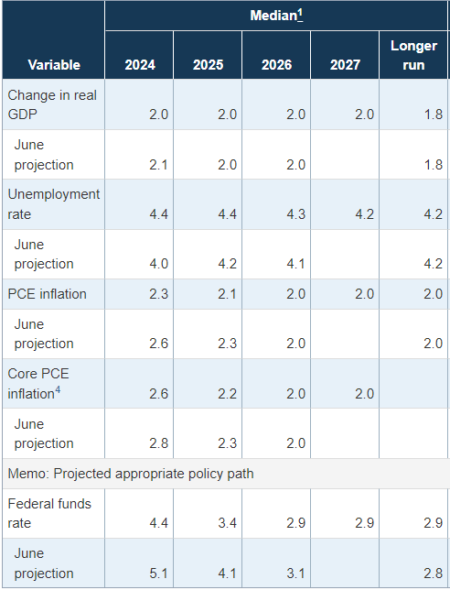
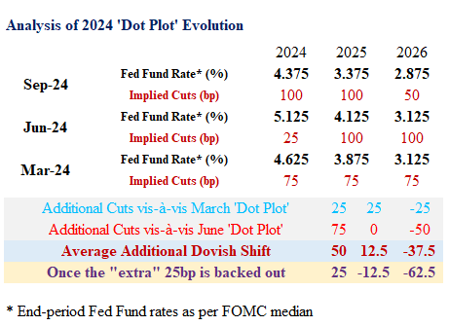
September FOMC: The First Step: Quantitative (Dot Plot) and Qualitative (Rhetoric) Easing Signals
Projections
GAP
Rhetoric
Notes:
And since we are talking about the entire policy trajectory, let me show another table to make my point even clearer on the front loading of rate cuts.
The latest Dot Plot implies that there is a total of 100bps of cuts this year, which is 50bp left after the 50bp cut last week.
This is 75bps more than the June Dot Plot but only 25bps more cuts than the March one.
For 2025, the Sept Dot plot shows 100bps of cuts and essentially this is the same as june 2024’s dot plot. In 2026, the Fed in fact showed less cut, just 50bps to end up just 25bps lower in 2026.
In totality, 100+100+50=250, just 25bps more than the 25+100+100 but a lot of front loading.
We can understand the intent that the Fed wants to communicate that they do not expect a recession in 2025 and hence no need for deep rate cuts and no need for panic.
On that note, we take a look at the summary of economic projections, we see that the Fed lower their inflation projections with core PCE inflation lower from 2.8 to 2.6% in 2025 but only slight downward revision from 2.3 to 2.2 in 2025.
The unemployment rate though was shifted significantly rising from 4.0% to 4.4% in 2024 and 4.2% to 4.4% in 2025.
In the longer term, they expect the unemployment rate to return to 4.2%.
The unemployment rate now is 4.2% for August which is lower than the 4.3% in July. The Fed expects these numbers to go up in the months ahead but still come down in 2026.
At this point, one should have some skepticism around such optimism, first it is what we have often mentioned that unemployment has a self-reinforcing momentum, people are unemployed they spending less and businesses invest less and hire less. In my opinion, expecting unemployment to rise and stop leans is as wishful or even more wishful then expecting unemployment to simply stay at current levels.
The hope from the Fed is that these early front loaded cuts can help to improve economic activity after a period of lag say 6 months and then dampen the deterioration in labour market conditions in 2025.
Looking at these projections, we can try and better understand why the Fed says they are squarely focused on their dual mandate and also why they moved 50bps.

Slide 4
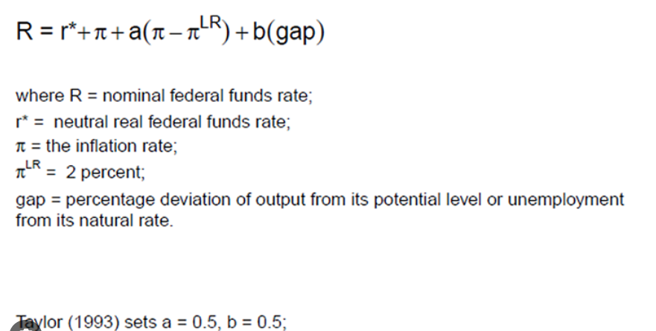
September FOMC: The First Step: Quantitative (Dot Plot) and Qualitative (Rhetoric) Easing Signals
1.75%-2.25%
1.8%
3.7%
←2019
Squarely focus on Dual Mandate
- Fed Chair Powell
∆r =
Weight*∆inflation + Weight*∆unemployment
Projections conditional on policy paths?
Projections
GAP
Rhetoric
Notes:
Indeed Fed Chair Powell started his 2am press conference by saying that the Fed is squarely Focus on the dual mandate.
Whenever the words dual mandate is mentioned, I cannot help but include the Taylor rule equation.
I hope I was sufficiently clear at the last outlook session in June when I showed this Taylor rule equation.
To re-iterate, I said that there was sufficient room to ease because we used the 2019 example, that inflation was at 1.8% and unemployment was 3.7 but the nominal policy rate was only 1.75-2.25%.
Clearly, an above 5% interest is too restrictive to tackle the current inflationary pressures. I am not saying that restriction is not needed to tackle inflation, but the point is that the stance was overly restrictive at 5.25-5.50% before the decision to cut 50bps last week.
If we do some simple math, we can see that the 0.4% point increase in unemployment and the 0.2% point decline in inflation roughly corresponds to the Fed’s decision to cut by 50bps especially if I give them equal weights.
Put simply, the decline in inflation provides room for 0.2%points of cuts while the 0.4% point increase in unemployment rate calls for a 0.4% point reduction in policy rate.
My thought experiment here for today is one which I think is useful down the road.
The first thought is to ponder if the economic forecast such as the unemployment rate conditional on the forecasted policy rates and is the anchor the pace of cuts or endpoint. Should the unemployment rate increase to say 4.5% by early 2025, what would the response of the Fed be?
If the Fed thinks that they need to cut to 3.4% by end 2024 to just maintain 4.4%, in the event, that the unemployment rate exceed that mark then, front loading their 4 cuts in 2025 to the first half or even first Qtr of 2025 is not that unforeseeable.
The first order of the day is to front load, and should the unemployment remain stubborn, the next course of action would be to deepen the cuts.

Slide 5

September FOMC: The First Step: Quantitative (Dot Plot) and Qualitative (Rhetoric) Easing Signals
Fed “do(es) not seek or welcome further cooling in labor market conditions”
- Fed Chair Powell at Jackson Hole
Broad Support for today’s decision.
- Fed Chair Powell
No one should look at the 50bps cut and think that this is the new pace.
- Fed Chair Powell
Notable step down in payroll gains.
- Fed Chair Powell
Dot plot projections are not policy plans Fed will move as fast or as slow as needed.
- Fed Chair Powell
We don’t think we are behind the curve
- Fed Chair Powell
Projections
GAP
Rhetoric
Notes:
These options to front load is certainly on the cards especially if we look at Fed chair Powell’s Rhetoric,
before I start on his words at the presss conference, it is important to recap that before the Sept Fomc meeting at the Jackson Hole Policy Symposium, Fed Chair powell said that he did not seek or welcome any further cooling in labour market conditions. This set the stage for a 50bps cut.
Fed Chair Powell started the press conference with what I showed earlier, saying that the Fed is squarely focus on its dual mandate of inflation and unemployment.
We do acknowledge that he said the 50 is not the new 25 which was why markets were not very buoyant and USD still held up. That said, he remains very open on his options, bringing in the words data dependence and saying that Dot Plot Projections are not policy plan and the Fed will move as fast or as slow as needed.
Furthermore, he has tried to sound upbeat by saying that they are not behind the curve. On this point, we retain some healthy skepticism, afterall, he did say that he would have cut earlier in July should he knew the july NFP number that showed a notable step down in payroll gains. As such, it appears that they might have caught up by doing a 50bps cut.
Accordingly, it remains to be seen if their assessment will still stand should labour market conditions worsen further.

Slide 6
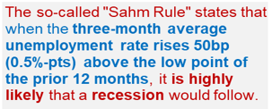
US Jobs: SAHM rule Panic?
US recession fears triggered suggests fragility of “Goldilocks” assumptions.
Claudia Rae Sahm
Notes:
On that note, it would be remiss of me not to talk about the sahm rule.
That conversation is now at it’s turning point and this was since last month’s labour market report in the US which saw a sharp jump in unemployment rate.
Last month on the Second of August we saw a sharp spike in US unemployment rate to 4.3% and triggered the SAHM rule.
The Sahm rule finds that if the 3 month average unemployment rate rises 50bps above the low point of the prior 12 months, it is likely that a recession will follow.
We acknowledge that the SHAM rule is merely a statistical occurrence or phenomena in Fed Chair Powell’s words. This is an instance where we say there is strong correlation though causality is not established.
Some people in the market argues that 50bps increase in unemployment rate is not much considering how low it was and say that those who point out recession risks are fear mongering.
What we want to point out is that our risk based driven approach to look at potential slowdown in growth is different from fearmongering.
Historically, deteriorating labor markets generate a self-reinforcing feedback loop. When jobs are harder to find, households trim spending, the economy weakens and businesses reduce investment, which leads to layoffs and further spending cuts.
This is why unemployment, having breached the 0.5-percentage-point threshold, has always increased a lot more — the smallest rise was nearly 2 percentage points, trough to peak.
That night of 2nd August, unemployment rate jumped, UST yields nose dived 20bps and US equities plummeted as recession fears were rampant. That episode underscores the fragility of goldilocks assumptions.
After that, Fed officials calm markets down by saying that the increase in unemployment rate is due to increase in labour supply and it is good problem because if more people are looking for work, the increase in labour supply will cool wage pressures and inflation.
What we want to say here is that the soft landing assumption by markets is really still an assumption, if the increase in unemployment was really such a good problem, why would Fed Chair Powell sound such a strong note at Jackson that “ he does not welcome any further cooling in labour market conditions”.
As such, the situation now depends on the Fed’s ability to navigate rate cuts in a manner that is able minimally maintain current growth conditions.
Let us take a further look at labour market conditions in the US. Afterall, in Claudia Sahm own words as the person who has a rule attached to her name — don’t just rely on one tool.

Slide 7
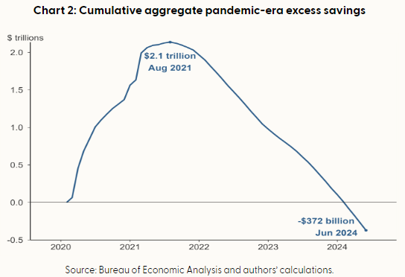

US Jobs: SAHM rule Panic?
Downward revisions to March 23 to 24: -818k
Downward revisions to prior 2 months: -86k
Notes:
Aside from the unemployment rate increase, we also see from the non-farm payrolls report that hiring has weaken significantly. At the last webinar in June, my figure here for the 3mma was 242k of workers being hired, at this point in time, the 3mm as of august is 116k. The latest non-farm payrolls at 142k released last Friday was below expectations of 165k.
While 142k is indeed still decent number but it is still one which is below pre-pandemic trends. Furthermore, it is not that there are not layoffs in the US, it is that the sector that are hiring outweigh the sectors which are retrenching workers. Manufacturing sector laid off works 4 out of 8 months in 2024 and that is consistent with the ISM manufacturing which shows that activity in manufacturing remains in contractionary territory. The longer the manufacturing sector remains in contractionary territory, the larger the risks that firms can longer hold onto their workers going forward.
Even as I talk about going forward let us go backward to 2nd august, even the dire number of 114 k last month was reduced to 89k.
Furthermore, the BLS in the US also revised downwards the total hiring from march 2023 to march 2024 by 818k because of updated data.
Data revisions are a very important part of policy making because it changes the entire picture of the economy of how they which is the Fed actually thought it was.
The data revisions induced dovish policy expectations and the reason that these historical revisions are important is that in 2021, the Fed was slow to hike rates because the labour market prints was low but it ended up that in early 2022 they saw huge upward revisions to data that caught them wrong footed.
This episode of being wrong was highlight in a recent speech by Fed Governor Michelle Bowman.
If the Fed understand the reasons of being slow to hike, these lessons would then also inform them about being slow to cut.
These type of historical experiences are what we call the subjective part of decision making on the next slide I will talk about the objective part of policy.
But before that, I will take the chance to explain the implications of a softer labour market. First, given that pandemic era savings have been eroded and as such households are continuously digging into pre-pandemic savings, my latest updated estimate which is simply extracted from the san Francisco fed, stands at -$372billion for June which is much steeped that the -$170billion we saw in august for those who were with me at the previous session three months ago.
This eroded savings imply that income from labour which is wages is increasingly important but if employment slows and wage growth slows as job openings and quit rate decline, then the purchasing power of the US consumer can slow quite significantly.
Quit rates are a very important indicator of wage growth.
Afterall, when people quit a job and join a new one, they often get a bump up in pay. With a lower quit rate, there is less churn in the labour market which implies less pressure on wage growth. As such, we do think that underlying price pressures have room to soften as wage growth turns a little bit milder.
With this backdrop of growth and inflation, we naturally turn to policy implications and expectations for the September FOMC which is happening just next week.
at this point, I have also included our risk based forecast of the Fed fund rate. We do think that there is room for 2 cuts in 2024 and further normalisation in 2025. My first caveat is that we are not calling for hard landing or recession as a base case. What we are saying is that there is potential for softening and there is a possibility of normalisation. Some time ago, I used to work with economic models, a lot of policy related numbers and get a lot of questions and today I will pose one of them today, imagine in 2019 when Fed fund rate was around 2% and inflation was 2.3%, if inflation increase to 3.4%, and you are Fed chair Yellen at that time, what do you think the Fed policy rate should be? Should it be the above 5.0% rate ? This question helps us get an objective view of interest rates, but we certainly acknowledge that decisions in life are subjective and based on past experiences, the Fed has fears of inflation resurgence and the policy rate has a different starting point is also anchored based on how much they have hike because of the 8% inflation in 2022. Nonetheless, the structural view is that there is room to normalise. (click)

Slide 8
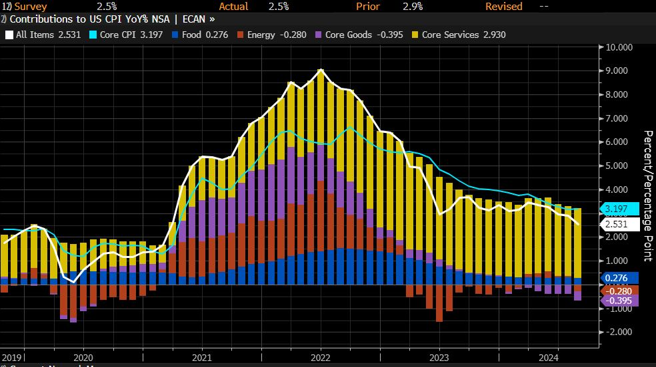
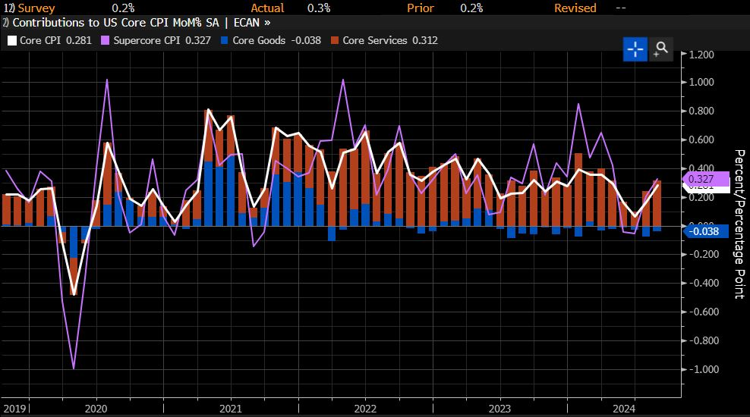
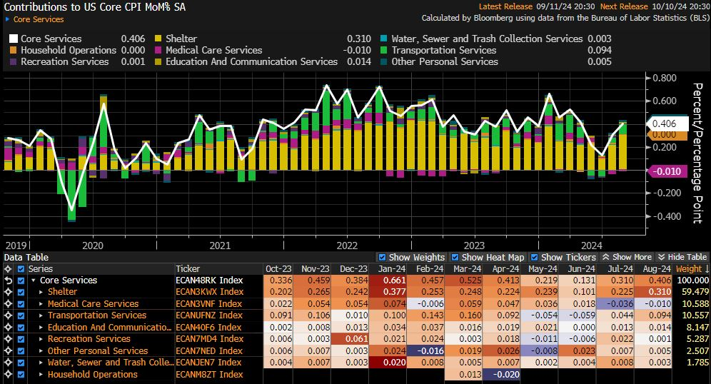
US CPI: Further Progress: Sufficient or Not??
Notes:
- I willjust take a few mins US CPI print. Even as the CPI even is not the main topic right now, it is still important as a peripheral factor to determine if member sof the FOMC want to go for another 50bps cut this year or it may still be important in late 2025 if we see a resurgence of inflation.
Last night, headline inflation in the US for August came in at 2.5% yoy which was in line with expectations and much lower than the 2.9% YoY in July.
What markets saw and focused on instead was that core inflation momentum which means the MoM% change was higher which is my top right chart.
Core inflation on a MoM basis rose to 0.3% MoM which is higher than expected and as such on a YoY basis core inflation remain sticky at 3.2%.
And why is that so? This was driven by housing costs. The factors behind the core cpi mom increase is broken down in my bottom left chart.
Clearly, we can see that core services contributed 0.4% point out of 0.3% points which also means that actually core goods prices fell. This is entirely services driven and rent driven.
Is housing/rental cost a concern to the Fed, the answer is yes but is it a bigger concern than the labour market right now, the answer is no.
How did markets adjust for this? Markets lowered the odds of a 50bps cut by the Fed at the meeting next week but remain very firm for a 25bps cut.
Aside from yesterday’s night US CPI report, the other notable price that has been falling is that of brent crude’s which has touched US$70/barrel because of global growth woes.
A quick analysis tells us that at 70-75 per barrel oil will remain a dis-inflationary force for headline inflation. In turn, Oil does not impair the Fed’s desire to ease.
On balance, our take is that this CPI print is not an impediment on the Fed’s current easing cycle especially at the initial stage of easing.

Slide 9
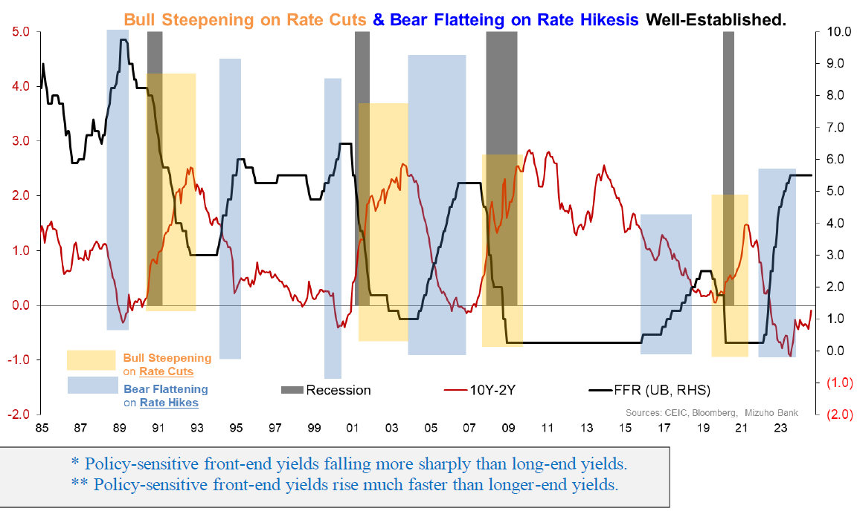
UST Yields: The Usual Bull Steepening
Notes:
As for the market impact of Fed easing, we will begin with UST yields,
the low-hanging fruit for higher long-end yields is simply a reversion (from rate hike “inversion”) to an upward sloping curve, coinciding with policy inflection to a rate cut cycle.
We can reasonably assume “bull steepening*” resulting from sharp Fed pivot to rate cuts. this reverses out the earlier “bear flattening**” from the preceding rate hike cycle,
which had ultimately “inverted” the yield curve. Put simply, the bull steepening, implies that as investors pile into USTs, the demand will be strong in the front end due to the rate cut.

Slide 10
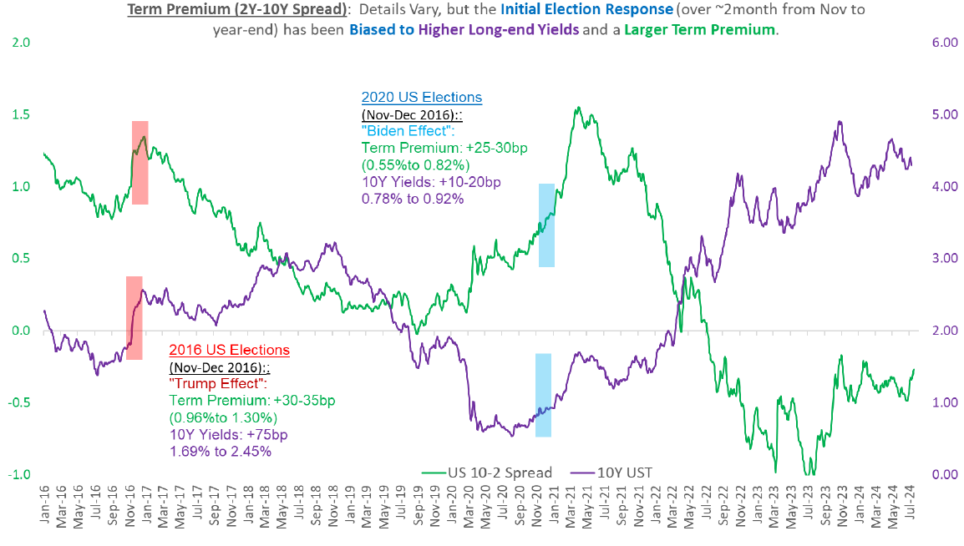
UST Yields: US Elections
Notes:
In addition, UST yield curve steepening as a by-product of US elections is arguably a factor to consider, being the lived, relatable recent experience. Not just of “Trump 1.0” in 2016 as well as the Biden win in 2020.
expectations tied to US elections are not just understandable given extrapolation of fiscal/geo-political/inflation risks

Slide 11
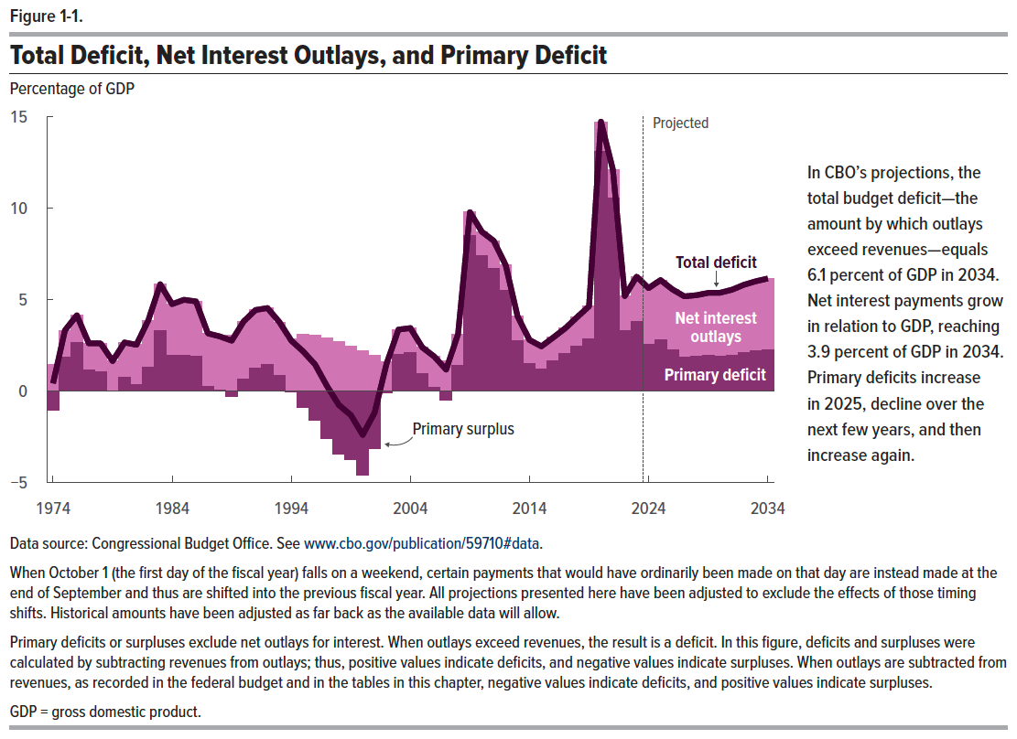
UST Yields: Why Our Fiscal & Consequent Yield Curve Views are Agnostic to Politics
Notes:
Not only is it difficult, but arguably misguided, to holistically pin down candidate-dependent fiscal policies in a vacuum.
But mostly, because our base case, limited view is that neither the Democrats nor the Republicans have the fiscal high ground.
Instead, it is merely the nature of their “fiscal sins” that differ (spending vs. tax cuts).
Hence, defaulting largely rely on the CBO’s estimates for fiscal deficit is a good start.
And the projections for fiscal deficit to be in the ballpark of 5.5-6..0% for the next decade (2025 through 2035) are reasonable, albeit worrying.
Crucially, net interest payments (NIP) starting to become the dominant source of fiscal burden (see the CBO Figure 1.1 below), necessarily limits fiscal options and imposes harsher constraints.
Notably, NIP is set to make-up 60-65% of total deficit in from 2025-2034 compared to just over a quarter of total fiscal deficit from 2010 to 2014 when fiscal deficit averaged a comparable 6.1%).
This means two things, that underpin a worrying fiscal trajectory with increasing incentive to term out debt.
First, incremental, policy-driven variations in primary deficits (ex-NIP) will have diminished sway on total fiscal deficit and the attendant bond issuances required.
Second, the incentive to term out debt issuances grows as interest rate burden crowds out current budget spending requirements.

Slide 12
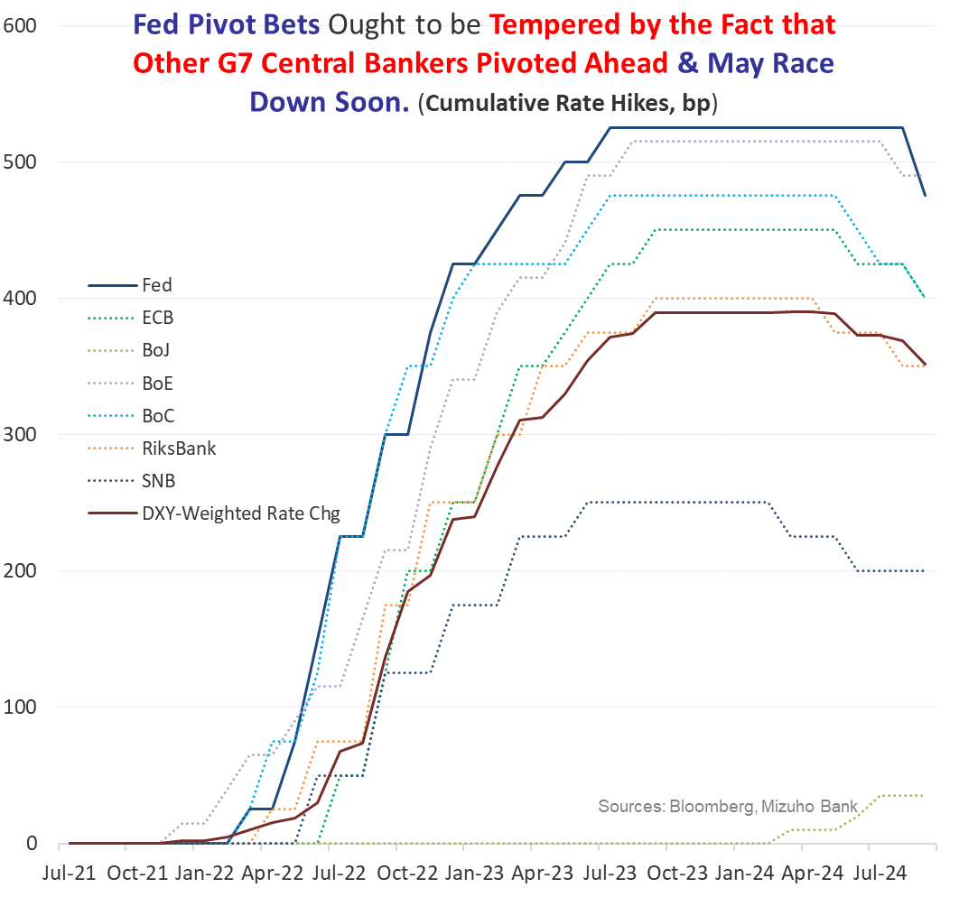
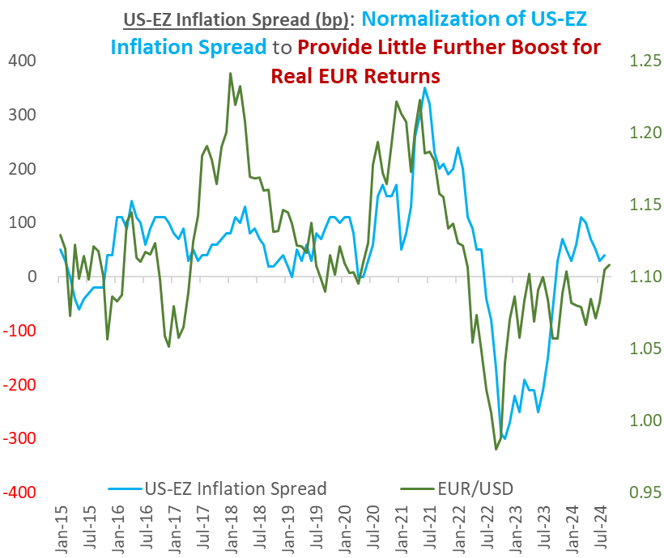
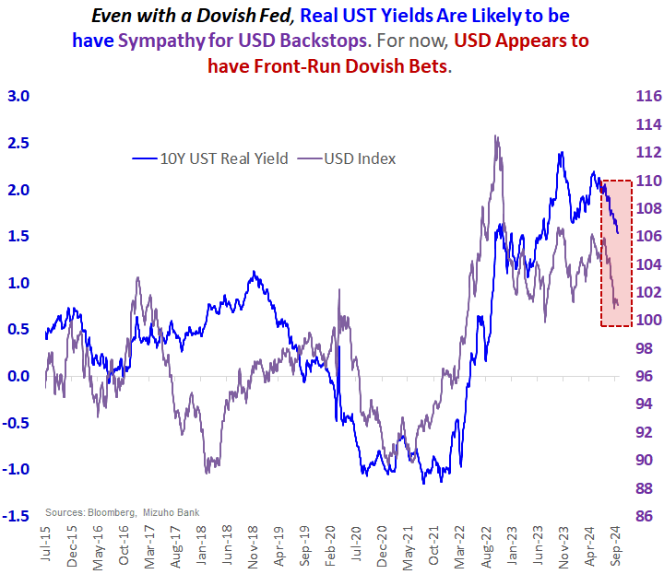
RISK - Policy: USD Bears are Exhausting One-Sided/Dimensional, Dialled-up Fed (Cut) Bets

Slide 13
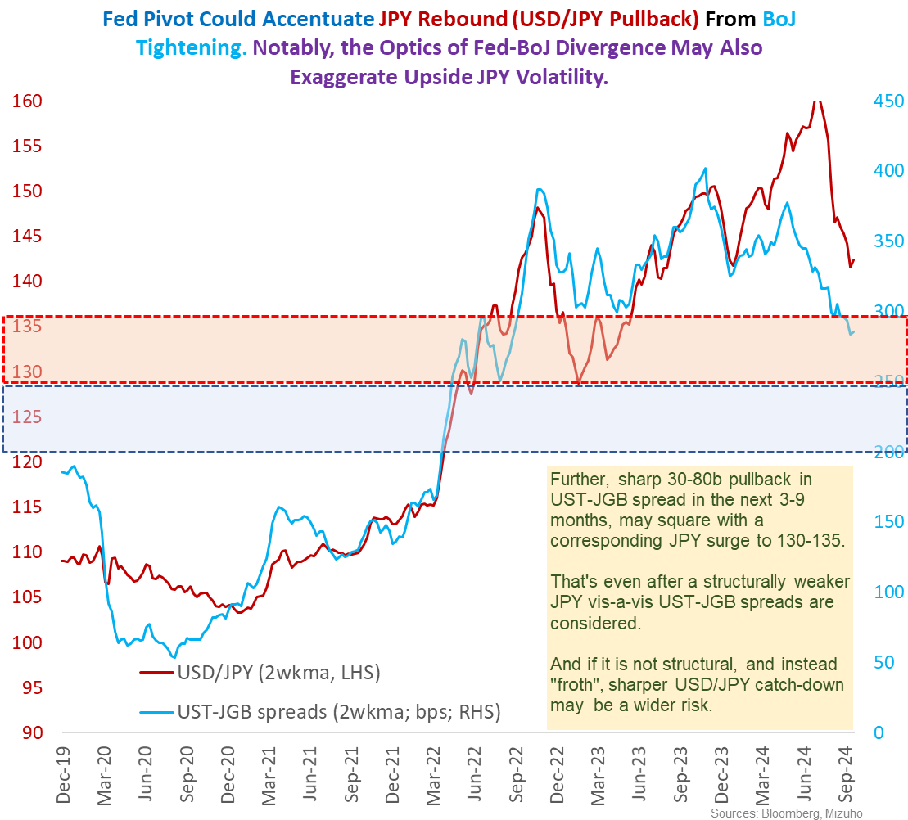
RISK: Fed-BoJ & JPY Correlations: Fed’s Greater Sway on JPY
BoJ: Suspended Tightening
To be sure, the BoJ was steadfast about higher terminal rates and the commitment to get there. So, on the surface there are no signs of bailing on further hikes. But the BoJ adeptly suspended its foreseeable tightening plans.
Not only by alluding to assessment of its two hikes so far, suggesting an interim pause. But critically by inserting the pre-condition of stable markets for further hikes.
This is unmistakable central bank speak for sitting on its hands for now.
Specifically, to avert any inadvertent outbursts of upside JPY volatility.
Which is to the detriment of the economy from a double-whammy of adverse income and wealth effects.
To that end, BoJ recanting on imported inflation risks from the JPY is the most distinctive code for diminished urgency to tighten and that is on account of JPY.
In fact, it arguably flips the nature of JPY risks to policy.
From a tightening bias to dampen JPY depreciation pressures to a case for delaying hikes on sharp JPY appreciation risks.
But all said, the BoJ is simply ensuring that it avoids no unforced errors on its part.

Slide 14
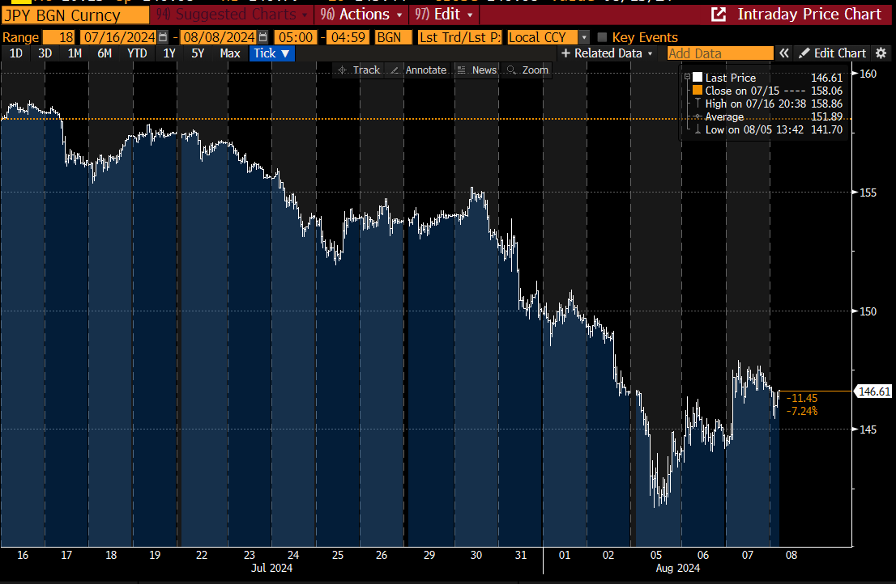
BoJ: THAT JPY Squeeze – Time-line & Thoughts
BoJ Hikes
Hawkish Talk
US Jobs Report Recession Fears
BoJ Dovish
Augmentation

Slide 15
Disclaimer
Important Information
This publication has been prepared by Mizuho Bank, Ltd. (“Mizuho”) and represents the views of the author. It has not been prepared by an independent research department and it has not been prepared in accordance with legal requirements in any country or jurisdiction designed to promote the independence of investment research and is not subject to any prohibition on dealing ahead of the dissemination of investment research.
Disclaimer
Unless otherwise stated, all views or opinions herein are solely those of the author(s) as of the date of this publication and are not to be relied upon as authoritative or taken in substitution for the exercise of judgement by any recipient, and are subject to change without notice.
This publication has been prepared by Mizuho solely from publicly available information. Information contained herein and the data underlying it have been obtained from, or based upon, sources believed by us to be reliable, but no assurance can be given that the information, data or any computations based thereon are accurate or complete. This publication provides general background information only. It is information in summary form and does not purport to be complete. This publication has been prepared for information purposes only and is not intended by Mizuho or its affiliates to constitute investment, legal, accounting, tax or other advice of any kind and all recipients of this publication are advised to contact independent advisors in order to evaluate the publication, including, without limitation, the suitability of any security, commodity, futures contract or instrument or related derivative (hereinafter, a “financial instrument”), product or strategy herein described. This publication is not intended to be relied upon as advice to investors or potential investors and does not take into account investment objectives, financial situation or needs of any particular investor. It is not intended for persons who are Retail Clients within the meaning of the United Kingdom’s Financial Conduct Authority rules nor for persons who are restricted in accordance with US, Japanese, Singapore or any other applicable securities laws.
This publication has been prepared for information purposes only and is not intended by Mizuho to market any financial instrument, product or service or serve as a recommendation to take or refrain from taking any particular course of action or participate in any trading or other strategy. This publication is not an offer to buy or sell or a solicitation of any offer to buy or sell any security or any of the assets, businesses or undertakings described herein, or any other financial instrument, nor is it an offer to participate in any trading or other strategy, nor a disclosure document under applicable laws, rules, regulations or guidelines. Nothing contained herein is in any way intended by Mizuho or its affiliates to offer, solicit and/or market any financial instrument, product or service, or to act as any inducement to enter into any contract or commitment whatsoever. Neither the author, Mizuho nor any affiliate accepts any liability whatsoever with respect to the use of this publication or its contents or for any errors or omissions herein.
Mizuho and its affiliates, connected companies, employees or clients may take the other side of any order by you, enter into transactions contrary to any recommendations contained herein or have positions or make markets or act as principal or agent in transactions in any securities mentioned herein or derivative transactions relating thereto or perform or seek financial or advisory services for the issuers of those securities or financial instruments.
All of the information contained in this publication is subject to further modification without prior notice and any and all opinions, forecasts, projections or forward-looking statements contained herein shall not be relied upon as facts nor relied upon as any indication of future results. Opinions stated in this publication are subject to change without notice. Future results may materially vary from such opinions, forecasts, projections or forward-looking statements. The information contained in this publication may not be current due to, among other things, changes in the financial markets or economic environment. Mizuho has no obligation to update any information contained in this publication. Past performance is not indicative of future performance.
This is a strictly privileged and confidential publication. This publication contains information addressed only to a specific individual and is not intended for distribution to, or use by, any person other than the named addressee or any person or entity in any jurisdiction or country where such distribution or use would be contrary to law or regulation. Save with Mizuho’s prior written consent, you may not disclose, divulge, reproduce or furnish any information contained herein to any other party. Please notify the sender immediately if you have mistakenly received this publication.
Singapore: Mizuho is licensed as a bank under the Banking Act (Chapter 19) of Singapore, and is regulated by the Monetary Authority of Singapore.
Japan: Mizuho is authorised and regulated by the Financial Services Agency of Japan.
United Kingdom / European Economic Area: In the UK, Mizuho is authorised by the Prudential Regulation Authority and subject to regulation by the Financial Conduct Authority and limited regulation by the Prudential Regulation Authority. Details about the extent of MHBK's regulation by the Prudential Regulation Authority are available upon request. This publication may also be distributed by Mizuho International plc (“MHI”). MHI is authorised by the Prudential Regulation Authority and regulated by the Financial Conduct Authority and the Prudential Regulation Authority.
United States: This publication is not a “research report” as defined in Commodity Futures Trading Commission (“CFTC”) Regulations 1.71 and 23.605. The content of publications distributed by Mizuho Securities USA Inc. (“MSUSA”) is the responsibility of MSUSA. The content of publications distributed directly to US customers by Mizuho is the responsibility of Mizuho. US investors must effect any order for a security that is the subject of this report through MSUSA.
© 2014 Mizuho Bank Ltd.

