Slide 1

Biting the Bullet on Trump 2.0
The (lead) bullet dodged Trump, but the Democrats have not dodged the (political) bullet. So, the World must bite the bullet on Trump 2.0 risks and elevated uncertainties that accompany. The noisy reduction of push-and-pull Trump 2.0 FX factors ostensibly reduced into compelling USD resilience (if not strength). More because as many key currencies are compromised. The UST yield curve steepener captures greater Trump 2.0 uncertainty and structural higher longer-term inflation but softer rates from more immediate global policy easing may leave broader yield downside intact (initially). CNH and other AXJ remain compromised by trade/geo-political risks from Trump 2.0; deterring front-running of Fed easing on softer US inflation and consumer confidence. But despite higher risk premium implied elsewhere, US equities may be upbeat given Trump’s obsession with S&P500.
Photo Credits: Shutterstock, FT
July 2024
Notes:
With a four month runway to the US elections, we will now revisit the macro impact of Trump 2.0, and also make sense of the recent currency movements.
First of all, we see that Trump 2.0 has compromised many key currencies such as the ren minbi and other Asian ex japan currencies and that in turns makes the USD resilient.
Second, the uncertainty brought about by Trump 2.0 is represented by the steepening yield curve as markets pile into shorter end US Treasuries and sell off the longer end as they worry about longer term inflation and us fiscal issues.
Lastly, we end off with a reminder that the Fed trades can easily dilute the Trump trades. Yet, our warning is that even as the Fed pivots, the EM-Asia FX may not be able to revert back to their same pre-Fed hike levels and the resulting implication is that EM-Asia central banks remain unlikely to front run the Fed.

Slide 2
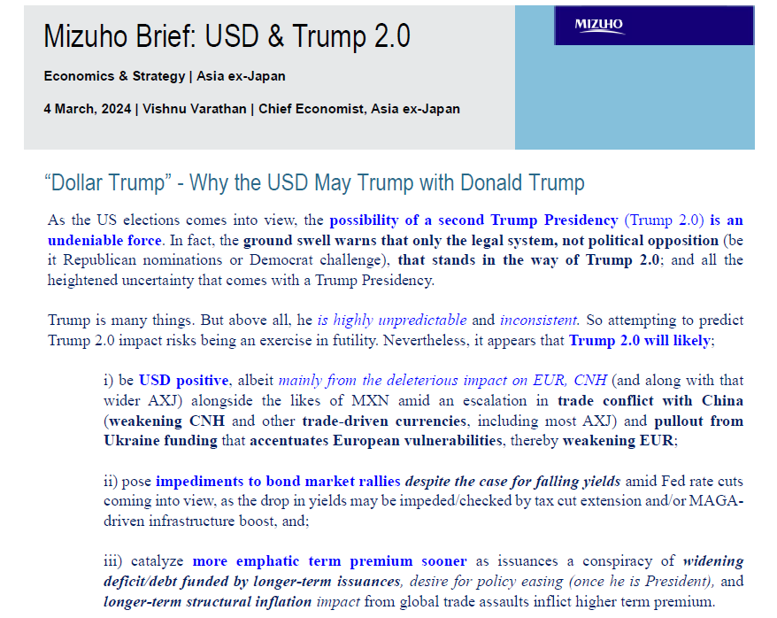
Re-visiting Earlier Assessments of Trump 2.0
Notes:
Before we begin, we revisit what we put out in March this year, our characterization of Trump is that he is highly unpredictable and inconsistent. Applying economic logic to his words is near impossible.
In his Bloomberg interview last week, he called the weak Yen and weak RMB a big currency problem because they wanted it weak. They referring to the respective governments. Then he says if you weaken it anymore, I am going to put tariffs on you.
Hold on a minute, all of us who are logical, will know that if put tariffs, you weaken the country’s trade and send their currency even weaker.
This is just one of Trump’s inconsistency.
Despite the inconsistency, we said that as a standalone factor, Trump is a USD positive and he is also an obstacle for bond markets to rally because of his tendency for tax cuts and infrastructure spending which drives up long term yields.
Consequently, the term premium is also likely to return.
So that was what we said back in March.

Slide 3
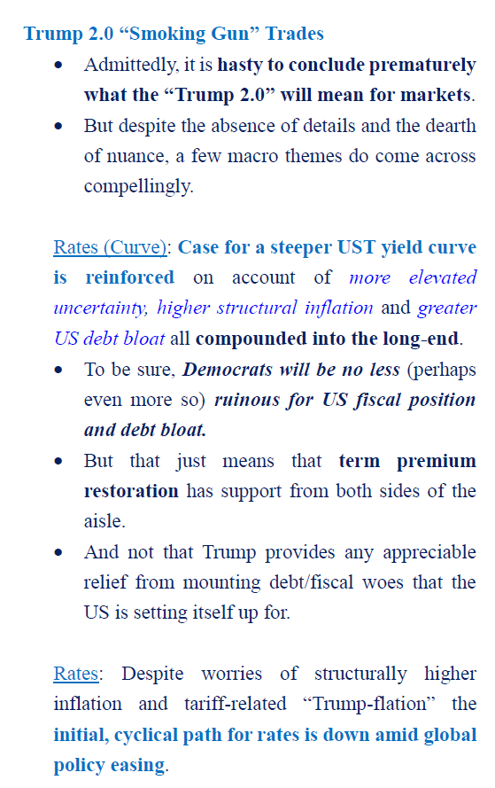
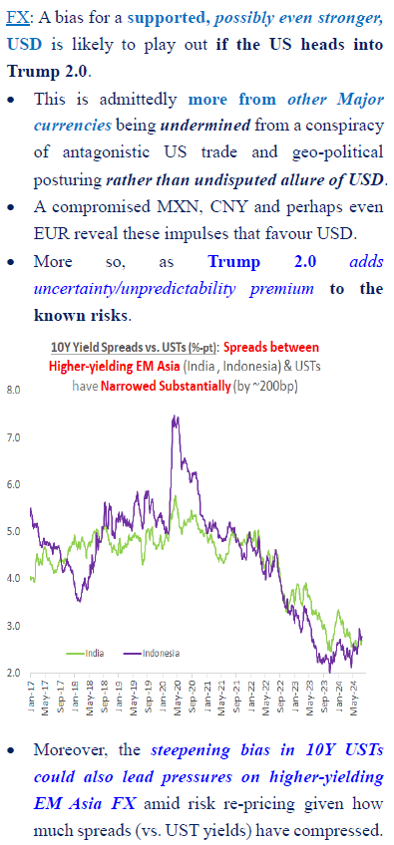
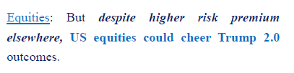
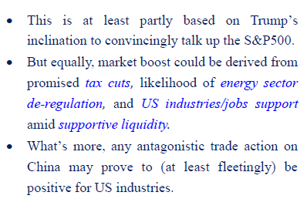
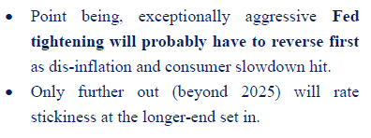
The Post-Shooting Trump 2.0 Assessment (15th July)
Notes:
Given that four months has passed, here is our post shooting Trump 2.0 assessment in terms of market outlook.
What is unchanged for rates is that the case for term premium support to return. This comes In the form of more debt compounded in the longer end and this is actually rather going to enjoy support from both republicans and democrats
That said, as we consider the global easing cycle, our thoughts for rates are that the aggressive cyclical Fed tightening will have to reverse first alongside dis-inflation and consumer slowdown.
Beyond 2025 is where the rates stickiness at the longer end will start to play out with structural fiscal concerns becoming the main driver.
In Terms of FX, Trump trades is likely to backstop the USD and furthermore, he adds the uncertainty premium to already known risks such as his tendencies on trade dispute. Last week, his sudden mention of Taiwan paying for their own defence also had a big hit on markets.
As for US equities, despite the higher risk, the tendency is still for US equities to cheer on trump 2.0, for one he has an inclination to talk up the S&P 500 and also real policy measures such as tax cuts and energy de-regulation could boost corporate profits.

Slide 4
US Elections: Bracing for Trump 2.0?
Weaker CNH, AXJ & MXN
Weaker EUR
Elevated Global Threats
Near-term USD Resilience
Trump 2.0
Trade (Tariffs)
Energy/Oil
Remove Restrictions
Impose Higher China/wider Tariffs!
Infrastructure [Fiscal]
Tax Cuts [Fiscal]
Ukraine [Conflict]
Gaza [Conflict]
Pull/Cut Aid
Uncertain Israel-Saudi Dynamics
Ramp-up Spending?
Extend Tax Cuts
Higher Inflation?
Tempers
Higher Yields
Higher Term Premium
Notes:
This schematic diagram is what we have presented before, it forms the holistic backdrop for considering the macro impact of Trump 2.0

Slide 5
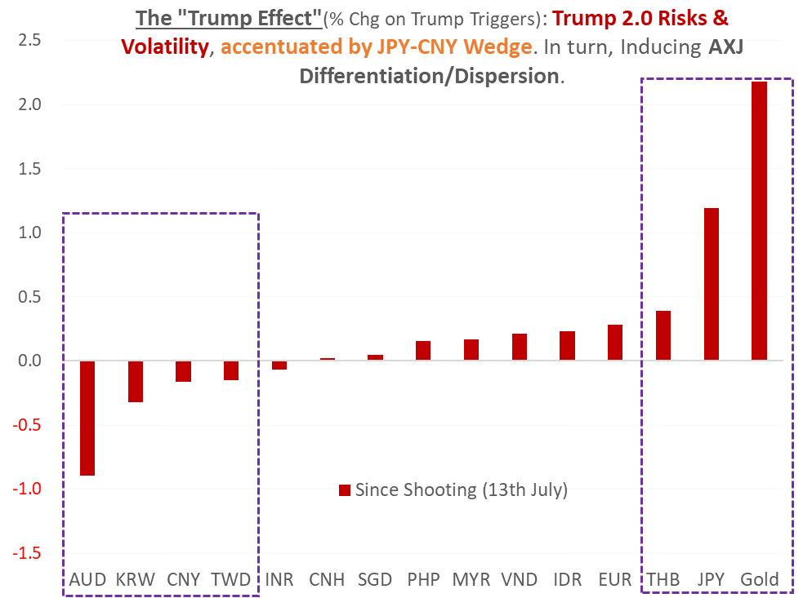

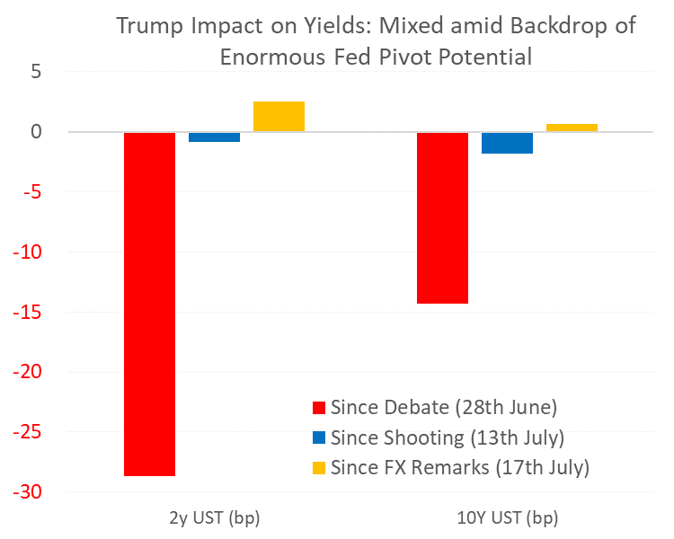
The Early Trump 2.0 Trades Not as Unequivocal?
As of 18 July
Notes:
While I have indeed talked about how Trump can be a net positive for the USD, we also recognized that early trump 2.0 trades have not been as unequivocal. We look at FX markets and then bond markets in this slide.
In FX, we saw some gains for some Asian currencies after trump alleged that the JPY and RMB was being competitively devalued.
The more interesting phenomena was that despite trump being equally scathing on both currencies, the Yen gained much more than the RMB. As for the underlying reasons, I will touch on them after two more slides.
So far, since the shooting, we saw a dispersion of outcomes for EM-Asia currencies which is partly dependent on their respectively correlation with the RMB or the JPY.
The THB being correlated to the JPY was able to enjoy some of the tailwinds from the JPY gains initially, but nonetheless, at this point today some of their gains have been reduced as their domestic issues on their digital wallet plan brings the focus back to their fiscal position.
On the other spectrum, the AUD and KRW followed the RMB weaker. The question that is likely to come up now is why is the AUD even weaker than the RMB. While part of the RMB stability is a construct of the PBoC’s actions, the other part of the reason behind AUD underperformance lies with the JPY appreciation. This refers to the risks of carry trades unwinding.
While the JPY appreciation may assist some currencies at the initial stage such as the THB, as it continues to appreciate, increasingly some currencies will begin to field the effects of unwinding carry trade.
The AUD is a well known candidate, with the stronger JPY, carry traders may be closing their positions and in turn sell down the AUD resulting in the AUD languishing at 66 cents right now.
As for bond markets, we see that so far the trump impact on yields is mixed amid the backdrop of enormous potential from Fed pivot.
Since the trump-biden debate, 2Y UST yields are around 30bps lower and 10Y yields are down 14bps and that simply underscores the backdrop of the enormous potential for Fed pivot bets.

Slide 6
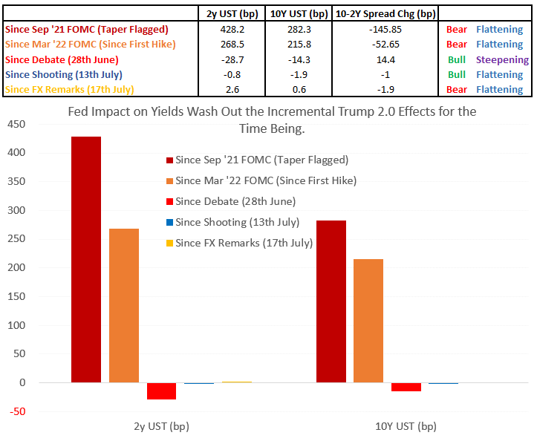
The Fed Can Dilute, if not, “Wash Out” Bond Market Impact
Notes:
Specifically, we see that the extent of how far UST yields have risen, more than 400bps increase for 2Y yields since tapering was flagged and more than 260 bps since the first hike.
This shows us the potential for these to be reversed. Even a 50% partial reversion of the increase in yields due to fed tightening since the first hike represents the potential for at least a 100bps decline in UST yields.
As such, it is not that Trump 2.0 has no impact on bond markets, the Trump 2.0 bets still represent an impediment to the decline in yields but it is unlikely to overcome the enormous potential of the Fed to ease.

Slide 7
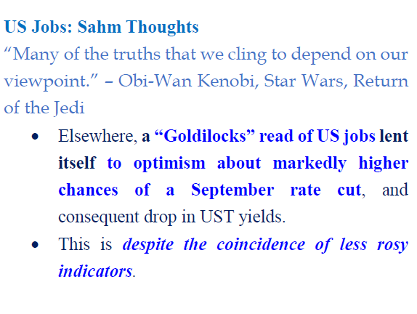
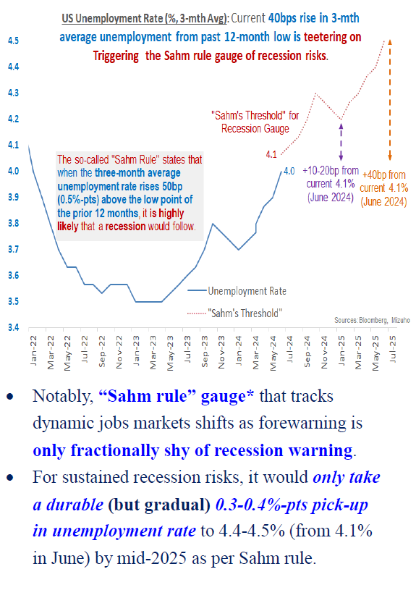
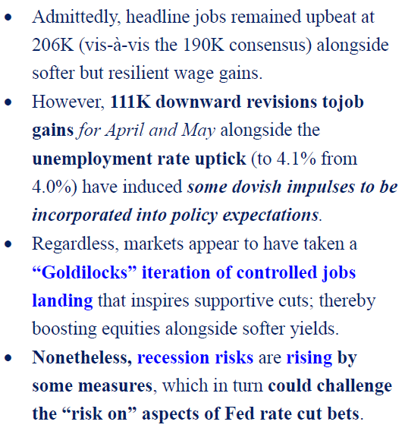
‘Sahm’ Thoughts on the Fed
Notes:
And since we talked about the potential to ease, here are our some of our thoughts on the Fed.
Rather than talking about inflation, we will touch on the labour market.
The fact that we are here talking about labour market in the US and not US inflation is telling of how the narrative for markets have changed.
In the US, recent non-farm payroll figures are not exactly bad, in June there was still 206k of job gains.
The issue was that there was 111k downward revisions for April and May.
This induced dovish policy expectations and the reason that these historical revisions are important is that in 2021, the Fed was slow to hike rates because the labour market prints was low but it ended up that in early 2022 they saw huge upward revisions to data that caught them wrong footed.
This episode of being wrong was highlight in a recent speech by Fed Governor Michelle Bowman.
If the Fed understand the reasons of being slow to hike, these lessons would then also inform them about being slow to cut.
Another informative indicator that we follow is the Sahm rule, which finds that if the 3 month average unemployment rate rises 50bps about the low point of the prior 12 months, it is likely that a recession will follow.
At this point in time, we are still around 10 bps away from this 50bps benchmark, though the risks are rising should the non farm payrolls weaken further.
Some people in the market argues that 50bps increase in unemployment rate is not much considering how low it was and say that those who point out recession are fear mongering.
What we want to point out is that our risk based driven approach is different from fearmongering.
In fact, this Sahm rule was also explicitly flagged out by ex president of the New York Fed, Bill Dudley, just last night, who was even more dovish and said that the Fed should cut rates next week.
Historically, deteriorating labor markets generate a self-reinforcing feedback loop. When jobs are harder to find, households trim spending, the economy weakens and businesses reduce investment, which leads to layoffs and further spending cuts. This is why unemployment, having breached the 0.5-percentage-point threshold, has always increased a lot more — the smallest rise was nearly 2 percentage points, trough to peak.

Slide 8
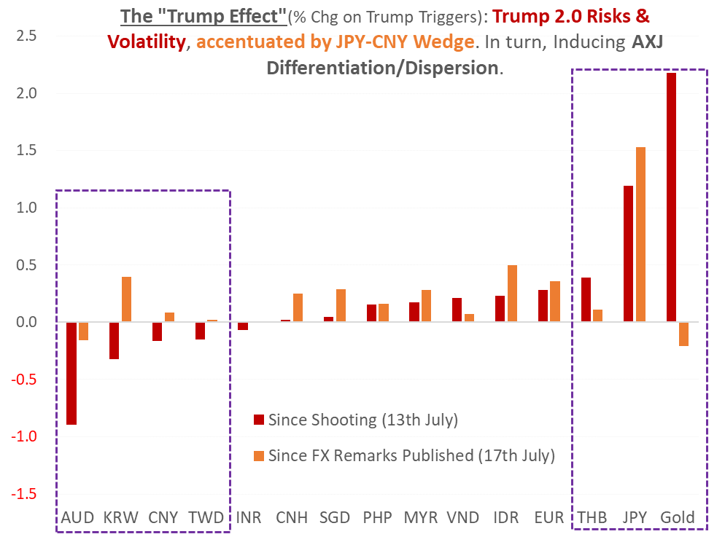
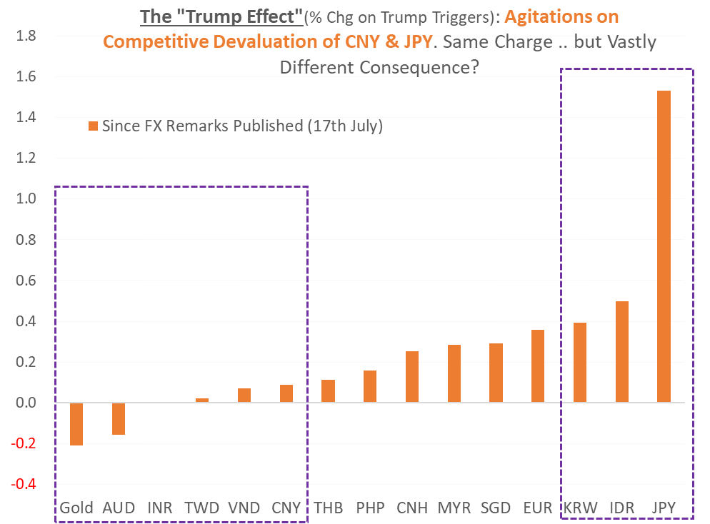
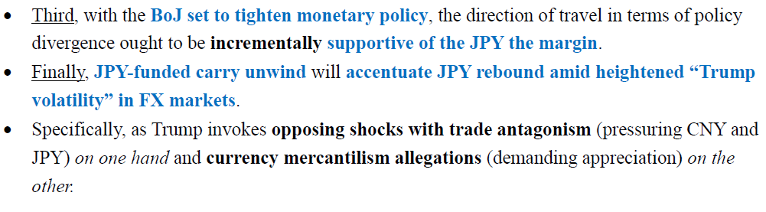
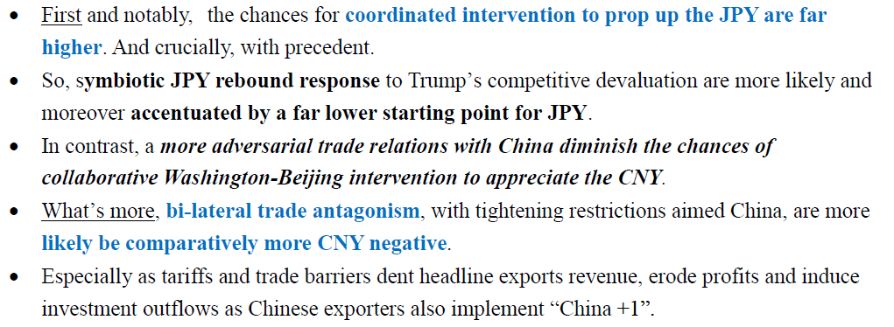
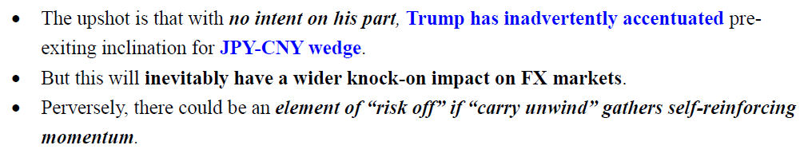
Trump’s Opposing FX Forces from Trade Antagonism & Devaluation Allegations
Notes:
Now as promised, I will explain the differing impact on JPY and RMB from Trump’s antagonizing remarks.
First, we see that chances for coordinated intervention with the US to prop up the JPY is much higher compared to the RMB given their adverse trade relations with China and that there is historical precedence of cooperation between the US and Japan to shore up the JPY.
The trade tariffs and also export restrictions aimed at China is also far more negative for the RMB.
Admittedly, we also have to acknowledge that JPY gains have a lower starting point given how much the JPY has weaken over the past 2 years.
And at this juncture, with the BoJ looking set to tighten monetary policy, even if the support to the JPY is marginal, it is at stark divergence with the PBOC who just eased by 10bps on Monday this week and also the Fed who is looking to ease soon.
Finally, the Trump’s misguided allegation on weaker currency giving trade advantages which in turns demands for JPY appreciation has the potential to set off the carry unwind which can have a self-reinforcing monetum to send the rest of EM-Asia FX weaker.
That in itself well also add further weakness for the RMB and accentuates what we highlight as the JPY-CNY wedge.
Furthermore, there is a propensity for risk off from multiples sources, for one, Fed cuts may come in the context of US economic slowdown , EM-Asia currencies may weaken more against the JPY as haven bets pile on.
In additional, a strengthening JPY in itself can also trigger risk off in asset markets such as a sell off in equities.
In short, long JPY against AXJ may have more sustained allure. Especially as relative JPY rebound on Trump’s mercantilism agitations conspire with BoJ tightening and potential for compounding “carry” squeeze even though there can be occasional pitstops for the carry unwind.

Slide 9
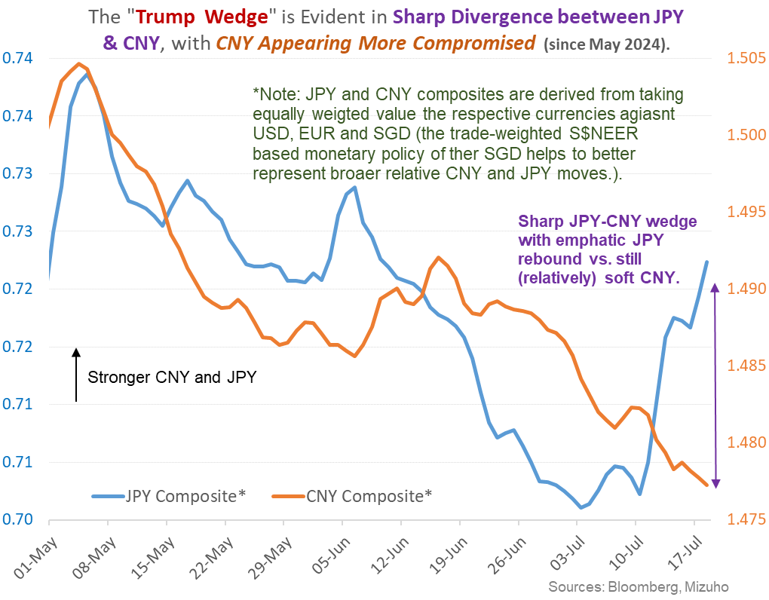
Resultant JPY-CNY Wedge
Chart from Bloomberg, San Francisco Fed,
Notes:
This is the JPY=CNY wedge as of 19 july and I am very sure that has widen even more given the jpy appreciation this week.

Slide 10
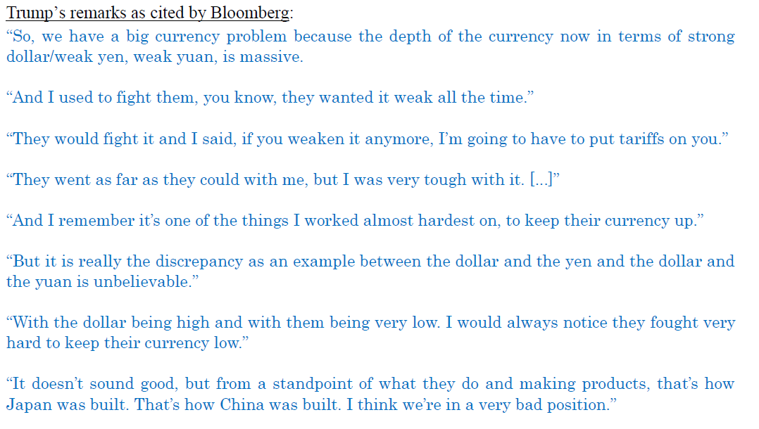
Trump’s FX Tantrum Tensions
Notes:
And the wedge was caused by Trump FX tantrum’s worsening the divergent underlying fundamentals which we mentioned just now.
Trump’s misplaced allegation is also evident here in which he says that they fought very hard to keep their currency low, I am sure the BoJ and MoF in japan does not agree on that considering how much FX reserves they spent to intervene to prevent excessive JPY depreciation.

Slide 11
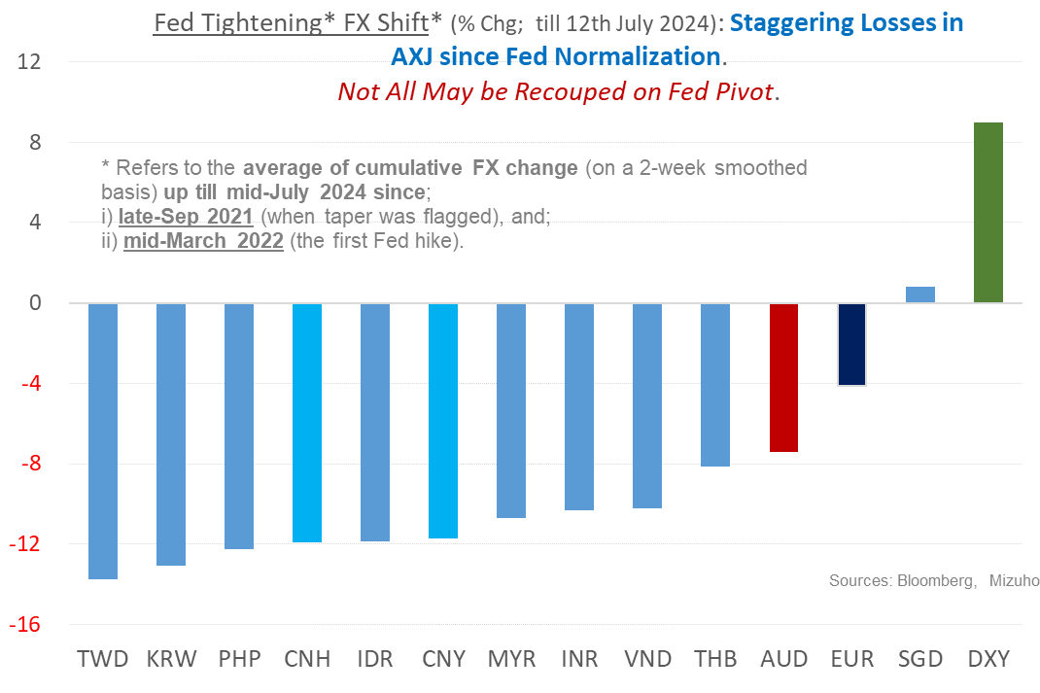
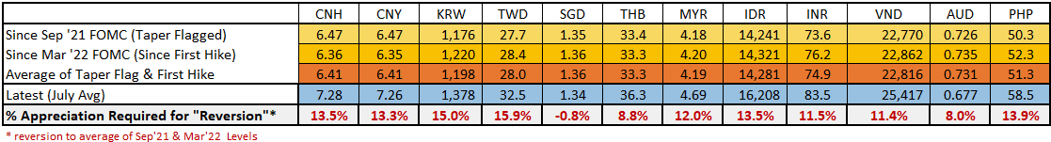
AXJ Reversion Challenged: Fed Pivot May Not Fully Restore Asia FX
Notes:
While Trump may not like to see weak Asian currencies and the received wisdom tells us that Fed pivot is often associated with a USD decline, we are now of the view that it may be very difficult for Fed easing to fully restore Asia FX back tot the same levels that was seen before the Fed hike.
Currencies such as the PHP has depreciated a staggering 13.9% since 2021. It is hard to envisage that the PESO would be able to gain 14% even by end 2025.
With the exception of SGD, which was boosted by an unprecedented magnitude of S$NEER appreciation (allowing it to keep pace with the USD), reversion to pre-Fed rate hike levels in the rest of AXJ would require substantial AXJ appreciation
There are both country specific and broad based factor underpinning the lack of reversion back to pre-Covid levels.

Slide 12
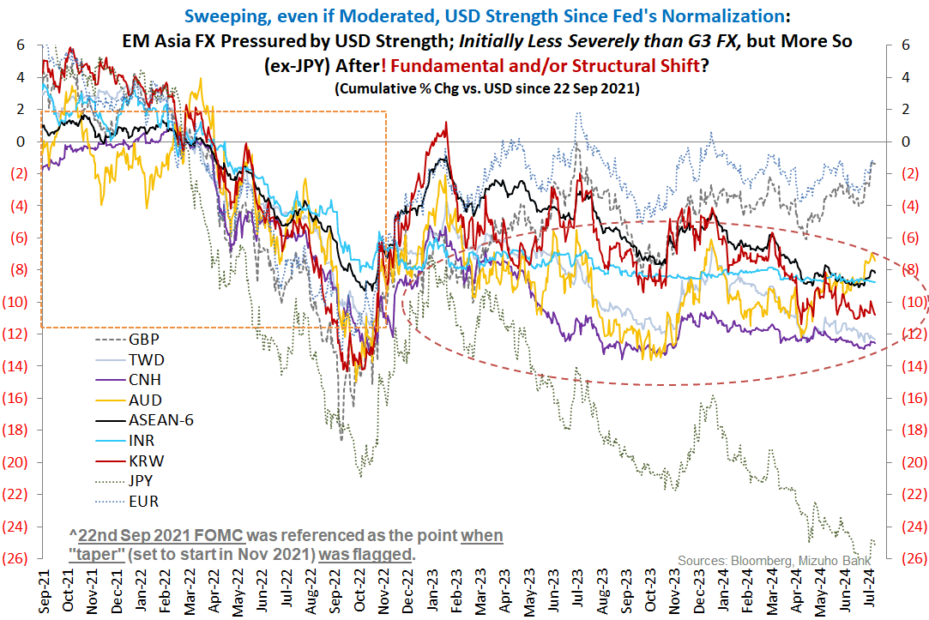
AXJ Reversion Challenged: Structural Elements May Dampen Asia FX More Durably
Notes:
- Some structural factors include the property sector and banking scandal related stresses for the Vietnamese Dong with NPL hitting 5%.
Political tensions hitting the THB regarding uncertainty of the Prime Minister position and also fiscal concerns such as the digital wallet.
Fiscal concerns in Indonesia from incoming President Prawbowo subianto who was reportedly looking at removing the fiscal deficit target and public debt ceiling hitting the Rupiah

Slide 13
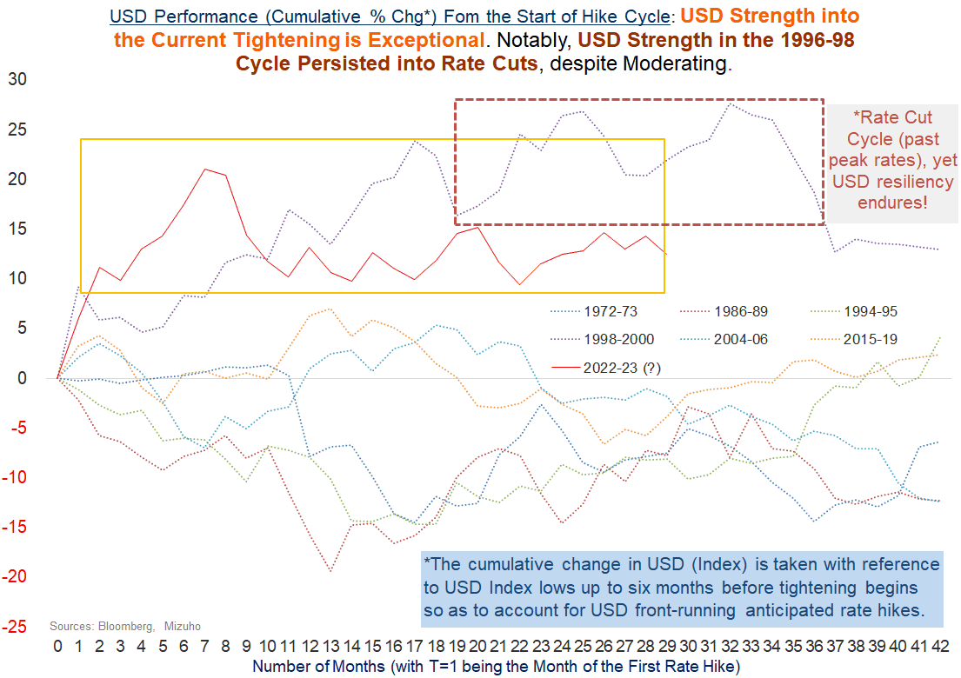
USD May Not be as Compliant
Chart from Bloomberg, San Francisco Fed,
Notes:
In terms of the broad factors, we see that the most anomalous finding is the persistent and defiant USD strength compared to previous cycles in which the USD softens ahead of Fed cuts.
In turn, this informs us to be aware not to attribute excessive USD weakening when Fed cuts actually take place.
Notably, we have one historical episode in which USD was resilient even when policy rates was cuts as indicate by the red coloured box.
Needless to say, that period was the Asian Financial Crisis which saw damaging Asian currency weakness in a painful period in which some of us may have lived through.

Slide 14
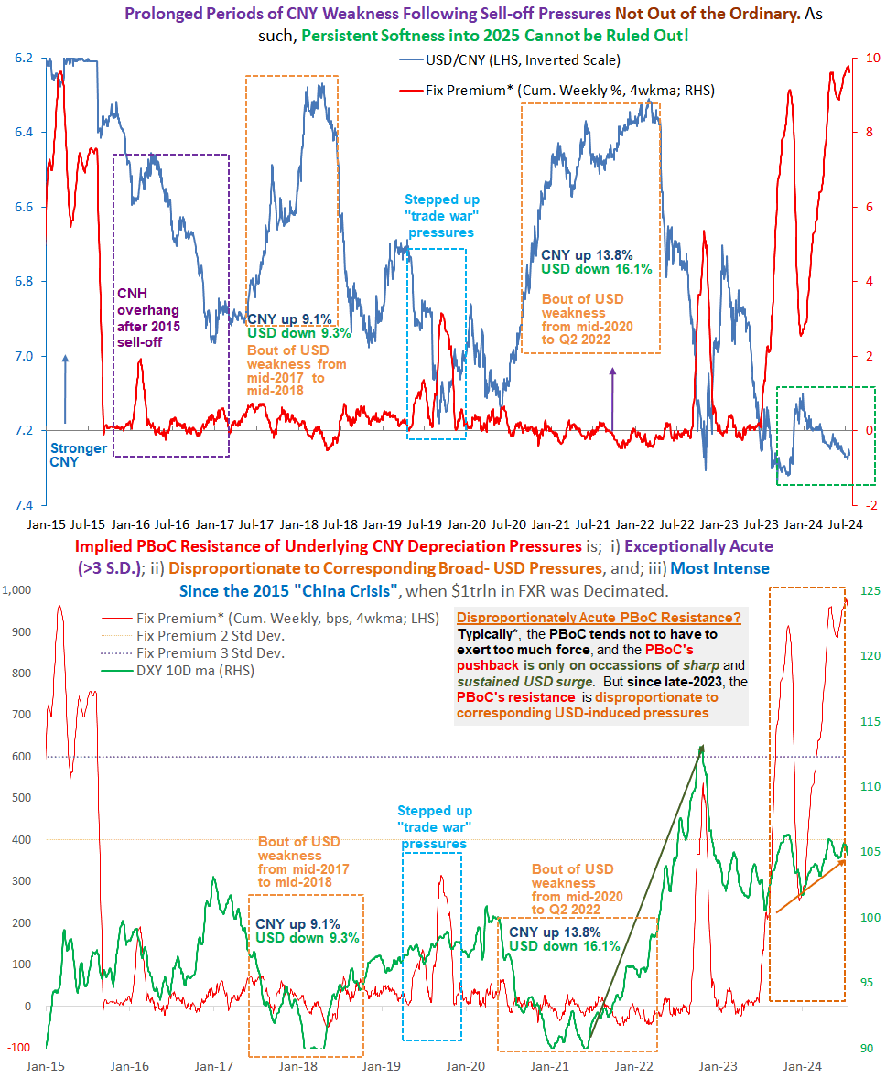
CNY is Far More Vulnerable Today, with Knock On Vulnerabilities
Notes:
On that note, we touch on China and the Renminbi’s vulnerabilities. On the top chart, we plot the fixing premium in red, the fixing premium is the PboC’s daily fixing compared to the previous night’s close.
The blue line is the USD/CNY.
The bottom chart also plots the fixing premium but in red colour and the dollar index in green.
First, as we have previously pointed out, to stablise the Chinese yuan, the fixing premium is at record highs as seen in the top chart.
The bottom chart tells us how high exactly is this fixing premium, the fixing premium is 3 standard deviations from its historical norm and is very disproportionate to the USD strength.
Specifically, the PBoC’s task now is to manage a control CNH depreciation which involves balancing between adverting a sell-off and avoiding excessive FX reserves depletion.
The point here is that we know that the PBoC’s fixing can keep the CNY stable but this cannot last forever.
In 2015, you can see on the top left corner the top chart, the PbOC devalued the CNY by 3% over the course of 2 days it went from 6.2 to 6.4, but that instead saw more sell-off with RMB weakness persisting thereafter in 2016.
In 2015 the PBoC also burnt through on trillion of FX reserves to no avail.
Turning to our current episode, learning from historical lessons, the cost benefit analysis is in favour of controlled and gradual CNH depreciation and given the tight correlations between Asian currencies and the RMB, this forms one of the key pillars of why a full AxJ reversion to the pre-covid levels can be challenged even as the Fed looks to pivot.

Slide 15
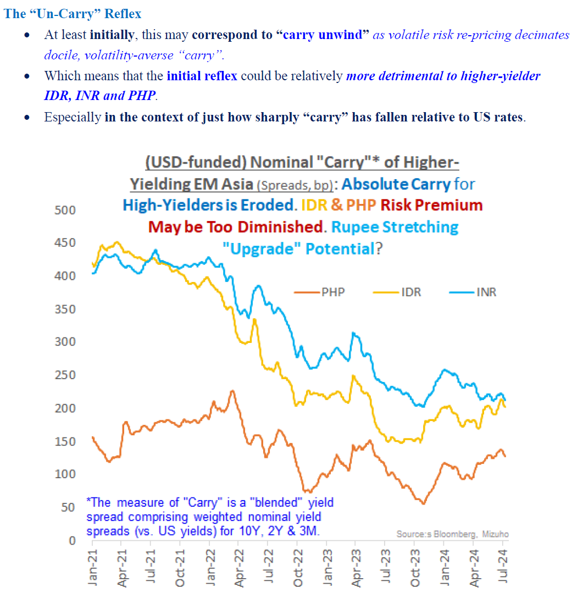
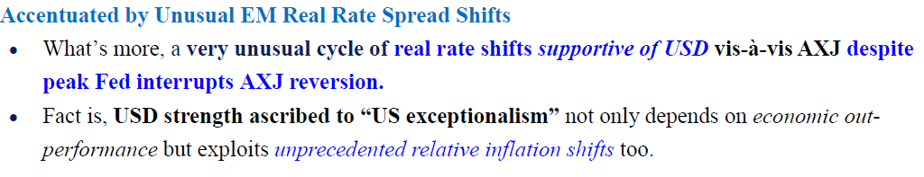
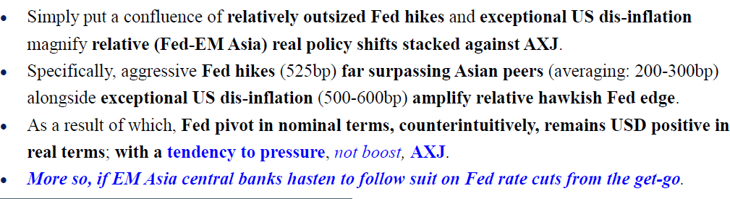
And EM Asia FX are in any Case Vulnerable to Risk Re-pricing
Notes:
Lastly, because of the lack of reversion implying a lackluster Asian FX performance, EM-Asian central banks may not want to follow the Fed to cut rates in lock step.
In the event that they do follow the Fed to ease the cut rates, EM-Asia central banks will be diminishing the rate spreads which the Fed cut provides which further impedes the recovery for EM-Asia FX.
I will end off by referring to not being carried away with rate cuts by the Fed,
Aside from the AUD which has suffered from the unwinding of carry trades due to the JPY appreciation, high yielders such as the IDR and PHP and the Indian Rupee are also at risk of the unwinding of carry trades from JPY funded carry.
But these same currencies can also be exposed to risk re-pricing,
Specially, if global growth risks start to rise, given how low the spread of rupiah bonds are relative to US yields just 200bps, any reversion back to US bonds could spark off bond sell-off and resulting currency weakness.
To be clear, we are not saying the USD is a funding currency in the traditional sense, what we are emphasizing is that in the past two years, despite the Fed hiking rates which saw UST yields spike, high yielders in India and Indonesia saw their risks spreads shrink, in short, due to the flush liquidity, markets were tolerating much narrower spreads and not selling off bonds of these higher yields to demand the same risk premium.
This backdrop is important, because now even as the Fed cuts and if this comes amid a backdrop of slowing US economy and risk off mood, markets may decided to reconsider how much risk premium they want to demand and trigger a bond market recalibration as something prudent or at the tail risk of sharp economic slowdown, an outright sell-off which will damage EM-Asia FX.
All in, our thoughts are that EM-Asia FX remains vulnerable even as the Fed pivots.
I am happy to take any questions.

Slide 16
Disclaimer
Important Information
This publication has been prepared by Mizuho Bank, Ltd. (“Mizuho”) and represents the views of the author. It has not been prepared by an independent research department and it has not been prepared in accordance with legal requirements in any country or jurisdiction designed to promote the independence of investment research and is not subject to any prohibition on dealing ahead of the dissemination of investment research.
Disclaimer
Unless otherwise stated, all views or opinions herein are solely those of the author(s) as of the date of this publication and are not to be relied upon as authoritative or taken in substitution for the exercise of judgement by any recipient, and are subject to change without notice.
This publication has been prepared by Mizuho solely from publicly available information. Information contained herein and the data underlying it have been obtained from, or based upon, sources believed by us to be reliable, but no assurance can be given that the information, data or any computations based thereon are accurate or complete. This publication provides general background information only. It is information in summary form and does not purport to be complete. This publication has been prepared for information purposes only and is not intended by Mizuho or its affiliates to constitute investment, legal, accounting, tax or other advice of any kind and all recipients of this publication are advised to contact independent advisors in order to evaluate the publication, including, without limitation, the suitability of any security, commodity, futures contract or instrument or related derivative (hereinafter, a “financial instrument”), product or strategy herein described. This publication is not intended to be relied upon as advice to investors or potential investors and does not take into account investment objectives, financial situation or needs of any particular investor. It is not intended for persons who are Retail Clients within the meaning of the United Kingdom’s Financial Conduct Authority rules nor for persons who are restricted in accordance with US, Japanese, Singapore or any other applicable securities laws.
This publication has been prepared for information purposes only and is not intended by Mizuho to market any financial instrument, product or service or serve as a recommendation to take or refrain from taking any particular course of action or participate in any trading or other strategy. This publication is not an offer to buy or sell or a solicitation of any offer to buy or sell any security or any of the assets, businesses or undertakings described herein, or any other financial instrument, nor is it an offer to participate in any trading or other strategy, nor a disclosure document under applicable laws, rules, regulations or guidelines. Nothing contained herein is in any way intended by Mizuho or its affiliates to offer, solicit and/or market any financial instrument, product or service, or to act as any inducement to enter into any contract or commitment whatsoever. Neither the author, Mizuho nor any affiliate accepts any liability whatsoever with respect to the use of this publication or its contents or for any errors or omissions herein.
Mizuho and its affiliates, connected companies, employees or clients may take the other side of any order by you, enter into transactions contrary to any recommendations contained herein or have positions or make markets or act as principal or agent in transactions in any securities mentioned herein or derivative transactions relating thereto or perform or seek financial or advisory services for the issuers of those securities or financial instruments.
All of the information contained in this publication is subject to further modification without prior notice and any and all opinions, forecasts, projections or forward-looking statements contained herein shall not be relied upon as facts nor relied upon as any indication of future results. Opinions stated in this publication are subject to change without notice. Future results may materially vary from such opinions, forecasts, projections or forward-looking statements. The information contained in this publication may not be current due to, among other things, changes in the financial markets or economic environment. Mizuho has no obligation to update any information contained in this publication. Past performance is not indicative of future performance.
This is a strictly privileged and confidential publication. This publication contains information addressed only to a specific individual and is not intended for distribution to, or use by, any person other than the named addressee or any person or entity in any jurisdiction or country where such distribution or use would be contrary to law or regulation. Save with Mizuho’s prior written consent, you may not disclose, divulge, reproduce or furnish any information contained herein to any other party. Please notify the sender immediately if you have mistakenly received this publication.
Singapore: Mizuho is licensed as a bank under the Banking Act (Chapter 19) of Singapore, and is regulated by the Monetary Authority of Singapore.
Japan: Mizuho is authorised and regulated by the Financial Services Agency of Japan.
United Kingdom / European Economic Area: In the UK, Mizuho is authorised by the Prudential Regulation Authority and subject to regulation by the Financial Conduct Authority and limited regulation by the Prudential Regulation Authority. Details about the extent of MHBK's regulation by the Prudential Regulation Authority are available upon request. This publication may also be distributed by Mizuho International plc (“MHI”). MHI is authorised by the Prudential Regulation Authority and regulated by the Financial Conduct Authority and the Prudential Regulation Authority.
United States: This publication is not a “research report” as defined in Commodity Futures Trading Commission (“CFTC”) Regulations 1.71 and 23.605. The content of publications distributed by Mizuho Securities USA Inc. (“MSUSA”) is the responsibility of MSUSA. The content of publications distributed directly to US customers by Mizuho is the responsibility of Mizuho. US investors must effect any order for a security that is the subject of this report through MSUSA.
© 2014 Mizuho Bank Ltd.

