Slide 1


Dragon Risks
“It does not do to leave a live dragon out of your calculations, if you live near him”
- Gandalf, Lord of the Rings
Photo Credits: Shutterstock, FT
April 2024
Notes:
Hi Susan 下午好，我是文兴，今天很高兴可以分享一些市场和经济看法。

Slide 2
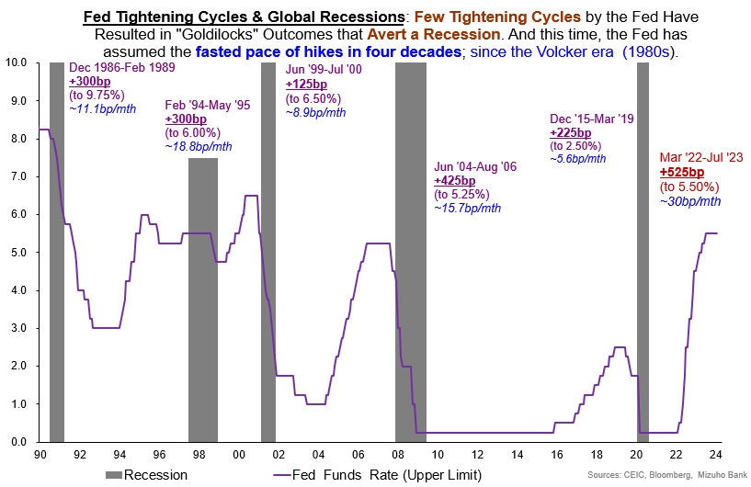
History is Not on the Side of “Immaculate” Soft-Landing; regardless of US Exceptionalism
Notes:
在我谈到人民币和林吉之前, 我会分享一些关于美联储基金利率的想法还有一些围绕美国经济增长的风险。毕竟，每个人都很清楚美国的例外论，以及美国的非农就业情况有多好.
今天我们jiu不讨论美国经济有多好。
相反，我们将简要地关注一些风险.
我们还将探讨美元强势是如何见顶但并未完全回落的。在此过程中，我们将强调许多风险。
我们首先快速浏览一下美联储基金利率的历史。
这张图表显示了美联储不同的紧缩周期，灰色区域显示了经济衰退的时期。
值得一提的是，加息速度是在每月平均30个基点
这是自80年代沃尔克时代以来的最快加息速度。从历史经验来看，紧缩时期几乎总是导致经济衰退。

Slide 3
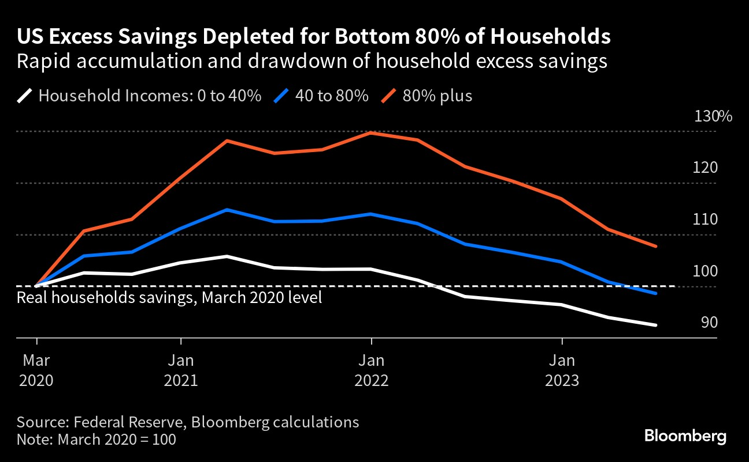
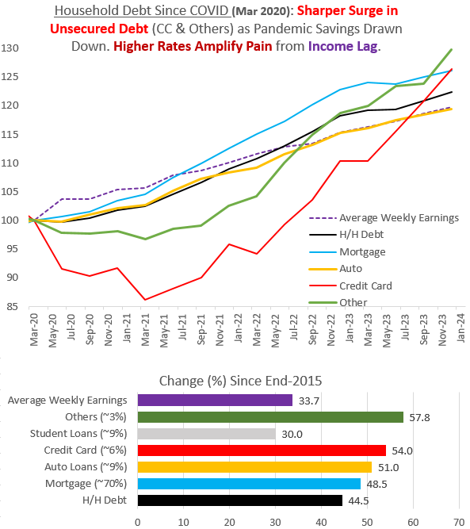
Unprecedented Distortions & Lags: Illusion of US Consumer Exceptionalism?
Chart from Bloomberg
Notes:
此外，我们看到，美国的过剩储蓄已基本耗尽。80%的家庭已经开始动用疫情前的储蓄，只有前20%的高收入家庭还有储蓄过剩。此外，在我们承认美国收入显著增长的同时，我们发现债务增长也在加速。令人担忧的是，信用卡债务等无担保债务的增长已经超过了收入增长。因此，这是围绕美国消费者韧性的一个显著风险。
Furthermore, we see that excess savings in the US has been largely depleted. 80% of the households are already drawing down on their pre-pandemic savings with only the top 20 percentile of households having excess savings. In addition, while we acknowledge the significant income growth in the US, we find that debt growth has also accelerated. Worryingly, unsecured debt growth such as debt on credit cards have surged above income growth. As such, this is a notable risk surrounding us consumer resilience.

Slide 4
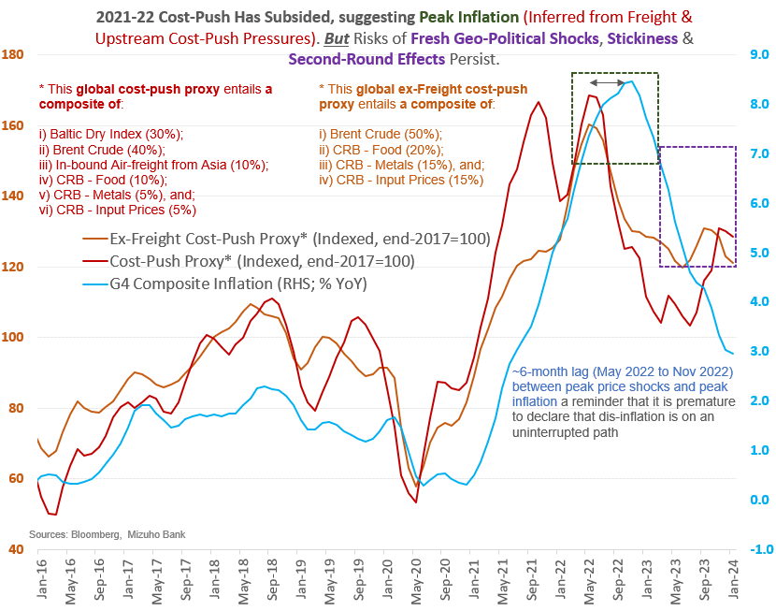
Bumpy Inflation: Irascible on Shocks (with a Lag) Underpinning “Last Mile” Worries …
Notes:
谈到通胀，美国的通胀肯定已经见顶。然而，我们看到了所谓的“last mile disinflation”出现新风险的迹象。
该图表显示了两个成本推动指标和G4通胀。成本指标显示，全球货运成本、能源成本和金属等原材料成本在2023年底和2024年初开始上升。通常，成本冲击与最终消费者价格之间就会有6个月的滞后。因此， 通胀之路可能崎岖不平，这不仅会使政策复杂化，还会损害消费者利益，削弱经济增长。
Turning to inflation, we believe that it has certainly peaked in the US. However, we see signs of fresh risks for last mile inflation. The chart shows two cost push indicators and G4 inflation.
The cost indicators show that global freight costs, energy costs and raw materials such as metals are that were declining have started to increase in late 2023 and early 2024 . Typically, the more upstream costs have a 6 months lag between the cost shocks and end consumer prices. As such, we warn of a bumpy inflation path which not only complicate policy but also hurts consumers and dents economic growth.

Slide 5
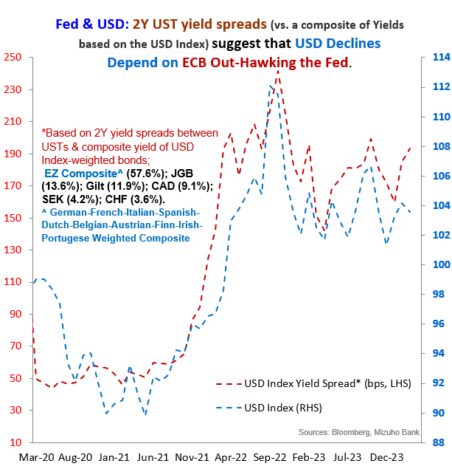
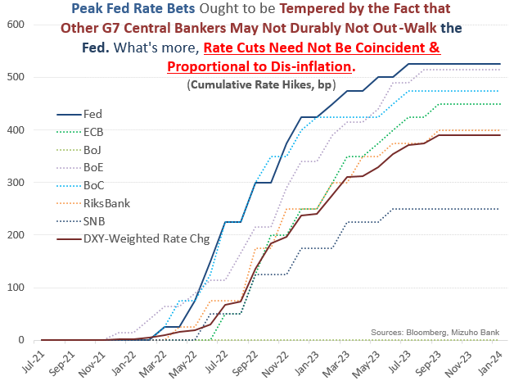
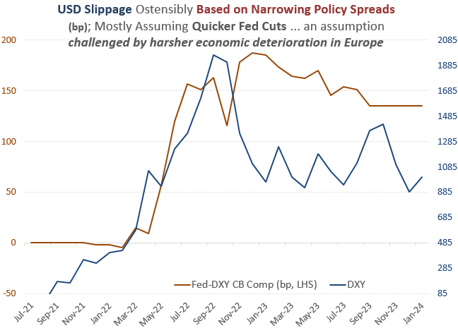
Competitive Pivot: USD Bears Banking on Spread Erosion … A Gambit, Not a Guarantee!
Notes:
现在让我们讨论美元的整体前景。在我们看来，美元空头指望美联储降息是一种策略，而不是保证。我们比较美国和欧元区的利差，当美国提供更好的利差时，美元指数上升。如果想要美元走弱，就一定希望欧洲央行比美联储更强硬。问题是，鉴于欧元区经济增长疲弱，这让人怀疑欧洲央行到底能比美联储强硬多少? 与美国相比，欧洲的经济状况更糟，欧洲央行甚至可能在美联储之前降息。其实在欧洲瑞士央行已经降息了。即使美联储主导降息的基本假设成立，我们也要记住，美联储的加息幅度比七国集团其他央行都要高。这个起点也很重要。这是利差的侵蚀，但即使在第一次降息后，美国的利差仍为正。随后，如果出现竞争性转向，其它央行也加入降息行列，那么相对于美国的息差实际上就可以维持。因此，即使抛售美元的趋势是相关的，这也不是直截了当。
Let us move on to the broad USD outlook proper.
In our opinion, USD bears are counting on Fed cuts is a gambit not a guarantee.
We compare the US and EZ spreads, when the US provides a better spread, the USD index goes up.
Going for a weaker USD, one must hope that ECB is more hawkish than the Fed.
The problem is that given the weak growth picture in the Eurozone, it throws doubt over how much more hawkish than the Fed, can the ECB really be?
With the harsher economic deterioration In Europe, it remains to be seen in terms of timing of cuts, it might even end up that the ECB might be even cut before the Fed. Let us not forget that SNB has already cut rates.
Even if the base case of a Fed led rate cut takes hold, let us remember that the Fed has hiked more than the rest of the G7 central banks. This starting point matters as well. It is a erosion of spread but the US hold a positive spread even after the first cut.
Subsequently, if a competitive pivot takes hold， essentially with other central banks joining in the cuts then the spreads relative to the US can in fact be maintained.
As such, even as the tendency to sell off USD is relevant, that is far from straight forward.

Slide 6
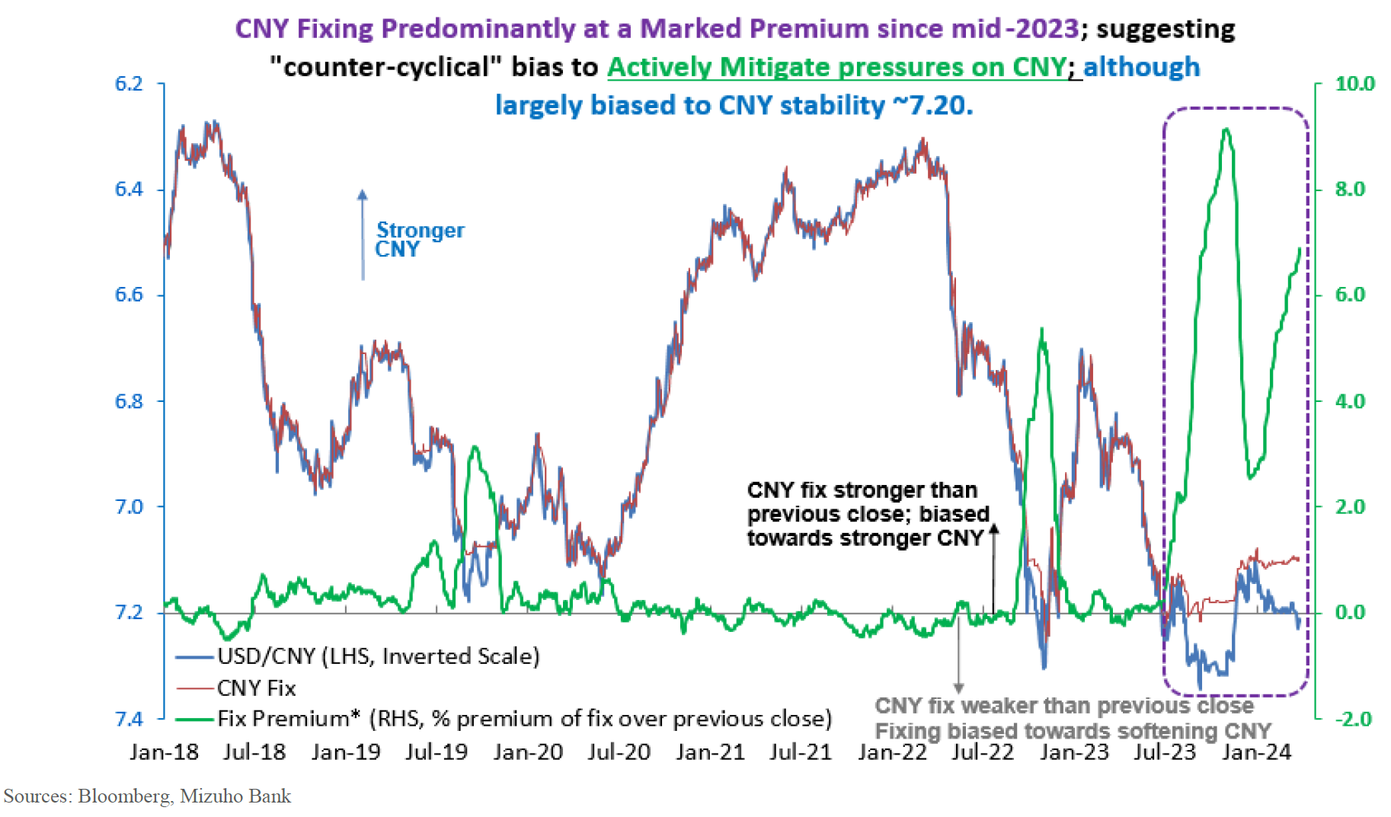
China: No Panacea & Problematic ‘PBoC Put’
Notes:
我将从分享我们对中国央行的看法开始中国部分。首先，我们必须承认，自2023年年中以来，人民币定盘价一直处于溢价状态。但是中国央行支持人民币的能力绝对不是万灵药。它甚至可能只是掩盖了一些尚未解决的潜在问题。人民币需要中国央行的支撑，其实是表现了明显缺乏独立人民币信心的严厉声明。中国央行的行动也倾向于将人民币兑美元汇率稳定在7.2，而不是引发反弹。因此，人民币多头不应对中国央行的强势中间价过于乐观。
I will start off the China section by sharing our thoughts on the PBoC and the RMB. First, it is important to acknowledge that CNY fixing has been at a premium since mid-2023.
The PBoC’s ability to backstop CNY is categorically not a panacea. It may merely conceal an unresolved underlying problem. The ostensible need for PBoC crutch is a scathing statement of a conspicuous absence of stand-alone CNY confidence. As such, CNY bulls should not be overly optimistic about the strong PbOC fixing.
Regarding the probability of policy easing by the PBoC, the need to ensure RMB stability and financial market stability imply that policy rate cuts remain a tricky proposition.
The PBoC may have to resort to a suite of targeted and calibrated easing for the time-being. These include, but are not limited to, RRR cuts supplemented by credit quota-type of tools to encourage bank lending.

Slide 7
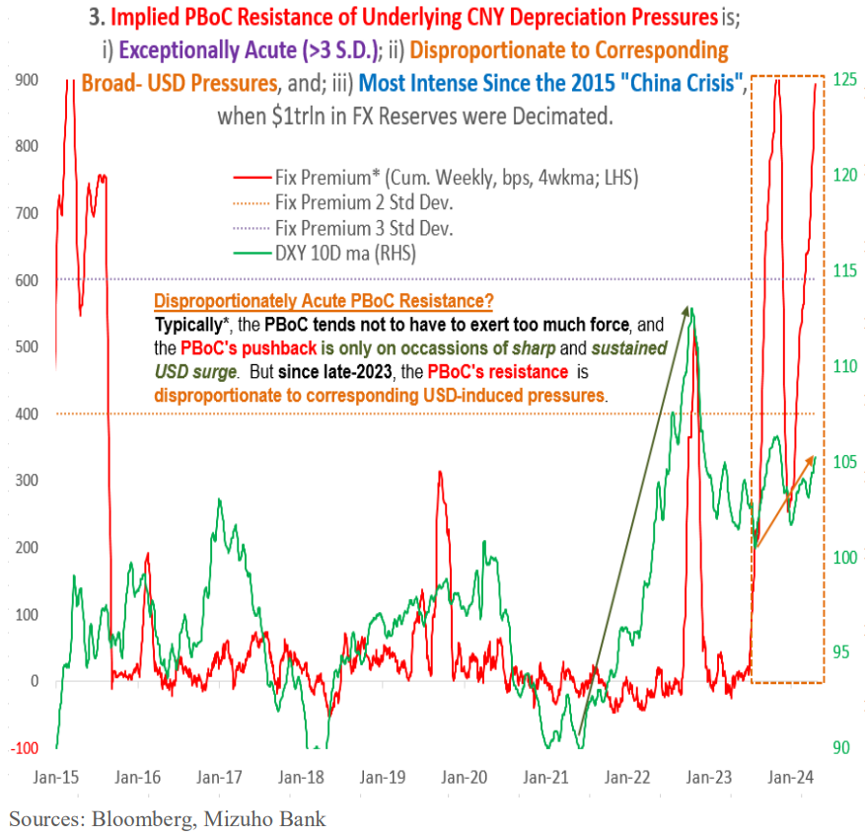
China: No Panacea & Problematic ‘PBoC Put’
Notes:
市场对中国第一季度的GDP增长表现不以为然，尽管5.3%的增长打破了市场的4.8的预期, 人民币继续走弱。关键是，需求的软肋不过是证实了此前对人民币持续施压的质疑.
根据10年的固定利率记录，最近，每周近900个基点的升值偏差使固定利率溢价远远超过3个标准差(3sd)。如此低的统计概(gai)率(lu)((小于0.2%)显示出强劲的定盘溢价与预期的、强烈的人民币支撑一致.
中国央行的动机必须是规避可识别的人民币压力，而不仅仅是应对美元单边走强.
关于中国央行放松政策的可能性，确保人民币稳定和金融市场稳定的需要意味着政策降息仍然是一个棘手的命题。中国央行可能不得不暂时采取一系列有针对性的、有刻度的宽松政策。这些措施包括(但不限于)降低存款准备金率，辅之以鼓励银行放贷的信贷配额型工具。然而，由于经济形势严峻，这些政策的有效性仍然有限。
I will start off the China section by sharing our thoughts on the PBoC and the RMB. First, it is important to acknowledge that CNY fixing has been at a premium since mid-2023.
The PBoC’s ability to backstop CNY is categorically not a panacea. It may merely conceal an unresolved underlying problem. The ostensible need for PBoC crutch is a scathing statement of a conspicuous absence of stand-alone CNY confidence. As such, CNY bulls should not be overly optimistic about the strong PbOC fixing.
Regarding the probability of policy easing by the PBoC, the need to ensure RMB stability and financial market stability imply that policy rate cuts remain a tricky proposition.
The PBoC may have to resort to a suite of targeted and calibrated easing for the time-being. These include, but are not limited to, RRR cuts supplemented by credit quota-type of tools to encourage bank lending.

Slide 8
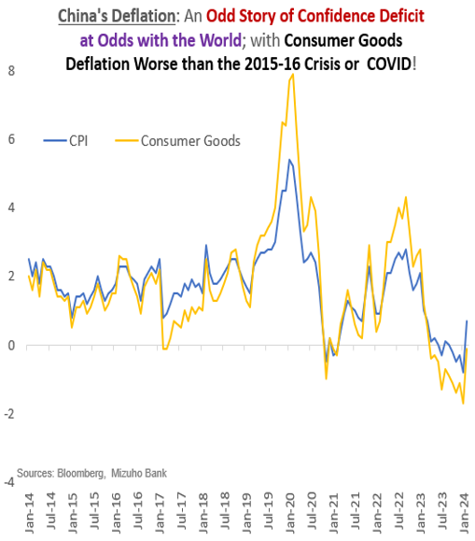
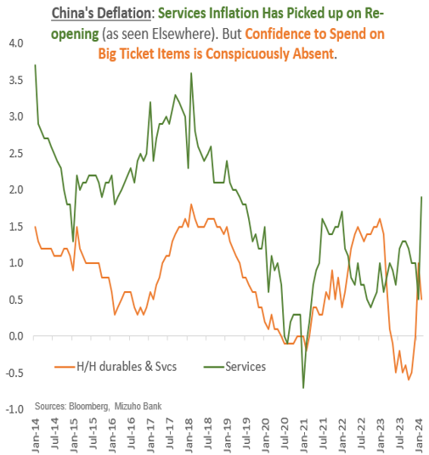
China: Chronic Confidence Deficit
Binding Structural Impediments
Confidence Deficit: By-product of uncertainty on "Common Prosperity" campaign (motivated by complex socio-political agenda that sometimes supplant economic aims).
➔ Confidence overhang hampers big-ticket spend and investments, compromising growth multipliers.
Notes:
我们认为，中国目前的主要问题是长期缺乏信心，而不是缺乏资金。他们的通货紧缩情况与世界其他地区不一致，我们看到他们目前正在经历的消费品通货紧缩比2015年或covid期间更严重。此外，虽然服务业通胀在重新开放期间有所回升，但我们看到，家庭对购买耐用品几乎没有信心。
缺乏消费信心背后的部分原因源于共同繁荣运动. 共同繁荣政策对企业家和特定行业进行了打压这给经济带来了不确定性. 信心不足阻碍了大额支出和投资.
We characterized China’s main issue right now as a Chronic lack of confidence rather than a lack of funding.
Their deflationary situation is at odds with the rest of the world and we see that the consumer goods deflation which they are currently experiencing is worse than that in 2015 or during covid.
In addition, while services inflation picked up during the reopening, we see that households have little confidence to spending on durables.

Slide 9
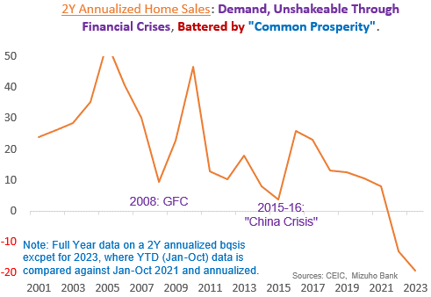
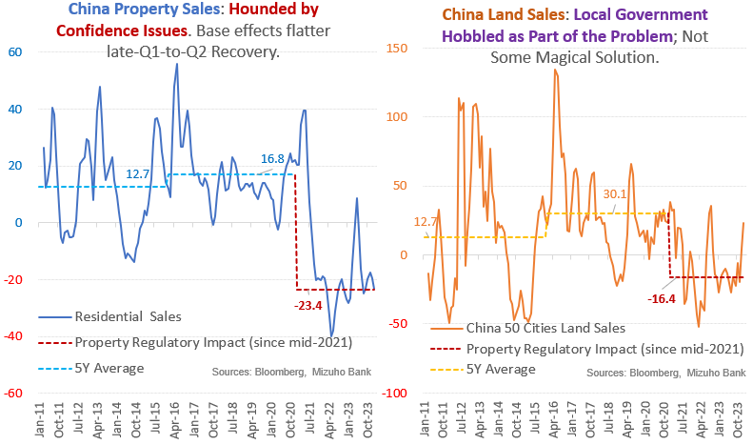
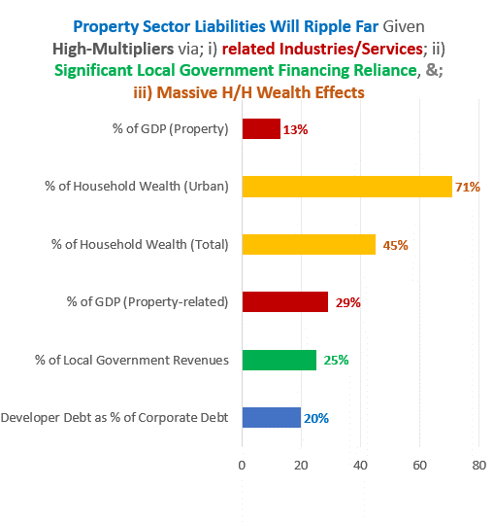
China: Property Overhang Will Take a Lot to Reverse
Property Overhang
Backstop critical but Falls Short!
Financing cashflow is welcome
But Not Sustainable Without Sales (Operating Cashflow) Recovery Requiring Confidence.
Psyche of “sure win” property has changed.
SOEs defaulting amid “Common Prosperity” leaves Confidence Shaky.
Compromises growth multipliers & credit.
Notes:
当然，陷入困境的房地产行业也严重打击了中国消费者的信心. 简单地说一下房地产行业，我们的立场是，要扭转现在的局面需要很多时间。房屋销售在2023年继续萎缩。此前，即使在金融危机期间，房屋销售也持续增长。然而，在这个关键时刻，房屋销售受到了共同繁荣和他们早些时候减少房地产行业债务的政策的严重打击。
我们也认为地方政府是问题的一部分，而不是解决方案。由于房屋销售不佳，土地销售收入下降，因此地方政府缺乏刺激经济的资金。至于当局制定的各种解决方案，如白名单，他们是受欢迎的，但没有销售是不可持续的。简而言之，融资现金流很重要，但经营现金流最终决定了长期生存能力。“稳赢”房地产的心态受到了动摇，因此，在房价下跌之际，缺乏信心阻碍了增长乘数。
Turning to the property sector briefly, our stand is that the overhang will take a lot to reverse.
Home sales has continued to contract. Previously, home sales continued to grow even during periods of financial crisis. However, at this juncture, home sales has been badly battered common prosperity and their earlier attempts to reduce property sector debt.
We view the local governments as part of the problem rather than the solution. Due to the poor home sales, land sales revenue has declined and as such local government lack funds to stimulate the economy.
As for the various solutions such as the whitelist created by the authorities, they are very much welcomed but it is not sustainable without sales.
In short, financing cash flows are important but operating cashflows ultimately determine long term viability.
The psyche of “sure win” property is shaken and as such the lack of confidence amid declining property price impede growth multipliers.

Slide 10
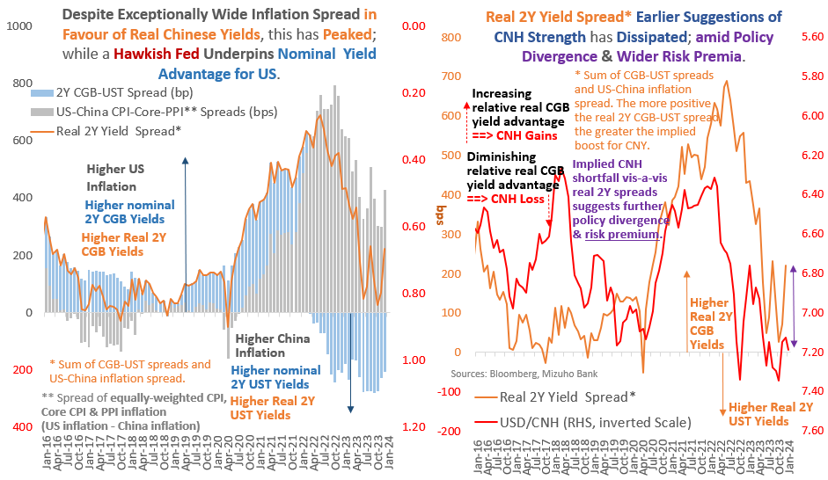
FX: CNH - Impacted by “Fundamental” Yield Support Eroded …
Notes:
在离岸人民币方面，我们看到名义收益率差继续对美元有利。事实上，去年美国的反通胀也意味着实际回报也有利于美元。因此，收益率的基本面支撑已受到侵蚀。
On the CNH, we see that nominal yield spreads continue to be an advantage for the USD. In fact, the dis-inflation in the US last year also imply that real returns are also in favour of the USD. As such the fundamental yield support has eroded.

Slide 11
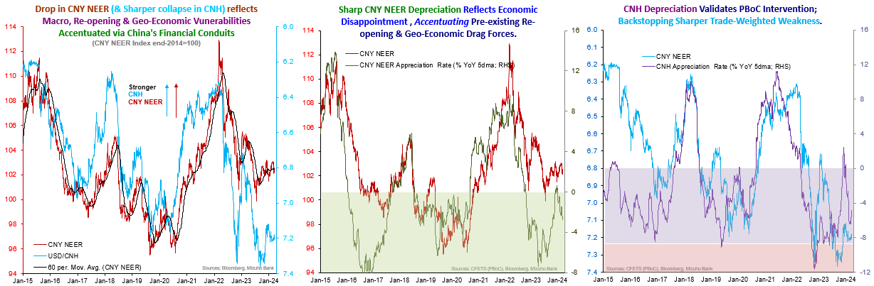
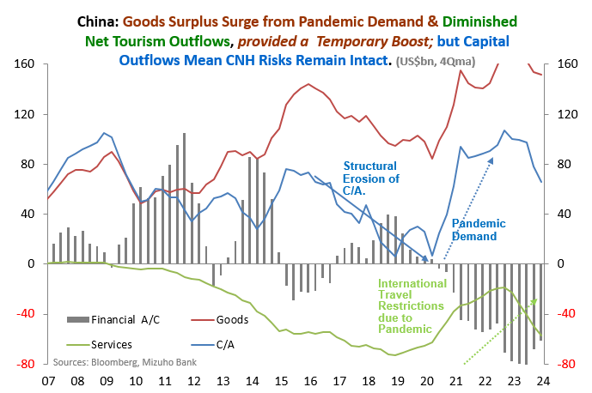
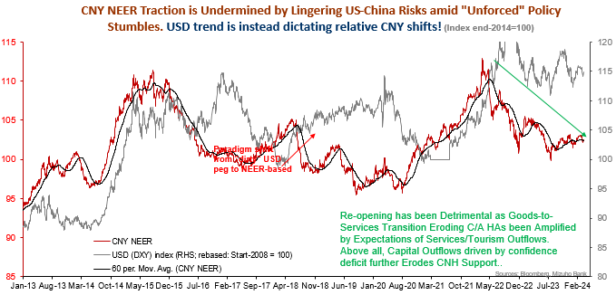
FX: CNH - … & is Still Not Out of the Woods
Notes:
总体前景是，CNH将继续面临多重国内阻力。这一点从前三张图表中人民币名义有效汇率的糟糕表现就可以看出。人民币对美元贬值并不奇怪。然而，在贸易加权的基础上，人民币对其贸易伙伴也走弱。当然，这在一定程度上是由于政策分歧，但也反映了我们前面提到的国内的疲弱的因素。
看看国内因素，我们看右下角的图表。此前，由于疫情导致的需求，货物贸易实现了强劲的经常账户盈余。此外，由于新冠肺炎限制，中国游客不被允许出境，这意味着服务赤字要小得多。
在2019年，中国游客在海外净消费超过3000亿美元。因此，大量储蓄使得外汇储备得以积累。在这一点上，我想指出的是，鉴于中国的巨额储备，并不是中国没有钱，而是缺乏信心，这意味着资本正在流出中国，这决定了人民币的疲软。决定汇率波动的是资金流，而不是储备存量
The general outlook is that CNH continues to face multiple domestic headwinds. This is evident from the dire performance of the CNY NEER across the top three charts. It is not surprising that the RMB weakens against the USD. However, the RMB has also weakened against its trading partners on a trade weighted basis. Certainly, this is partly due to policy divergence but also a reflections of their domestic weakness which we touch on earlier.
Looking at domestic factors, we look at the bottom right chart. Previously, pandemic demand allowed a strong current account surplus from the goods trade. Furthermore, because of covid restrictions, Chinese tourist were not allowed out of the country which means there is much smaller services deficit. In 2019, Chinese tourist spent more than 30bllion dollars abroad on a net basis. As such there is considerable savings which allows FX reserves accumulation. On this, I want to point out that it is not that China has no money given the large reserves, however it is the lack of confidence which imply capital flowing out of china that determines the CNH weakness. It is the flows that determine the price and not the stock of reserves.

Slide 12
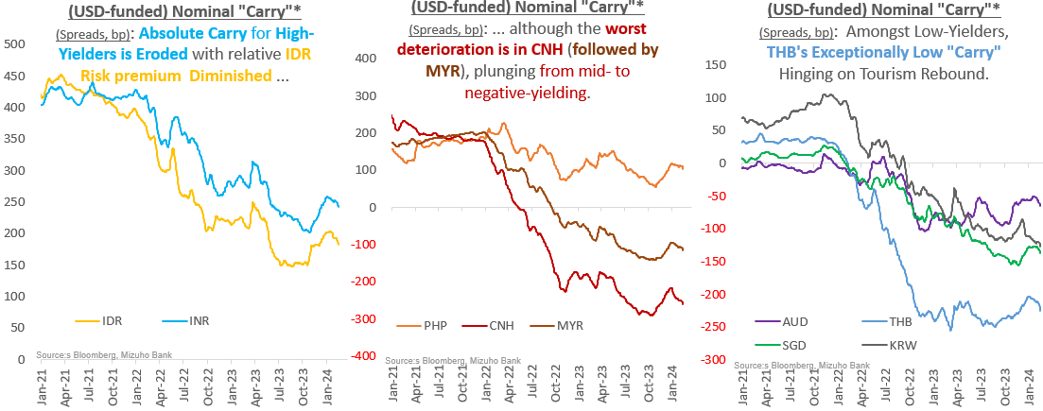
EM-Asia FX-Build-up of Volatility as “Carry” Buffer Declines: Harder to Keep Calm & “Carry” On
Notes:
转向亚洲外汇市场，我们看到仅有的印度卢比和菲律宾比索仍为正值。马来西亚林吉的利差也从约200个基点的正利差降至负收益率。虽然套息交易的概念看起来相对简单，但我们要指出， 如果风险溢价重新定价，套息交易者可能会遭受资本损失。
Turning to EM-Asia FX, we see that the only INR and the PHP is left with a positive carry.
The MYR also saw its carry proposition decline from positive spread of around 200bps to negative yielding.
While the concept of carry trades look relatively simple, we point to potential capital loss for carry traders in the event that risks re-pricing occurs.

Slide 13
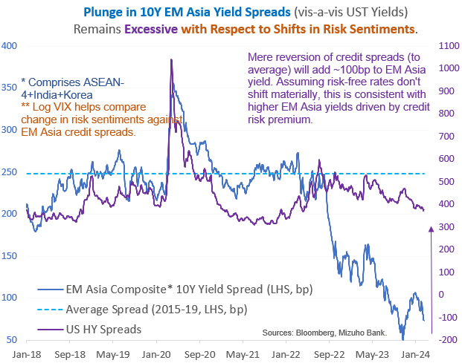
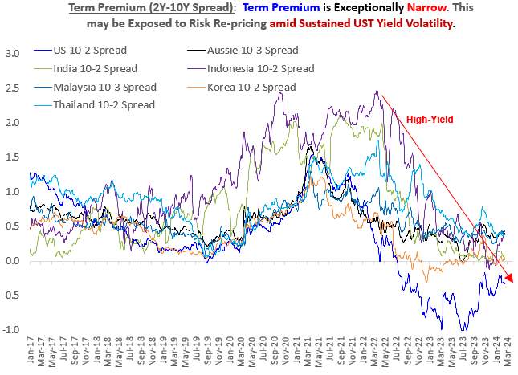
Risk Re-Pricing: Conditions for Risk & Term Premia Restoration?
Notes:
具体来说，我们看到亚洲于美国的收益率差已经大幅下降，而且与历史标准相比，这种下降幅度似乎过大.
如果在信用风险溢价的推动下出现均值回归，亚洲的收益率有可能上升100个基点。因此，任何套息交易都可能因风险重新定价而面临巨大的潜在损失。
Specifically, we see that EM-Asia yields spreads relative to USTs has plunged and this plunge appears to be outsized. Should a mean reversion take place driven by credit risk premium, there is a potential to add 100bps to yields in EM-Asia. Consequently, any carry trades can face huge potential loss from the risk re-pricing.

Slide 14
MYR: External Reliance and Domestic Reforms
Notes:
至于马来西亚林吉，我们已经提到了马来西亚的负利差。下面，我将谈谈导致马来西亚林吉贬值的一些国内因素。这些因素恶化马来币在强势美元环境下的表现。首先，我们看到经常账户余额因商品收支顺差减少而缩水，因此这也拖累马币的表现。此外，马来西亚对中国出口的巨大份额也意味着中国经济和人民币的持续疲软对马来西亚林吉特有显著的溢出效应。
在国内，首相安华的经济政策和方向总体上是合理的。然而，政策改革需要大量的政治资本。一些值得注意的政策包括取消公务员养老金和正在进行的燃料补贴改革。这些政策在财政上是合理的，但历史告诉我们，它们不太可能受到欢迎，可能会遭遇反弹和社会动荡，进而引发政治不稳定的风险。我们认为，这是令吉走弱的众多原因之一。
While we had already mentioned the negative carry of the MYR. I will now touch on some domestic-related factors which worsen MYR weakening. That said, these factors merely nudge the overall USD trends and is unlikely to override the prevailing USD trend in markets. First, we see that current account balance has shrunk due to a smaller goods balance surplus and as such this will weigh on the MYR performance. Furthermore, Malaysia’s large share of exports to China also imply that on-going weakness in China economy and the RMB has significant spillover on the MYR.
Domestically, economic policies and directions from PM Anwar has been generally sound. However, the policies reforms require a lot of political capital. Some notable policies include removal of pensions for civil servants and on-going attempts to fuel subsidies reform. The policies are fiscally sound but history tells us that they are unlikely to be popular and may meet with backlash and social unrest which in turn can trigger political instability risks.

Slide 15
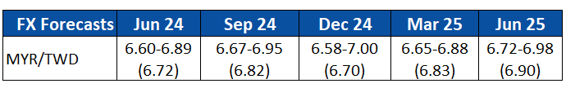
MYR/TWD: Structural Trends Upheld Amid Near Term Volatility
Notes:
从这里开始，我将直接分析马币对台币，解释结构背景，并与可能的近期表现联系起来。随着台湾出口竞争力的持续增长，台湾的经常账户规模已超过马来西亚。我们预计结构优势将在短期内适当保留，特别是随着半导体周期在2024年继续复苏。虽然马来西亚的电子行业也将受益于半导体行业的复苏，但涨幅可能会比较温和，因为它们在技术阶梯上的位置没有那么高。
在大宗商品方面，我们看到原油价格的上涨近年来并没有提振林吉特。考虑到马来西亚是一个能源出口国，而台湾进口的大量能源价值超过GDP的1%，油价上涨本应提振令吉台币。一个原因是我们之前提到过马来西亚的政治不稳定风险。这也意味着，财政政策改革成功通过的迹象可能有助于马来西亚林吉特的复苏。诚然，半导体周期的顶峰以及政治局势何时被视为稳定，很难把握。
From here, I will go direct into MYR TWD pair to explain the structural backdrop and link to the likely near term performance. Taiwan’s current account has outstripped that of Malaysia as their export competitiveness continues to grow. We expect that the structural advantage to be duly retained in the near term especially as the semiconductor cycle continue to recover in 2024. While Malaysia’s electronics sector will also benefit from the semiconductor recovery, the gains are likely to be more modest due to them not being as high up the technology ladder.
Turning to the other commodity, we see that Brent crude price increasing has not been able to lift the MYR in recent years. Given that Malaysia is an energy exporter while Taiwan imports a significant amount of energy worth more than 1% of GDP, higher oil prices ought to have lifted the MYR TWD. One reason is the political instability risks in Taiwan earlier, we mentioned earlier. This also means that signs of fiscal policy reforms being successfully passed through may help assist the MYR recovery. Admittedly the peak of semiconductor cycles and when the political situation is going to be deemed stable is hard to catch.

Slide 16
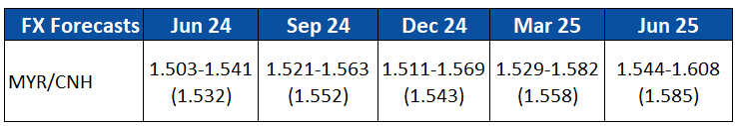
MYR/CNH: Stability at the Mercy of Two Way Risks
Catch up risks on MY political stability
Global oil prices remain at risk of large moves
Fiscal deficit position improvement also hinges on 2H 2024 rollout of fuel subsidy rationalization
Next General Elections in 2028.
Close economic linkages imply “common suffering” does not reduce risks of idiosyncratic shocks
Current MYRCNH volatility at recent lows does not absolve risks of future shocks
Notes:
转向MYRCNH。不出所料，我们也观察到，油价上涨未能支撑马币兑人民币的汇率。这意味着仍有追赶空间的风险。尽管如此，全球石油市场仍然非常不稳定。今天早上，以色列导弹刚刚袭击了伊朗，造成了冲突进一步升级的风险. 全球油价上涨的主要原因是欧佩克+的减产，以及中东冲突等供应侧地缘政治风险。因此，油价大幅下跌并非不可能。
在马来西亚，财政责任法案于2023年10月通过。它要求联邦政府赤字在未来3-5年内降至GDP的3%。这在很大程度上取决于今年下半年实施的更具针对性的燃油补贴。如果在不引发巨大政治动荡的情况下推出这项补贴，林吉特将有升值的空间. 此外，一旦在这些政策推出后出现稳定的局面，下一次大选将在2027/28年底举行，这是相当遥远的，稳定的政治局面和财政稳健的经济有助林吉表现。
在过去的几个月里，人民币兑林吉汇率相当稳定。然而，从右下方的图表中，我们看到低波动性可能不会持续那么久。冲击可能来自中国房地产行业的恶化(你已经是这方面的专家了)，或者是马来西亚的政治局势和全球油价。总的来说，他们共同的经济痛苦仍然会受到自己国内特殊的冲击。
Turning to the MYRCNH. Unsurprisingly, we also observe that higher oil prices have been unable to buoy the MYR. This represents a risk that there is some catch-up left for the MYR. Nonetheless, the global oil market remains very volatile. Most of the increase in global oil prices have come from supply cuts by opec+ and also supply side geo-political risks such as the conflict in the middle east. As such, a sharp fall in oil prices is not out of the question.
In Malaysia, the fiscal responsibility act was passed in October 2023. It mandates the federal government deficit to fall to 3% of GDP in the next 3-5 years. Much of it will hinge on the implementation of more targeted fuel subsidies in the second half of this year. There is room for MYR gains should the subsidy be rolled out without a huge political unrest. Furthermore, once there is a semblance of stability after the roll out of these policies, the next general elections are in late 2027/28 which is quite far away and the stability might assist the MYR.
The current MYRCNH has been rather stable in the past few months especially as the two countries trade relations draw closer. However, from my bottom right chart, we see that the low volatility may not be that lasting. Shocks can easily come from a deterioration of the Chinese property sector which you are already the expert on or even Malaysia’s political situation and global oil prices. On balance, common suffering can still be subject to idiosyncratic shocks.

Slide 17
Disclaimer
Important Information
This publication has been prepared by Mizuho Bank, Ltd. (“Mizuho”) and represents the views of the author. It has not been prepared by an independent research department and it has not been prepared in accordance with legal requirements in any country or jurisdiction designed to promote the independence of investment research and is not subject to any prohibition on dealing ahead of the dissemination of investment research.
Disclaimer
Unless otherwise stated, all views or opinions herein are solely those of the author(s) as of the date of this publication and are not to be relied upon as authoritative or taken in substitution for the exercise of judgement by any recipient, and are subject to change without notice.
This publication has been prepared by Mizuho solely from publicly available information. Information contained herein and the data underlying it have been obtained from, or based upon, sources believed by us to be reliable, but no assurance can be given that the information, data or any computations based thereon are accurate or complete. This publication provides general background information only. It is information in summary form and does not purport to be complete. This publication has been prepared for information purposes only and is not intended by Mizuho or its affiliates to constitute investment, legal, accounting, tax or other advice of any kind and all recipients of this publication are advised to contact independent advisors in order to evaluate the publication, including, without limitation, the suitability of any security, commodity, futures contract or instrument or related derivative (hereinafter, a “financial instrument”), product or strategy herein described. This publication is not intended to be relied upon as advice to investors or potential investors and does not take into account investment objectives, financial situation or needs of any particular investor. It is not intended for persons who are Retail Clients within the meaning of the United Kingdom’s Financial Conduct Authority rules nor for persons who are restricted in accordance with US, Japanese, Singapore or any other applicable securities laws.
This publication has been prepared for information purposes only and is not intended by Mizuho to market any financial instrument, product or service or serve as a recommendation to take or refrain from taking any particular course of action or participate in any trading or other strategy. This publication is not an offer to buy or sell or a solicitation of any offer to buy or sell any security or any of the assets, businesses or undertakings described herein, or any other financial instrument, nor is it an offer to participate in any trading or other strategy, nor a disclosure document under applicable laws, rules, regulations or guidelines. Nothing contained herein is in any way intended by Mizuho or its affiliates to offer, solicit and/or market any financial instrument, product or service, or to act as any inducement to enter into any contract or commitment whatsoever. Neither the author, Mizuho nor any affiliate accepts any liability whatsoever with respect to the use of this publication or its contents or for any errors or omissions herein.
Mizuho and its affiliates, connected companies, employees or clients may take the other side of any order by you, enter into transactions contrary to any recommendations contained herein or have positions or make markets or act as principal or agent in transactions in any securities mentioned herein or derivative transactions relating thereto or perform or seek financial or advisory services for the issuers of those securities or financial instruments.
All of the information contained in this publication is subject to further modification without prior notice and any and all opinions, forecasts, projections or forward-looking statements contained herein shall not be relied upon as facts nor relied upon as any indication of future results. Opinions stated in this publication are subject to change without notice. Future results may materially vary from such opinions, forecasts, projections or forward-looking statements. The information contained in this publication may not be current due to, among other things, changes in the financial markets or economic environment. Mizuho has no obligation to update any information contained in this publication. Past performance is not indicative of future performance.
This is a strictly privileged and confidential publication. This publication contains information addressed only to a specific individual and is not intended for distribution to, or use by, any person other than the named addressee or any person or entity in any jurisdiction or country where such distribution or use would be contrary to law or regulation. Save with Mizuho’s prior written consent, you may not disclose, divulge, reproduce or furnish any information contained herein to any other party. Please notify the sender immediately if you have mistakenly received this publication.
Singapore: Mizuho is licensed as a bank under the Banking Act (Chapter 19) of Singapore, and is regulated by the Monetary Authority of Singapore.
Japan: Mizuho is authorised and regulated by the Financial Services Agency of Japan.
United Kingdom / European Economic Area: In the UK, Mizuho is authorised by the Prudential Regulation Authority and subject to regulation by the Financial Conduct Authority and limited regulation by the Prudential Regulation Authority. Details about the extent of MHBK's regulation by the Prudential Regulation Authority are available upon request. This publication may also be distributed by Mizuho International plc (“MHI”). MHI is authorised by the Prudential Regulation Authority and regulated by the Financial Conduct Authority and the Prudential Regulation Authority.
United States: This publication is not a “research report” as defined in Commodity Futures Trading Commission (“CFTC”) Regulations 1.71 and 23.605. The content of publications distributed by Mizuho Securities USA Inc. (“MSUSA”) is the responsibility of MSUSA. The content of publications distributed directly to US customers by Mizuho is the responsibility of Mizuho. US investors must effect any order for a security that is the subject of this report through MSUSA.
© 2014 Mizuho Bank Ltd.

Slide 18
FX: TWD – FX Peaks and Semiconductor Bottoms
At the margin, TWD weakness had been accentuated by the very substantial pandemic gains.
The fact is current levels are just slightly worse off 2019 levels in a period of trade wars amid US China tensions. Global supply chain tensions over semiconductor have certainly not retreated.
Nonetheless, the semiconductor sector cycle appears to have bottomed. Five consecutive quarters of (economy wide) inventory drawdown underscores the caution in private sector but also imply impending need to increase production if history holds. Current account surplus recovery backstops the TWD.
On balance, TWD looks set for a modest but bumpy recovery path.
Notes:
半导体周期可能会出现好转，但可能不会像疫情期间那样强劲。

Slide 19
FX: TWD – FX Peaks and Semiconductor Bottoms
Semiconductor sector continues to aid growth and export revenue recovery especially as terms of trade improves.
Given persistent Middle East tensions, oil prices continue to be a potential risk factor which could delay the TWD recovery.
DPP Election win maintains status quo which also keeps in place economic pressures from China. Domestically, the loss of a legislative majority impedes policy making. On the external front, the lack of reciprocity from Beijing on allowing Chinese tourists into Taiwan restrains a fuller recovery of the tourism sector.

Slide 20
Trump 2.0 (US Elections): Bracing for Geo-economic Blows
Weaker CNH, AXJ & MXN
Weaker EUR
Elevated Global Threats
Near-term USD Resilience
Trump 2.0
Trade (Tariffs)
Energy/Oil
Remove Restrictions
Impose Higher China/wider Tariffs!
Infrastructure [Fiscal]
Tax Cuts [Fiscal]
Ukraine [Conflict]
Gaza [Conflict]
Pull/Cut Aid
Uncertain Israel-Saudi Dynamics
Ramp-up Spending?
Extend Tax Cuts
Higher Inflation?
Tempers
Higher Yields
Higher Term Premium
Notes:
预计特朗普将对美元产生净积极影响。
他倾向于提高对中国商品的关税，这可能会削弱人民币和亚洲货币。
在地缘政治冲突方面，他的反复无常，包括削减对乌克兰的援助，`增加了地缘政治的不确定性。在不确定时期，美元是一种避险货币.
他还倾向于取消对石油钻探的限制。
这将意味着美国的石油产量将增加，从而使美元更不受能源冲击的影响。
我们当然不会忘记，他喜欢建设基础设施和减税。这将导致美国国债发行量增加，美元收益率上升，从而支撑美元。

