Slide 1
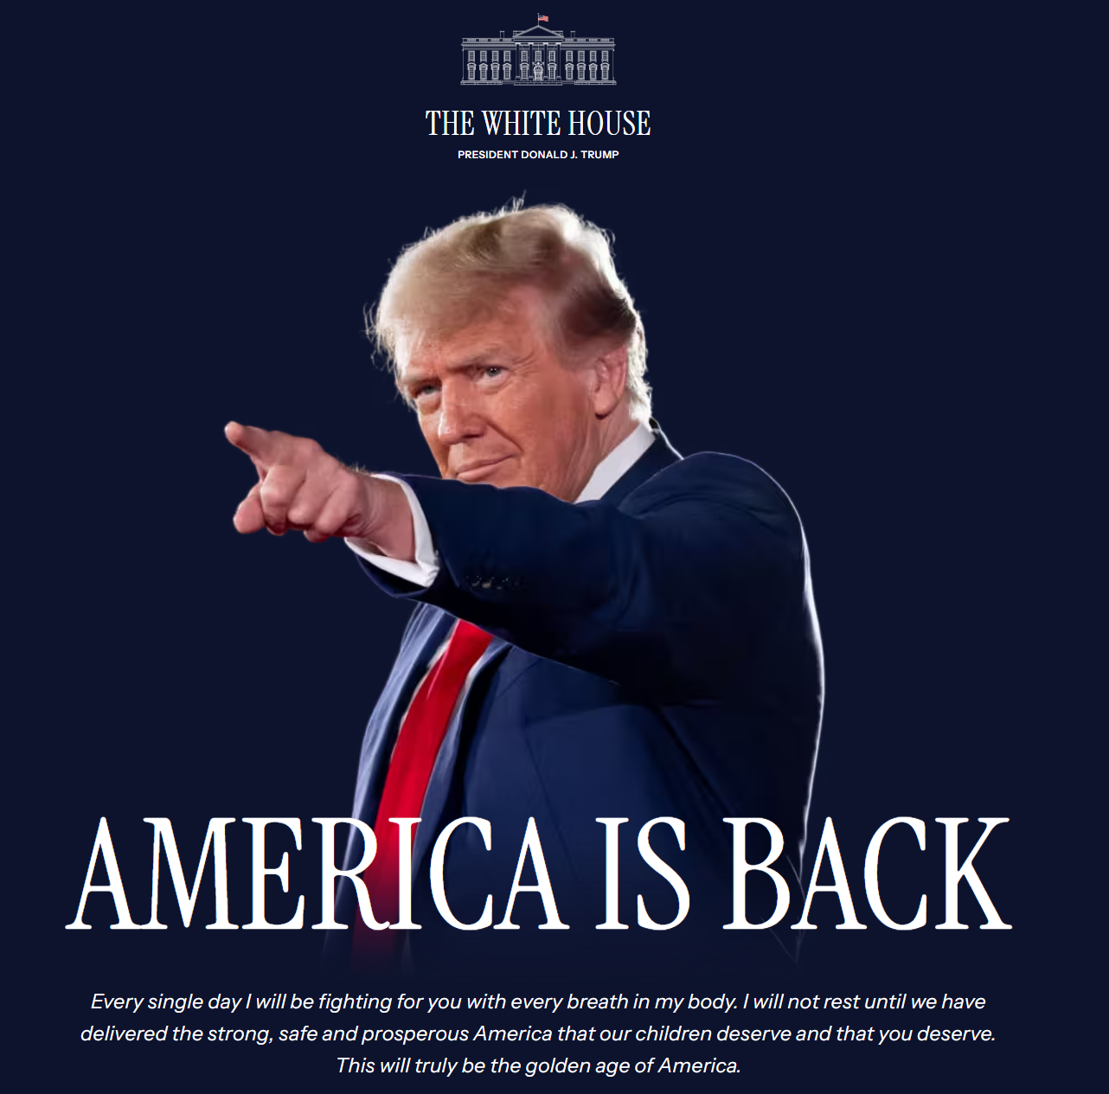
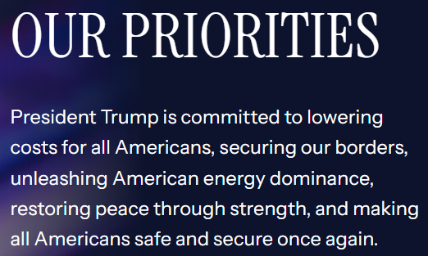
Trump’s Tariffs
Assessing Threats &
Anticipating Turbulence
“Losing all hope was freedom.”
– Fight Club
He that breaks a thing to find out what it is, has left the path of wisdom.”
— Gandalf
Photo Credit: The White House website
June 2025
Notes:
Thank you everyone for having me here. It is an honor and great pleasure for me to be here.
I will start with an apology. Sorry for putting Donald Trump’s picture up here.
Some of you may not like to see him. One CFO I met last month on my road trip in North Asia told me,
I really don’t want to see his face after he caused the company so much losses.
Some of you leaders in your own region and area, seated here may feel the same way.
So let us move to the next slide, we can move on from his face but I have to still talk about Donald trump and what is coming because we have to assess the threats that we are facing and prepare for the turbulence.

Slide 2
Trump 2.0 Tariffs - Threats & Turmoil
Tariff Shock & Psyche
- Relief, Not Resolution
- Complex Reciprocity
Disruption Or Deal?
- What does the US want?
- Who's most at risk?
Beyond Trade: Bringing a Trade Knife to a Geo-Economic Gun Fight
- The Security Angle
- Baby (Exorbitant Privilege) Not Bathwater (Shared Burden)
Market Outcomes*
- USD: Exaggerated Risks
- Confounding Correlations
- CNH Taking Cover
- AXJ Assuming Structural Vulnerabilities
Tariff Shock & Psyche
Disruption or Deal?
Beyond Trade
Market Outcomes
Notes:
For today, I will give a broad general overview of our stance on tariffs and the USD.
For the first three parts, we will give brief touches and the main focus is on part four will be on recent market movements.
We will go through the tariff shock so far and state that it is merely relief rather than rather than resolution
Resolution is difficult become of how complex the concept of reciprocity.
Discuss briefly on what does the US want to do, do they really want a deal?
Then we will move on to look at why this situation is really beyond trade and because the situation is beyond trade
We see that there are some fragmentation risks for the world.
The main focus of today’s will be on the market outcomes.
I will share our USD view and also the exaggerated risks surrounding the USD.
We will also touch on some Asian currencies because I do know that all of you who are based around the ASEAN region.
We will also have time for some Q and A because I will inevitably miss out some of the topic you guys are interested in.

Slide 3


False Dichotomies & Persistent Threats – Disturbance, Disruptions & Departures
The (False) Deal Dichotomy: Trump has global economies fixated on striking a deal, in desperate hopes of averting US trade tariffs. So, “deal” or “no deal” has become the misguided dichotomy of risk sentiments. This is but a tragic distraction from the inevitability of geoeconomic turbulence ahead. The deals are meant to divide, disorientate and fragment. Not provide a resolution for a resumption of global commerce as the world knew it. In which case, industries will invariably be adversely impacted. Supply chains will be disrupted. Margins will be battered. And financial markets will be forced to re-price risks. Dealing with (US-China Geoeconomic) War: Whereas the “real deal” is that the (US-China geoeconomic) war will remain unresolved, with the negative spill-overs likely to overwhelm any trade deal relief. Point being, the US deems; unilateral redefinition of the global order as the only means for the US to secure the upper hand against China and; dire economic, geo-political and environmental consequences merely the necessary cost of ensuring US supremacy. Crucially, this cost (economic or geopolitical) will be imposed on the rest of the world. Geo-economic shocks of this order inevitably trigger; major disturbance in the flow, allocation and cost of capital; Involving disruptions in global trade/industry and; Consequent departures from known geopolitical, economic & market dynamics and associated correlations.
H2 2025
H1 2026
FX: Brace for Shocks: Elevated uncertainty entails greater two-way volatility hinging on a cascade of acute headline risks. Non-linearity of FX dynamic and rapid shifts in correlations accentuate vulnerabilities and amplify pain if markets are caught wrong-footed. Moreover, a dynamic re-ordering of haven asset allure that stress-tested USD and USTs enlarges the threat of abrupt inflections/“level shocks”. What’s more, mounting JPY tensions from evolving BoJ-haven-trade dynamics and sharp CNH trade-offs (conflicting trade and geopolitical objectives) may spillover as latent AXJ shocks. Softer, But Steeper Rates: Softer front-end rates are underpinned by growing dovish bets, edging out “higher for longer” narrative at the margin as overriding adverse demand shocks from tariffs are more widely conceded. In addition, significantly and structurally higher term premium, reflecting the new geo-economic realities, is also par for the course. But that said, sharp lurches in US fiscal-tariff balance is likely to accentuate two-way, long-end volatility. In Asia, more pronounced term and risk premia, from inherited UST dynamics rubbing off and inflicted US risks rubbing the wrong way.
“Without pain, without sacrifice, we would have nothing.”
– Fight Club
Notes:
These days one of the favorite questions of our clients is do you think there will be a deal?
The deadline, by the way, is <30 days for every country in the world except China because China’s 90 days only started last month.
So there is actually not much time to make deal anyway.
The more worrisome issue in our view is that this dichotomy of a deal or no deal is simply a tragic distraction because
it seems that the deal themselves are mean to divide, disorientate and fragment.
Any deal which the US makes with any country will definitely not represent an all clear for a return to the global trade situation in 2024.
Global commerce will be permanently disrupted even if there is a deal.
In any case, the baseline now for most people is that Country-level tariff rates with most of the United States’ other trading partners remain at 10 per cent.
Anyone based in Australia here, this was even assumed inside the RBA’s baseline last month.
The point here is that even central banks which keeps repeating on and on about uncertainty have now even the confidence to admit and say guys, we need to put in 10%.
And from my business trips to clients, a lot of them are at least factoring in a 10% tariff rate to the US depending on what industries they are in.
In our view, this is merely being realistic as the world finds ways to deal with US-China Geo-economic war.
Our view is that the administration in the US right now see unilateral redefinition of the global order as the only means for the US to secure the upper hand against China
Dire economic, geo-political and environmental consequences are merely the necessary cost of ensuring US supremacy.
As a result, we see three things,
Disturbance in the flow of capital globally
Disruptions in global trade
Departure from well know economic and market correlations.
With that, Our FX outlook which is our USD view is that we should brace for shocks.
To be clear, we anticipate a softer USD by mid 2026 and to be clear this means that we expected the DXY the Dollar Index to hover around 94-98 in mid-2026.
The problem here is that this will continue to be a volatile path just like the rollarcoaster on my slide and the picture was deliberately skewed.
This will be a non-linear path as we expect the USD to display possible bouts of recovery?
You must be thinking where is this recovery from?
We see three main sources of risks that will provide some impetuous for USD recovery:
First, is the risk of shifting correlations, what we used to know about correlations with the USD has broken down, but history tells us that this is unlikely to be a permanent break.
Second, JPY dynamics are evolving due to BoJ policy interacting with tariff worries also imply that USD weakness is not a given.
Third, CNH risks due to conflicting trade and geo-political objectives may also weaken AxJ FX.
I will touch about all three factors in detail later so just bear with me.

Slide 4
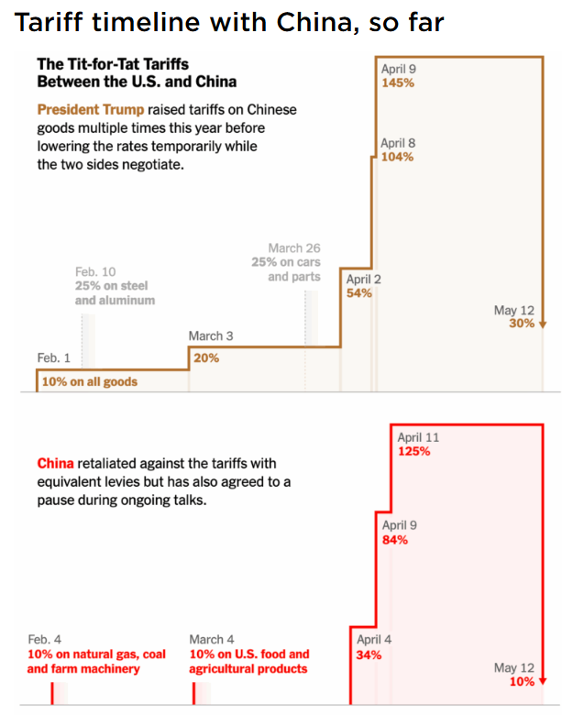
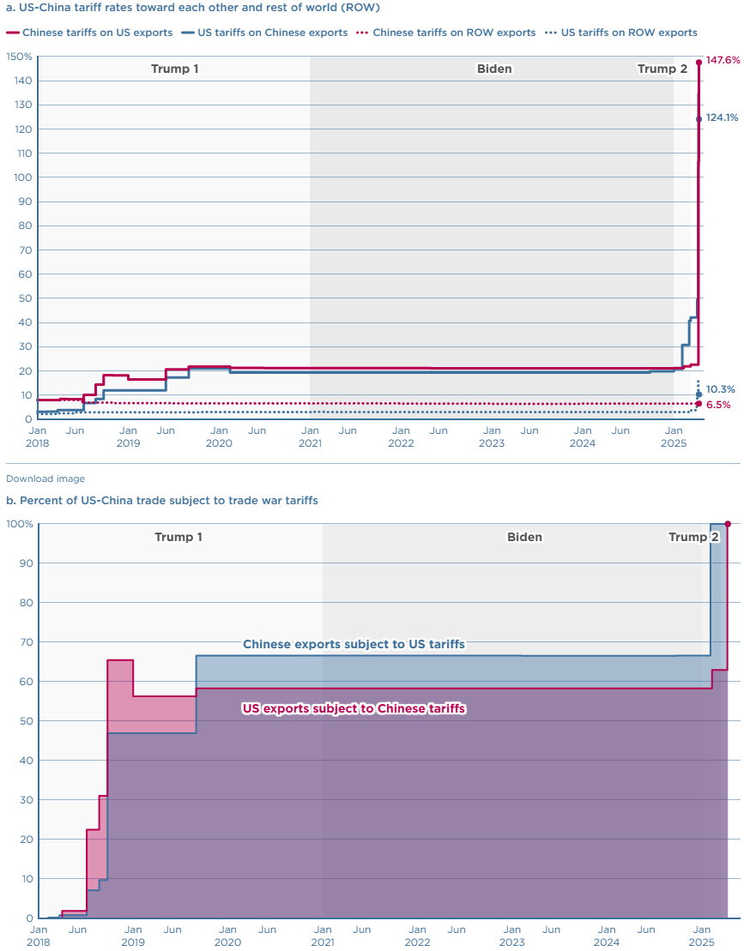
1. Tariff: Underlying Turbulence, Not Lasting Truce
“Great, kid, don’t get cocky.”
—Han Solo, Star Wars: A New Hope
Tariff Shock & Psyche
Disruption or Deal?
Beyond Trade
Market Outcomes
Notes:
This slide is simply mean to show the disturbance to global trade that I mentioned.
Tariffs are now higher than before even after the truce, and there is no certainty that it will not go higher.
Furthermore, it is not just the level of tariff that is higher.
The breath of good which tariffs are applied to are also much broader.

Slide 5
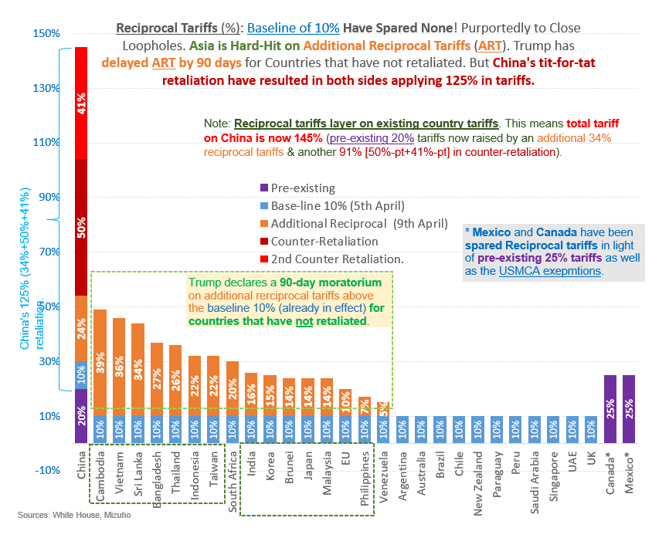
1. Tariffs: US-China Reprieve, Not Resolution
“Great warrior. Wars not make one great.”
– Master Yoda, Star Wars
Reciprocal tariffs with a baseline (minimum for any country) of 10%.
Elevated uncertainty amid threats of escalation threaten global demand.
Opaque & Misguided reciprocal tariffs complicate path to dial back.
Asia hard-hit. Notably, ASEAN as “China + 1” hedge is challenged.
AXJ Pressures: AXJ pressures may persist despite softer USD, as demand shock, China spillover & FDI holdback flag disproportionate pain.
US-China Temporary Relief: While it is encouraging that US & China have agreed to de-escalate (by 125%-pts), it is premature to declare a resolution. Negotiations are set to be tough. Both sides subject to miscalculations. US’ overestimation of leverage is worrying.
Tariff Shock & Psyche
Disruption or Deal?
Beyond Trade
Market Outcomes
Notes:
Similarly, this chart shows a 10% baseline for all countries, and most countries here except (….)
Have no deals at all with the US.
De-escalation of US-China trade war is really just temporary relief especially if I view it from the actual economic situation on the ground.
Demand shock in our region, china spillover and restrain investment spending will hurt.
Companies find it hard to decide where should they invest in because no one is too sure about which countries will get a deal.

Slide 6
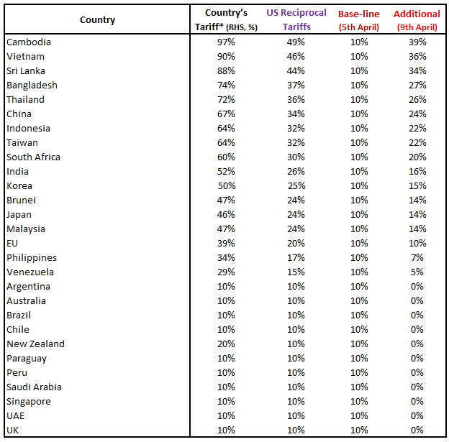
1. “Reciprocal” Ideology Complex by Nature
“In a dark place we find ourselves, and a little more knowledge lights our way.”
– Master Yoda, Star Wars
Reciprocal
Tariff Imbalance
VAT
FX Polices
Non-Tariff Barriers
Tariff Shock & Psyche
Disruption or Deal?
Beyond Trade
Market Outcomes
Notes:
The difficulty in getting a deal is reflected here. These are the various aspects which all the countries are negotiating on.
Solving tariff imbalance, addressing non-tariffs barrier, VAT and FX policies.
I think Value Added Taxes might stand out to some of you here.
Why is the US concerned about value added taxes?
Here it is important that the US at the negotiating table points out that in the US there is no VAT and so any goods which is imported is not subject to VAT but us goods imported by the rest of the world has VAT.
Here, no matter if you think it is ridiculous or not, these factors make negotiations tough and very complex.

Slide 7
1. Obfuscated/Obstructed by a Plethora of Hard-to-Quantify Considerations
Non-Tariff Barriers
Imports Policies
Environmental Barriers
Other Barriers
Sanitary/Phyto-sanitary Measures
Labour Barriers
Technical Barriers to Trade
Government Procurement
IP Protection
Services Barriers
E-Commerce Barriers
Investment Barriers
Subsidies
Anti-Competitive Practices
State-Owned Enterprises
Tariff Shock & Psyche
Disruption or Deal?
Beyond Trade
Market Outcomes
“Never tell me the odds”
– Han Solo, Star Wars
Notes:
Complexity is also even more entrenched if we take a look at non-tariff barriers.
Everyone here knows that there are investment related rule in each of your countries ranging from Vietnam to Indonesia.
Even culture specific restrictions are target such as halal meat requirements.
Clearly, address all these are much harder than lower tariffs on US goods.

Slide 8
2. The Impossible Trinity of Trump Tariffs
“How puzzling all these changes are! I'm never sure what I'm going to be, from one minute to another.”
– Alice’s Adventures in Wonderland
Fiscal Revenues
Geo-political Leverage
Trade-Industrial Rebalancing
Broad-based
Certainty
Tariffs
Targeted/Strategic
Dispensability
Nuanced &
Calculated
Sweeping & Unfazed
One (Tariff) Tool, Many Objectives Apart from the obvious motivation to force trade/industrial re-balancing and supply-chain relocation (to the US), tariffs also pursue geopolitical leverage and to raise fiscal revenues.
Conflicting Objectives: Conflict in objectives. Fiscal revenues argue for steady, wide and steep tariffs. Leverage prioritizes non-trade deal-making (that entails rescinding on tariffs) and trade rebalancing requires strategic nuance.
Conflicting Objectives: Acute tariff uncertainty results from the one tariff tool is being exploited for multiple objectives. , undermines a path to quick resolution.
Tariff Shock & Psyche
Disruption or Deal?
Beyond Trade
Market Outcomes
Notes:
The next question to answer is what is the US trying to achieve with tariffs?
Do they really want a deal? Or perhaps they are not looking for a deal, they want the money from tariffs to improve fiscal revenues.
We use this triangle to have a concise way of looking at tariffs. There are three big objectives of tariffs: fiscal revenue, Trade Re-balancing and geo-political leverage.
On the very top in green is fiscal revenue, when tariffs are broad based, apply to all applied to all countries, the intention will lean towards collecting revenues.
The targeted sector ones which range from autos to solar panels are aimed at industrial rebalancing.
We can see that the auto tariffs tend to be more calculated and nuanced with the made in American proportion of the car not being subjected to tariffs.
On the RHS, the dispensable part of tariff is used for geopolitical leverage in negotiations.
The 10% baseline which looks very certain is used to collect revenue but the reciprocal part such as 46% tariffs on Vietnam is used for bilateral negotiations.
They are somewhat dispensable, Donald Trump can remove them once the objective is achieved.

Slide 9
2. & the Asymmetric Inclinations Tilted Against China+
“Named must your fear be before banish it you can.”
– Master Yoda, Star Wars
Fiscal Revenues
Geo-political Leverage
Trade-Industrial Rebalancing
Sector-Based
Tariffs
China +
Europe
MCA
Heightened Tariff Uncertainty: Inherent conflict entailed in the three objectives heighten tariff-related uncertainty.
Recognizing Differentiated Tariff Risks: Crucially, a more pronounced country/bloc-specific emphasis.
Trade/Industrial Rebalancing Bent for China-Asia: Conceivably, a more emphatic Trade-Industrial Rebalancing bent of stickier tariffs may apply for China, spilling over into Asia, given the geo-economic rivalry.
Leverage Bias for North American: In contrast, supply-chain dependencies may dictate a greater degree of leverage angle on North American tariffs, which may be primed for dial-back.
China Complex-North American Divergence: As a result of which, a more prominent divergence in the tariff threats/resolution between China-Asia complex and North America may emerge.
Tariff Shock & Psyche
Disruption or Deal?
Beyond Trade
Market Outcomes
Notes:
From a geo-political perspective, there is an obvious inclination targeting China and Asia while Canada and Mexico leans more towards some mild extraction of better trade terms.
The main point to highlight here is there is a potential for trade/investment divergence between China-Asia complex and North America as a region.

Slide 10
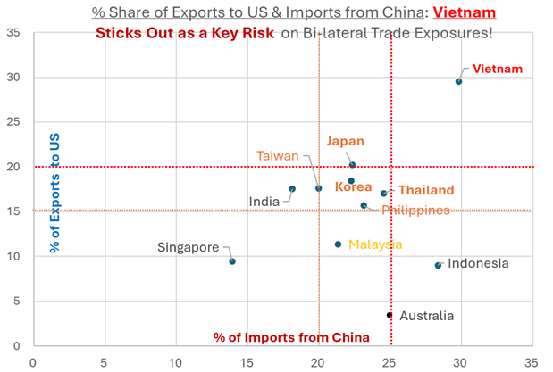
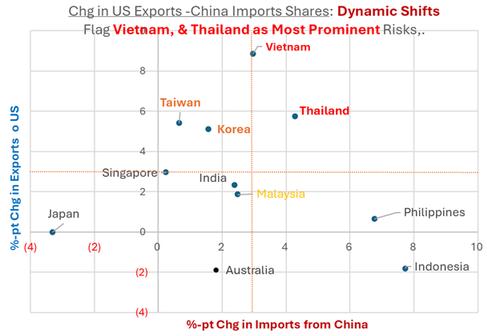
2. Tariff Risks: China-Linked Risks Elsewhere Not Eradicated
ASEAN Risk Determination
Enabler of China
Substitute for China
Trade Risks Escalate
Trade Risks Subside
Tariff Shock & Psyche
Disruption or Deal?
Beyond Trade
Market Outcomes
“The probability lies in that direction.”
– Sherlock Holmes
Notes:
As China becomes targeted, the question is who within ASEAN is at risk?
Vietnam sticks out. The lhs chart shows each countries % of your exports to US and % of imports that is from China.
Vietnam imports a lot from China and exports a lot to the US.
We also want to know which country in ASEAN is increasingly facilitating the US-China supply chain. The RHS is the change in exports to the US and change in imports from China since pre-pandemic times. Thailand is notable as it has increased exports to the US and also increase imports from China.
The big picture to determine risk is to ask if the country is an enabler of China or a possible substitute for China.

Slide 11
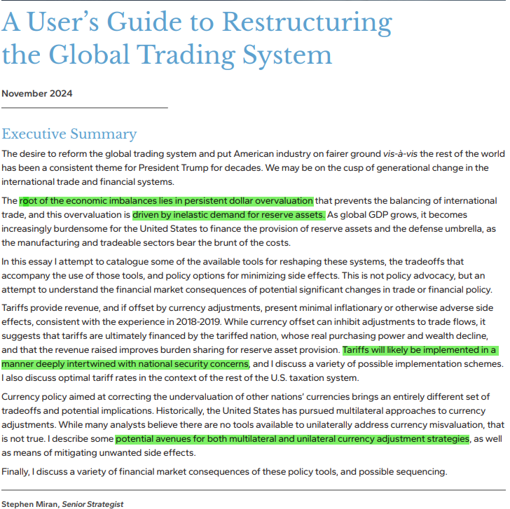

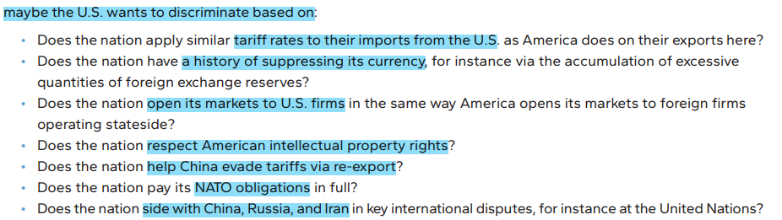
3. Miran & (so-called) Mar-a-Lago Accord
“When you look at the dark side, careful you must be, for the dark side looks back.”
– Master Yoda, Star Wars
ASEAN Risk Determination
Enabler of China
Substitute for China
Tariff Shock & Psyche
Disruption or Deal?
Beyond Trade
Market Outcomes
Miran’s paper [638199_A_Users_Guide_to_Restructuring_the_Global_Trading_System.pdf]
Notes:
So things are really not just about tariffs and it become clearer from Stephen Miran’s paper
On slide 11 and 12 are just content extracted from Stephen Miran’s paper. Sephen Miran is the white house council of economic advisor chairman.
On the RHS, We can see that the geo-political focus on China is on whether trading partners are being enabler of China?
Does the country help china evade tariffs?
The geo-economic bottom line here is that the US wants to secure the upperhand against the China and will employ all means to achieve it.
The FX emphasis in this report is that the US is using tariffs to correct economic imbalance and they have a desire to correct what they think is an over-valued USD,
Here is his train of thought.
The USD is overvalued because it is a reserve currency and UST is a reserve asset.
And because of the USD being overvalued, he says that America’s trade suffers, America’s Manufacturing suffers, so let’s implement tariffs.
Tariffs can provide revenue.

Slide 12
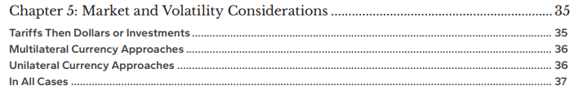
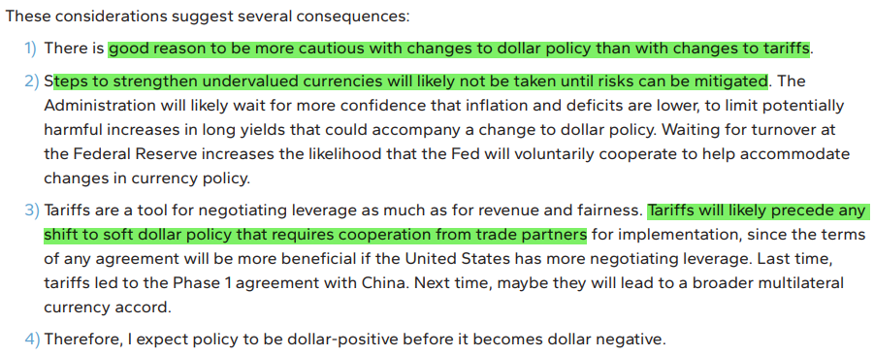
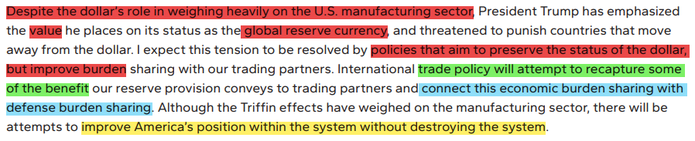
3. Miran & (so-called) Mar-a-Lago Accord ➔ Evolving Risks
Powell: End of term May 2026
Tariff Shock & Psyche
Disruption or Deal?
Beyond Trade
Market Outcomes
Notes:
What markets are fretting is certainly not just tariffs. They fear what comes after tariffs.
In his report, it is clearly labelled tariffs then investments or Dollars. Clearly, risks are evolving.
Tariffs are a tool for negotiation before moving to achieve a softer USD.
Why don’t they aim for a weaker USD at the start?
They want to wait for inflation in the US to be low and the fiscal deficit to be lower.
They want any increase in UST yields due to USD policy to be mitigated.
In short, the current administration desires lower IR.
In fact we want to point out the risk that they explicitly stated that they can wait for turnover at the Federal Reserve to help accommodate changes in currency policy.
One point you might want to put into your calendar is that Powell’s term is Chairman ends in May 2026. 1 year from now.
Markets are now very wary of potential policy to soften the dollar, it can be explicit policy or implicit bilateral agreement which we may never know because there can be Non-disclosure agreement clauses.
So markets have sold off the USD in a big way.

Slide 13
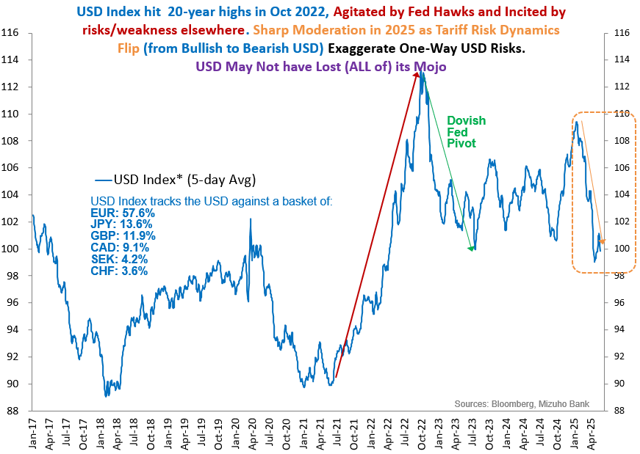
4. USD: Demise (De-Dollarization) Exaggerated?
“Reports of my death are greatly exaggerated.”
– Mark Twain
USD: Doubt, Not Demise
USD’s exceptional plunge mainly reflects abrupt & upfront macro doubts on tariff shocks.
Not an imminent demise of USD’s reserve currency status that portends a collapse.
Stretched bullish USD positioning earlier had exaggerated the intensity of USD bearishness.
More so given aggressively front-loaded, tariff blowback shocks (detrimental to USD) accentuated by overturned haven allure.
But it’s misguided to project a linear USD depreciation based off current pace of travel.
  Measured DXY Declines: Instead, a measured USD level shock shifting near-term equilibrium lower (~96-98 DXY center-of-gravity) is more likely.
  Lagged, Phased, Incomplete CNH Gains: Lagged, phased and incomplete CNH catch-up corresponding to USD declines is likely as US-China “deal” emerges.
  Exploiting Convenient Policy Buffer: But for now, expect the PBoC to exploit cover of a weak USD to derive relief via considerably weaker trade-weighted CNH amid trade headwinds.
  Relative CNH & AXJ Underperformance: In other words, CNH is set to continue under-performing most Major FX amid a softer USD. And AXJ are likely to follow suit as trade bugbear impacts Asia disproportionately.
Tariff Shock & Psyche
Disruption or Deal?
Beyond Trade
Market Outcomes
Notes:
Amid so much uncertainty, we move onto the main focus for most of you. The USD.
A lot of talk has been about how the USD is losing its reserve currency ratio. We think not.
A lot of the plunge reflects the markets factoring in macroeconomic concerns about the tariff impact on the US.
Take a look at the DXY, the USD Index, it is now at 99-100, this is even higher than 2019 levels. If in 2019, some of tells you the USD is no longer the reserve currency, you will think that the economist does not know what he is talking about.
Similarly, at this point, we acknowledge that the USD has suffered a sharp declined.
But we want to say it the decline is from exceptional starting points, at the start of the year the USD/JPY was at 160 EUR reaching parity.
The weak starting point of these major currencies accentuated the USD depreciation.
Our outlook does acknowledge a weaker dollar but not a measured one, the USD index equilibrium shifting to 96-98 as its center of gravity in mid-2026
More importantly, we want to say it is a non-linear path and our forecast reflect this by signaling potential for USD appreciation.
For Asia, we think that should details of a concrete deal between the US and China begin to appear, there is room for the CNH to catch up with some gains.
More importantly, the catchup is unlikely to be a full complete one, because trade tensions will persist and any deal is unlikely to reverse the situation back to 2024 levels. Our lessons from Trump 1.0 tells us so.
Accordingly, as CNH is likely to underperform the appreciation path ahead for EM-Asia is also limited even amid a weaker USD.

Slide 14
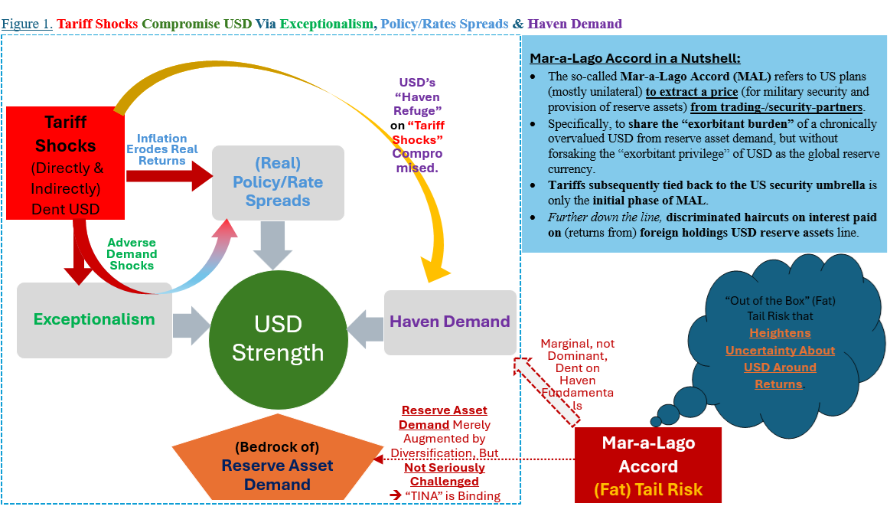
4. USD’s “Trump Trade” Reversals Confuse Correlations
“I find your lack of faith disturbing.”
- Darth Vader, Star Wars: A New Hope
Tariff Shock & Psyche
Disruption or Deal?
Beyond Trade
Market Outcomes
Notes:
Here is a diagrammatic representation of how tariff shocks affected the USD. The dynamics behind how this works will also feature into possibility of USD appreciation.
First of all, tariff shocks dent the USD because it imparts an adverse demand shock on the USD and as such USD weakens.
In the first place, USD was strong because it kept running at above trend growth for the last few years.
Second. Tariff contains an inflation threat and markets fear that it will imply that real policy spread will be eroded, the higher the inflation the lower the real return.
Tariffs also overturn the usual correlation that says the USD is a haven currency, usually when there is uncertainty or geopolitical conflicts, the USD strengthens.
However, tariffs have over-turned that correlation, USD weakens during risk off these few months. My next slide has more on this.
Lastly, this is the tail risk that hogs headlines is that USD is weaker because of the Mar-A-Lago accord in which the US wants trading partners to strengthen their currency.
However, if we give a serious thought about this, this is a case of marginal diversification and not wholesale abandoning of USTs. Portfolio managers and reserve managers of global central banks tweaking ratios of their portfolios and certainly not moving away on a massive scale. There is simply no alternative, are we going to hedge everything on non-interest bearing asset such as gold or volatility cryptocurrency? This is why we only have a moderate shift in the USD index lower.

Slide 15
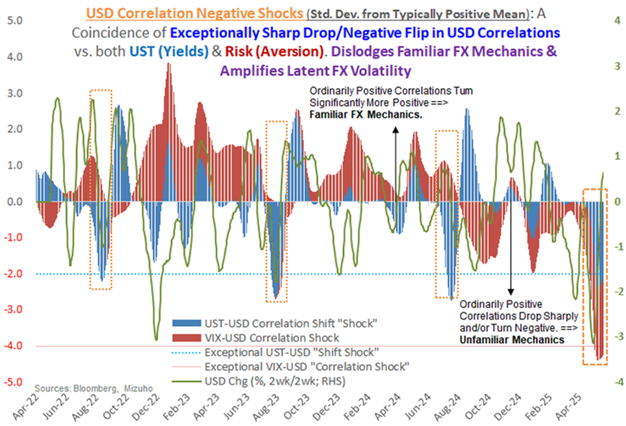
4. USD’s “Trump Trade” Reversals Confuse Correlations
“I'm afraid I can't explain myself, sir. Because I am not myself, you see?”
– Alice in Wonderland
Exceptional departures from well-established USD correlation dynamics warn of elevated unpredictability that has become inconspicuously embedded in FX markets.
Specifically, exceptional in the momentum and degree of correlation shifts. That reveal extraordinarily stretched standard deviations in USD correlations.
Specifically, magnitude and coincidence of excessive (>2 standard deviation) decline in both change in UST-USD correlation and VIX-USD correlation.
implications are that; 1)USD has decoupled, and unpredictably so, from (UST) yield-driven moves; 2)USD’s haven allure has weakened dramatically, arresting received wisdom about buying USD (vis-à-vis EM FX) into “risk off” triggers.
Greenback may be less reliably predicted by both rates (long-end UST yields) and risk. Resulting unfamiliarity of FX mechanics inevitably elevates unpredictability in FX markets.
This in turn sets the stage for outbursts of latent (currently subdued) volatility.
Notably, what’s at risk is the remarkable (and unexpected) stability of AXJ through turbulent tariff headlines in the cover of a bearish USD dissociated from haven allure and higher UST yields.
Hence, risks of sharp downside volatility in AXJ cannot be dismissed prematurely. Neither on complacency about resilience thus far (which is distorted by correlation departures), nor on account of US-China tariff relief that falls woefully short of a durable resolution.
Tariff Shock & Psyche
Disruption or Deal?
Beyond Trade
Market Outcomes
Notes:
- Even then, we warn that USD upside volatility is ever present, just now I mentioned that tariffs overturn correlation that USD appreciates during times of uncertainty.
Two type of correlation are displayed here, one is VIX-USD. When there is fear, VIX index rises and the dollar tends to rise, this is the red bar.
Now the red bars are flipped, when the VIX increases, the USD falls, and this shock is more than two STD DEV.
The second correlation that is overturned is the one which says that the higher the UST yields, the stronger the USD. The blue bars are also negative.
There is a large shock to two type of conventional correlations which means the unpredictability is extremely high.
Why is that so? At any time, either one or both of these correlations can be flipped back and we have seen them revert back as well when you look at the chart here..
That is why we think that the remarkable stability of AxJ currency can be at risks despite the soft dollar backdrop.

Slide 16
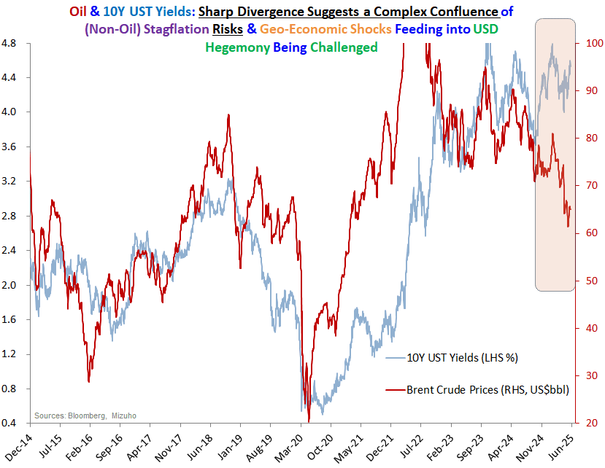
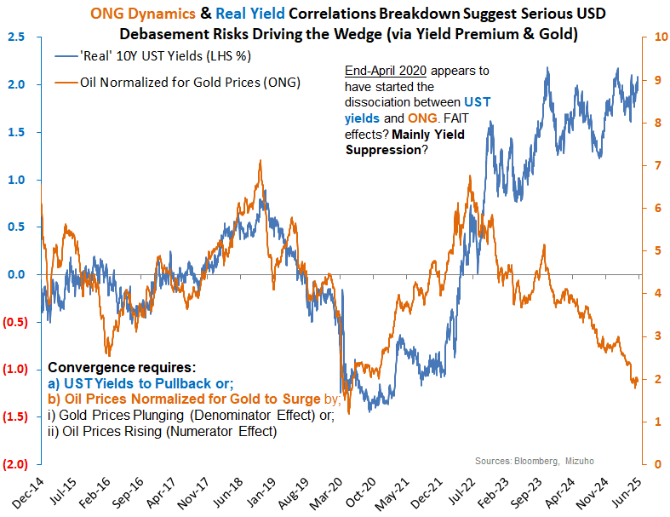
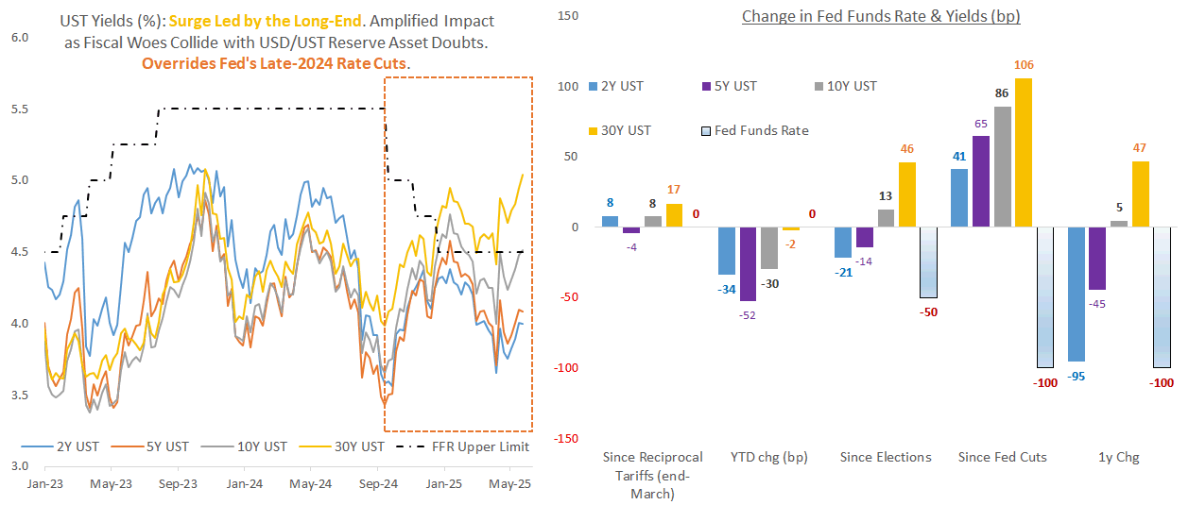
4. UST Yield-Oil/Fed Departure on Debasement Risks?
“To a dark place this line of thought will carry us. Hmm. Great care we must take.” – Master Yoda, Star Wars
Tariff Shock & Psyche
Disruption or Deal?
Beyond Trade
Market Outcomes
Notes:
Now we have established that UST yields are higher but the dollar is soft. We will now go deeper in the different drivers behind the elevated UST yields.
First reason is the obvious one on my bottom right chart, long end yields are higher because of fiscal worries, worries about Trump’s big beautiful bill
30Y and 10Y US treasuries have obviously spiked up a lot and this is also because of what we mentioned earlier,
that in the Stephen Miran paper, there were suggestions to swap existing US debt with ULTRA long ones which is 100Y bonds.
Aside from this, we tend to look at oil prices, oil prices tend to be quite correlated with 10Y yields but we see that there is an obvious divergence which suggest that there is non-oil stagflation risks and geo-economic shocks that challenges the desirability of longer end USTs.
These are more structural factors. One other factor we sense is that there is debasement risks.
Debasement simply refers to the increase in money supply or some people typically call it the Fed printing money and that reduces the purchasing power of the currency.
As such, price of gold has risen despite rising real yield. Usually gold prices decline when real yield rise.
even as we acknowledge the weak USD, we want to point out the weak dollar overstates the AXJ resilience.

Slide 17
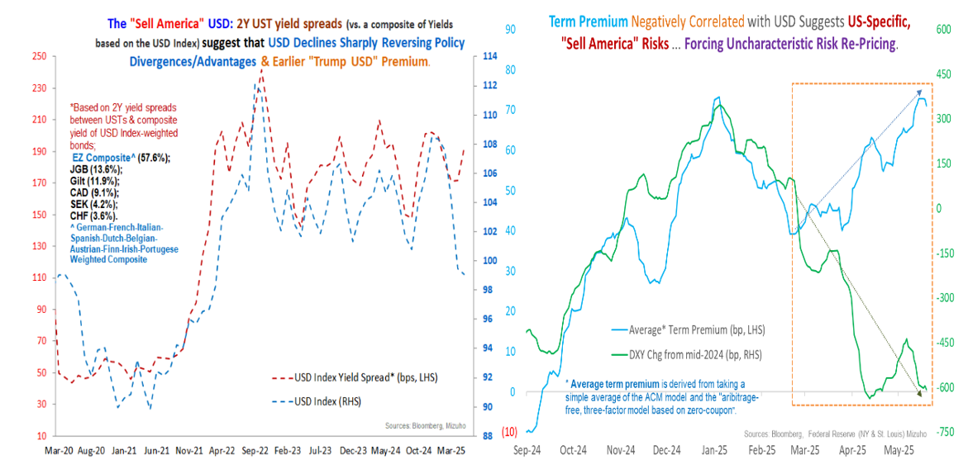
4. Sell America and Risk Term Premum?
“To a dark place this line of thought will carry us. Hmm. Great care we must take.” – Master Yoda, Star Wars
The implications are:
i) Bets on entrenched USD bearishness may be overdone.
ii) USD is likely set to resume positive response to UST yields/spreads on sufficient risk-pricing.
iii) Interim pent-up volatility and potential USD-led inflections in FX markets are par for the course
iv) Higher UST term premium could spill-over to later compromise higher-yielding AXJ with fiscal/trade vulnerabilities.
Tariff Shock & Psyche
Disruption or Deal?
Beyond Trade
Market Outcomes
Notes:
The upshot is that it is premature, if not misguided, to assume that the breakdown in USD-UST yield/spread correlation is a permanent feature.
• Instead, the negative flip in USD-UST yield correlation arguably reflects a temporary recalibration process of risk re-pricing, even if it is abrupt and non-linear.
Instead, the evidence suggests term premium being re-priced considerably higher to account for US fiscal, trade, credit, and geoeconomic risks alongside some hedge against USD debasement.
The implications are:
i) Bets on entrenched USD bearishness may be overdone.
ii) USD is likely set to resume positive response to UST yields/spreads on sufficient risk-pricing.
iii) Interim pent-up volatility and potential USD-led inflections in FX markets are par for the course
iv) Higher UST term premium could spill-over to later compromise higher-yielding AXJ with fiscal/trade vulnerabilities.

Slide 18
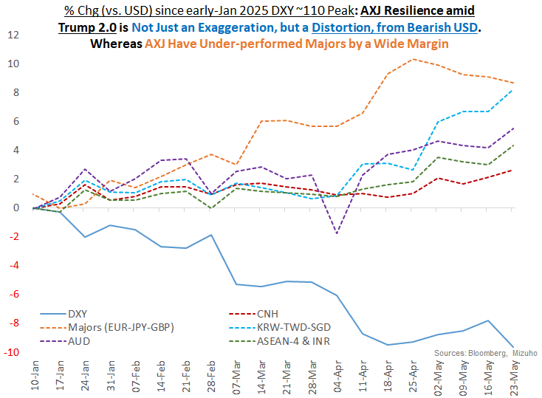
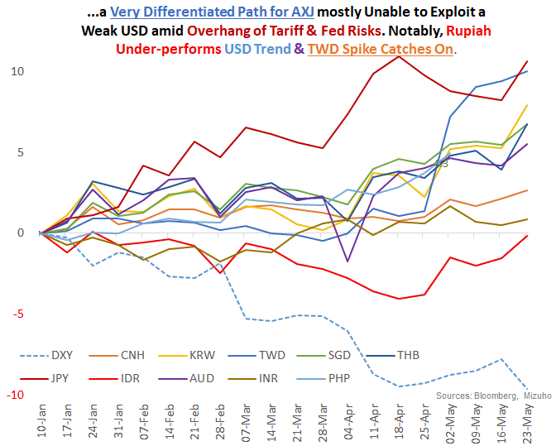
4. USD Bears – AXJ: Obfuscate & Overstate (Resilience)
"Your focus determines your reality." - Star Wars, Qui-Gon Jinn
Tariff Shock & Psyche
Disruption or Deal?
Beyond Trade
Market Outcomes
Notes:
Even as we acknowledge that the USD is weaker, the important emphasis for FX in Asia ex Japan is that the backdrop of DXY dropping more than 10% overstate resilience in Asia.
That is to say currencies in asia has largely underperformed majors this year. The ringgit has gained about 5% and the THB has gained about 4%.
INR, IDR and VND depreciated.
Outperformers aside from the JPY has been the TWD, but the TWD case is a mere catchup and was a result of a historic two day move.

Slide 19
Case Study: The TWD
Wrong-Footed Exposure
The sharp, historic (amplitude of) surge in TWD was reportedly amplified by;
Deliberate lapse in anticipated CBC intervention (at key) levels triggering a wave of (self-reinforcing) TWD buying;
magnified as under-hedged exporters and insurers (both constituting significant long-USD exposures) inadvertently caused a stampede into panicked hedges.
Historic, Not Necessarily Disproportionate
Admittedly, the historic proportions of the intensity/pace of TWD surge justifiably raises concerns about dislocations.
But what’s notable that in the grander scheme of things, TWD’s move is not disproportionate per se as it merely catches up with JPY moves.
Sympathetic TWD-JPY Dynamic
The TWD-JPY comparison, and expectations of convergent dynamics, is not too stretched given both the “flow” and “stock” similarities.
Flow (P&L): That is, Taiwan is a huge Current Account surplus country (with massive USD P&L exposed to FX volatility),
Stock (Balance Sheet): And like Japan, Taiwan is a huge net USD asset owner. Hence, USD exposures on the balance sheet are massive, and under conditions of heightened volatility in FX markets, can invoke massive FX reactions.
Compressed, Not “Continental Drift”
Admittedly, just how compressed this massive TWD catch-up is raises legitimate concerns about reflexivity - which definition warns of destabilising overshoot.
But it will be hasty to declare a tectonic and permanent shift in FX valuations resulting from sustained, significant, reserve asset/wealth reallocation out of USD assets.
Instead, this arguably reflects aggressive compensation for under- hedged exposures. Not a wholesale migration out of US assets to elsewhere. This is not “continental drift” across the Atlantic (or for that matter, Pacific).
Deal Over De-dollarization
The elephant in the room is the question of whether this is the beginning of a broader de-dollarization move by massive US asset owners - with Taiwan staging its asset reallocation for strategic reasons
We think not. Taiwan has very few good options. And while US security guarantees are eroded, and perhaps even ephemeral, it is still the best bet that Taiwan has.
Hence a dedollarization strategy by Taiwan is not conceivable as a viable position. Instead, allowing some TWD appreciation with further commitment to support US asset markets may be the least unfavourable concession (for a deal/US security umbrella).
Notes:
May the 2nd and May the 5th
So the TWD has been making the headline but what about the big guy, the RMB who is hiding steadily under the cover of a weak USD.

Slide 20
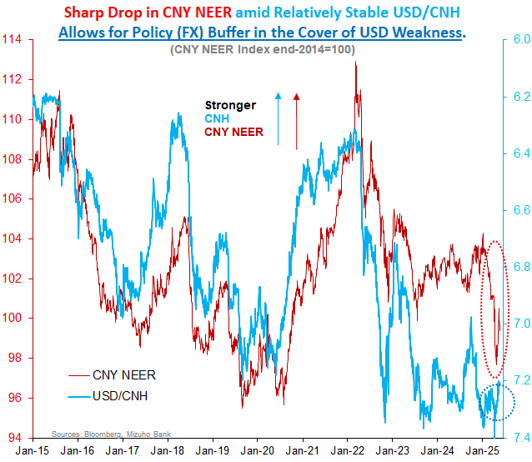
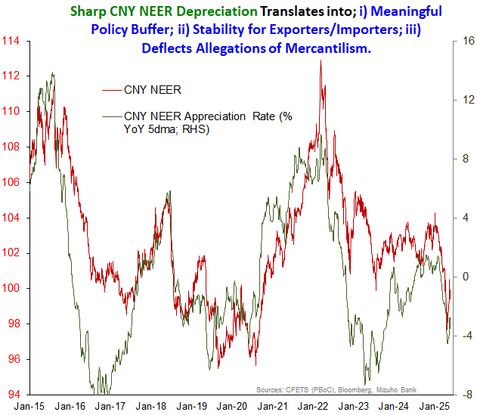
4. CNH Stability Trade-Offs (USD & NEER) Amid USD Cover
CNH stability (vs. USD) is an illusion enabled by a bearish USD wave, whereas the reality is sharp drop in effective (trade-weighted) CNH exchange rates.
Nonetheless, this is a useful “illusion”, providing the PBoC with sufficient geo-political cover, as a relatively softer USD helps deflect potential criticisms of mercantilist policies.
Not only does the PBoC enjoy FX policy buffer against acute trade turbulence, but it also offers stability for Chinese exporters/importers and builds FX reserves.
To be sure, this FX policy sweet spot courtesy of USD bears is likely to be fleeting.
Whereas what’s persistent are acute geo-economic risks, and attendant policy trade-offs, that feature in the new global order us being advanced.
Tariff Shock & Psyche
Disruption or Deal?
Beyond Trade
Market Outcomes
Notes:
The USD/CNH has drop to 7.2 levels and that provide the PBoC with a convenient cover to hide under as an appreciating RMB allows them to deflect any accusation that they are manipulating their currency to benefit their exports.
In reality though, if we look at the Nominal effective exchange rate, what we find is the reminbi has depreciated against its trading partners simply because it has gained less than its regional peers. As such, it is not only the stability of an exchange rate that assist Chinese exports, these levels help as well.
Looking ahead, our thoughts are that the policy sweet spot might be fleeting. There is still a substantial need for the PBoC to support the economy and with lower rates, the RMB gets a weaker backstop.
We are also yet to see any clear geo-economic risk that is appearing in China. When the RMB turns volatile, AxJ FX will be in the crosshairs.

Slide 21
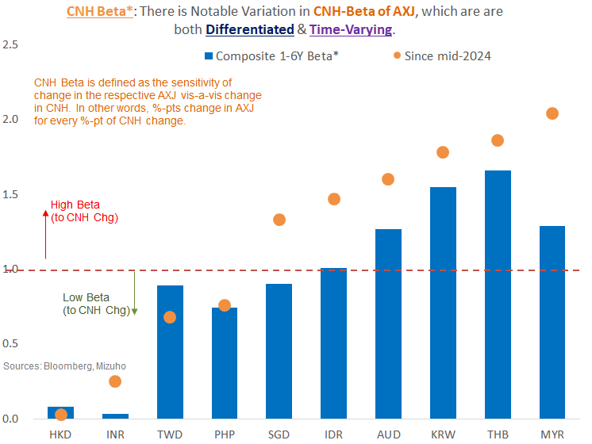
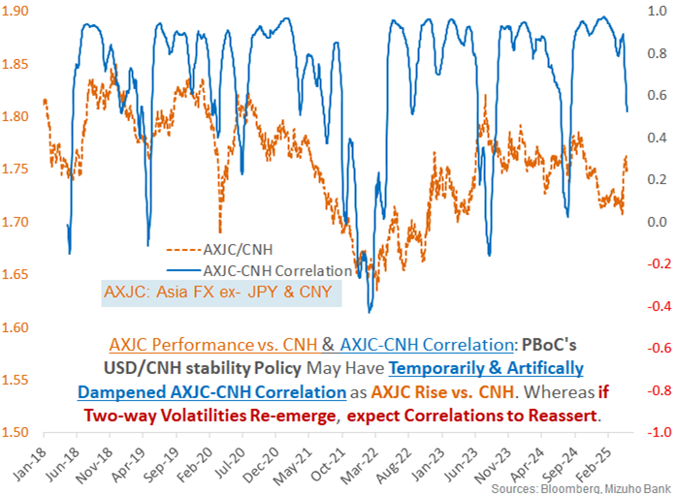
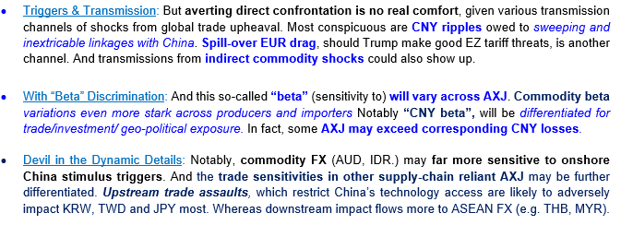
4. FX - CNH Beta: Expect AXJ Volatilities to be Heightened & Fluid
Tariff Shock & Psyche
Disruption or Deal?
Beyond Trade
Market Outcomes
Notes:
The CNH movements are certainly a key driver of AxJ currencies. So we have to take a look at the CNH beta which is the sensitivity of AxJ currencies to a change in CNH>
Here we can see that when the beta can be >1, which is to say that if the CNH depreciate by 1% these currencies can lose more than 1%.
Sensitivities are different across the different currencies.
For commodity currencies such as the AUD and IDR, they are more sensitive to onshore mainland China developments relative to trade developments.
Even for trade related shocks, the type of technology restriction trying to curb China access to tech will hurt the KRW and TWD more while more broad based trade shocks tend to be more downstream and affect the MYR as China is Malaysia’s largest export market.

Slide 22
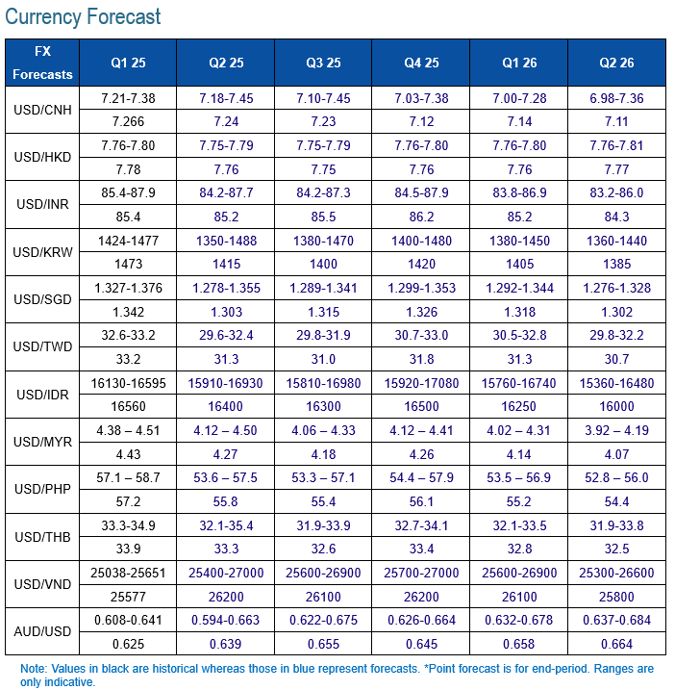
AXJ Risks & Outlook
(Tariff) Disturbance & Disruption: Trump’s understatement about “a little disturbance” from tariffs is self-serving. But equally, an unintended (albeit admission of economic self-harm from indiscriminate, sweeping tariffs. But as it turns out, “a little disturbance” entailed nerve-wrecking disruption bordering on dislocations.
Manic Depressive (FX) Markets: Wild swings in AXJ alongside wider risk asset as markets lurched from acute fears of economic crash (from global trade shocks) to exuberant relief on suspended tariff step-up accompanied by the prospects for a deal to avert the worst.
False Dichotomies: Trouble is, with the extreme fears of outsized tariffs, false dichotomies, which amplify volatility, without effectively ameliorating the underlying risks, have been adopted. Misguided focus on “deal” or “no deal” that is falsely conflated with “risk on”/relief and “risk off”/fear’s amplify headline risks and associated swings in sentiments, risk assets and FX (AXJ).
Flawed Risk Gauges: Whereas, complex and inextricably linked supply-chains, especially within Asia, suggest that bilateral deals with US may only offer superficial relief. Whereas resolution for Trump 2.0 tariffs may be far more fraught. Accordingly, the “risk on”/“risk off” reflexes are liable to be flawed.
Dollar-Risk Departure: What doesn’t help is that there has been a departure from the usual “left-half USD Smile” (haven allure of USD) dynamics, which stipulates USD gains during episodes of “risk off”. But in sharp contrast, Trump 2.0 tariffs assaults have, counter-intuitively, triggered a broad-based USD sell-off since March, overwhelming early(-Q1) AXJ pressures (amid USD strength) from trade uncertainties.
Notes:
And with that.. .

Slide 23
Disclaimer
Important Information
This publication has been prepared by Mizuho Bank, Ltd. (“Mizuho”) and represents the views of the author. It has not been prepared by an independent research department and it has not been prepared in accordance with legal requirements in any country or jurisdiction designed to promote the independence of investment research and is not subject to any prohibition on dealing ahead of the dissemination of investment research.
Disclaimer
Unless otherwise stated, all views or opinions herein are solely those of the author(s) as of the date of this publication and are not to be relied upon as authoritative or taken in substitution for the exercise of judgement by any recipient, and are subject to change without notice.
This publication has been prepared by Mizuho solely from publicly available information. Information contained herein and the data underlying it have been obtained from, or based upon, sources believed by us to be reliable, but no assurance can be given that the information, data or any computations based thereon are accurate or complete. This publication provides general background information only. It is information in summary form and does not purport to be complete. This publication has been prepared for information purposes only and is not intended by Mizuho or its affiliates to constitute investment, legal, accounting, tax or other advice of any kind and all recipients of this publication are advised to contact independent advisors in order to evaluate the publication, including, without limitation, the suitability of any security, commodity, futures contract or instrument or related derivative (hereinafter, a “financial instrument”), product or strategy herein described. This publication is not intended to be relied upon as advice to investors or potential investors and does not take into account investment objectives, financial situation or needs of any particular investor. It is not intended for persons who are Retail Clients within the meaning of the United Kingdom’s Financial Conduct Authority rules nor for persons who are restricted in accordance with US, Japanese, Singapore or any other applicable securities laws.
This publication has been prepared for information purposes only and is not intended by Mizuho to market any financial instrument, product or service or serve as a recommendation to take or refrain from taking any particular course of action or participate in any trading or other strategy. This publication is not an offer to buy or sell or a solicitation of any offer to buy or sell any security or any of the assets, businesses or undertakings described herein, or any other financial instrument, nor is it an offer to participate in any trading or other strategy, nor a disclosure document under applicable laws, rules, regulations or guidelines. Nothing contained herein is in any way intended by Mizuho or its affiliates to offer, solicit and/or market any financial instrument, product or service, or to act as any inducement to enter into any contract or commitment whatsoever. Neither the author, Mizuho nor any affiliate accepts any liability whatsoever with respect to the use of this publication or its contents or for any errors or omissions herein.
Mizuho and its affiliates, connected companies, employees or clients may take the other side of any order by you, enter into transactions contrary to any recommendations contained herein or have positions or make markets or act as principal or agent in transactions in any securities mentioned herein or derivative transactions relating thereto or perform or seek financial or advisory services for the issuers of those securities or financial instruments.
All of the information contained in this publication is subject to further modification without prior notice and any and all opinions, forecasts, projections or forward-looking statements contained herein shall not be relied upon as facts nor relied upon as any indication of future results. Opinions stated in this publication are subject to change without notice. Future results may materially vary from such opinions, forecasts, projections or forward-looking statements. The information contained in this publication may not be current due to, among other things, changes in the financial markets or economic environment. Mizuho has no obligation to update any information contained in this publication. Past performance is not indicative of future performance.
This is a strictly privileged and confidential publication. This publication contains information addressed only to a specific individual and is not intended for distribution to, or use by, any person other than the named addressee or any person or entity in any jurisdiction or country where such distribution or use would be contrary to law or regulation. Save with Mizuho’s prior written consent, you may not disclose, divulge, reproduce or furnish any information contained herein to any other party. Please notify the sender immediately if you have mistakenly received this publication.
Singapore: Mizuho is licensed as a bank under the Banking Act (Chapter 19) of Singapore, and is regulated by the Monetary Authority of Singapore.
Japan: Mizuho is authorised and regulated by the Financial Services Agency of Japan.
United Kingdom / European Economic Area: In the UK, Mizuho is authorised by the Prudential Regulation Authority and subject to regulation by the Financial Conduct Authority and limited regulation by the Prudential Regulation Authority. Details about the extent of MHBK's regulation by the Prudential Regulation Authority are available upon request. This publication may also be distributed by Mizuho International plc (“MHI”). MHI is authorised by the Prudential Regulation Authority and regulated by the Financial Conduct Authority and the Prudential Regulation Authority.
United States: This publication is not a “research report” as defined in Commodity Futures Trading Commission (“CFTC”) Regulations 1.71 and 23.605. The content of publications distributed by Mizuho Securities USA Inc. (“MSUSA”) is the responsibility of MSUSA. The content of publications distributed directly to US customers by Mizuho is the responsibility of Mizuho. US investors must effect any order for a security that is the subject of this report through MSUSA.
© 2014 Mizuho Bank Ltd.

Slide 24
Appendix: Case Study: VND - Depreciation Risks & Fading Allure
Tariff Shock & Psyche
Disruption or Deal?
Beyond Trade
Market Outcomes

Slide 25
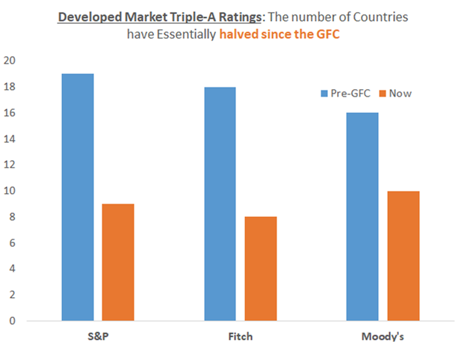
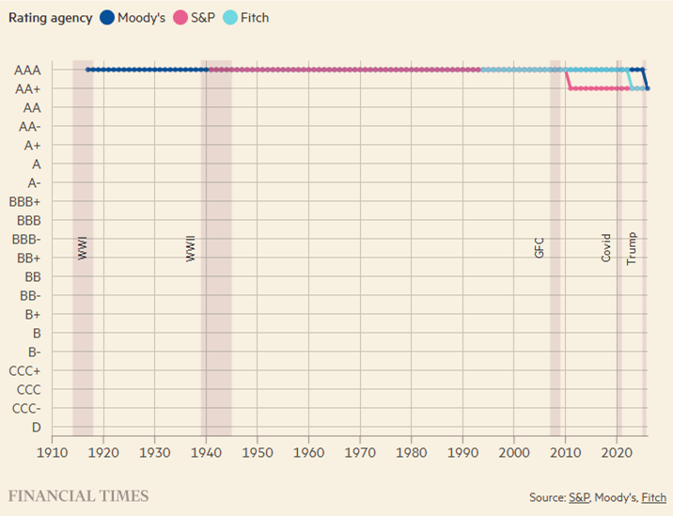
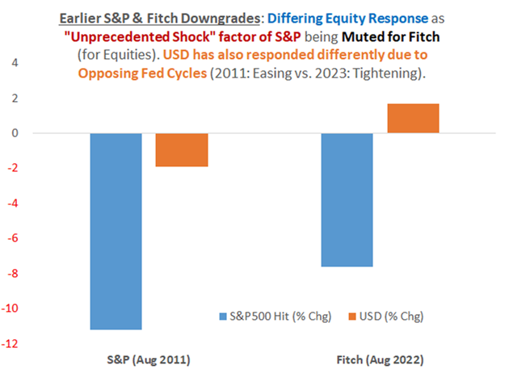
Appendix: Moody’s Downgrade: Profound, Not Prescient
The one-notch downgrade of US credit ratings from Aaa to Aa1 is ultimately inconsequential for markets.
Unsurprising catch down with S&P and Fitch, that does not reveal anything new about mounting US credit/fiscal woes.
Crucially, the downgrade does not adversely impact liquidity/collateral value of USTs, ➔ No inadvertent & imminent forced liquidation shocks.
What’s more, the post-GFC relaxation in global fund mandates significantly mitigate forced liquidation of USTs from (‘AAA/Aaa’) ratings lost.
Above all, there are no viable triple-A alternatives that are sufficiently deep and liquid to threaten the reserve asset (currency) status of USTs (USD).
So, this is will neither be a crisis for USTs and the USD’s reserve currency status nor an inadvertent shock to global liquidity plumbing.
UST Slippage to Benefit AAA Universe: That said, amid long-end UST volatility on knee-jerk selling may at the margin benefit (lower yield spreads of) bonds with undisputed* triple-A ratings (Australia, Germany, Netherlands, Switzerland, Sweden, Denmark, Norway and Singapore).
Attendant FX Gains vs. USD: The attendant pullback in the USD is also likely to be accentuated by corresponding gains in CHF, AUD, SGD, EUR, SEK, NOK and DKK.
Gold: Gold, which has already been on a stellar ascendancy for a couple of years now could admittedly be further underpinned. But further and sustained buoyancy is checked as a limited hedge rather than a substitute.
Credit Spreads: Counter-intuitively, ring-fenced risks from Moody’s ratings downgrade could tactically/temporarily dampen credit spreads elsewhere. but wider geo-economic risks warn of wider credit premium as the sustained direction of travel.
*Defined as triple-A ratings from all three agencies, hence Canada is excluded after Fitch’s downgrade in 2020.

Slide 26
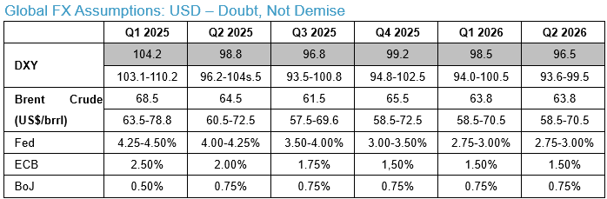
Appendix: Global Assumptions
This in turn is set to be a bugbear for growth (multipliers) outside of select industries. As such, the ECB will have to cut deeper heading into H2 2025 if pre-existing economic weakness and vulnerabilities are exacerbated by trade trades making landfall. Inadvertent (but inevitable) EUR volatility through pockets of perceived policy divergence and trade/diplomatic abrasion/relief render policy complex, and trade-offs sharper. But this is a necessary cost of policy relief.
BoJ: To be fair, the BoJ is serious about setting course for rates to go higher. But just not imminently so. Especially given Japan’s disproportionate vulnerabilities to any global trade shocks unleashed by Trump 2.0 tariffs. Crucially, the consolation of a bilateral US-Japan deal does not sufficiently mitigate, dire threats of adverse income/balance sheet shocks from wider global trade upheaval reverberating via complex, interconnected supply-chain linkages. Hence, Japan’s deep exports dependency that ties back to wages and already fragile household confidence, ought to hobble BoJ hawks. Point being, the BoJ’s greatest peril is premature tightening into debilitating external headwinds that amplifies economic pain. What’s more, when the Fed re-hastens its pace of cuts, the consequent ill-timed, sharp JPY strength threatens to aggravate economic pain. So, hawkish talk on further tightening conditioned on averting trade shocks and securing further wage gains is as far as BoJ hawks may push the envelope. Timing is everything. And “not right now” is the overarching message for BoJ hawks. So, for now, BoJ hikes ought to stop short of 1.00%.
G3 Central Banks: Timing (Cuts) is Everything
Fed: Despite an even more hawkish accent to the March ‘Dot Plot’, with just two (50bp) rate cuts for 2025, the stage is set for an abrupt dovish inflection in H2 – to cut rates by 125bp to about 3.00-3.25%. But for now, policy is in a state of suspended animation amid rippling Trump 2.0 tariff assaults, which threaten to inflict simultaneously price shocks and adverse demand hit. Hence, the interim Fed playbook will be to hold its ground to better assess the evolving balance of risks. But this is merely timing the optimal (and likely sharp) rate cut path. Point being, the direction of travel (lower) in rates is not in doubt, much less seriously challenged. That said, the Fed does not have the luxury of pre-emptive rate cuts given inherited, post-pandemic “sticky” inflation conspiring with left-over (albeit fading with a lag) job market resilience. US exceptionalism is over. So, sharp catch-down cuts are a matter of time. But timing matters! In fact, it is everything.
ECB: Revealingly, the ECB is increasingly alluding to tariff shocks that ultimately prove dis-inflationary as adverse income shocks outlast and overwhelm price jumps. But the hawkish camps continue to reserve judgment and defer to data dependence. Nonetheless, a higher degree of economic uncertainty and geo-political liabilities, suggest persistent fragilities in confidence.

Slide 27
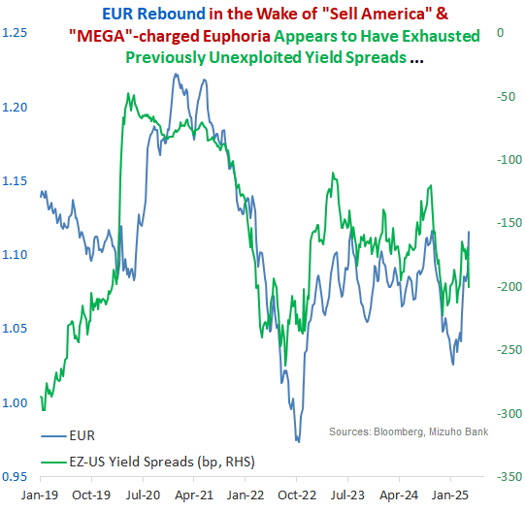
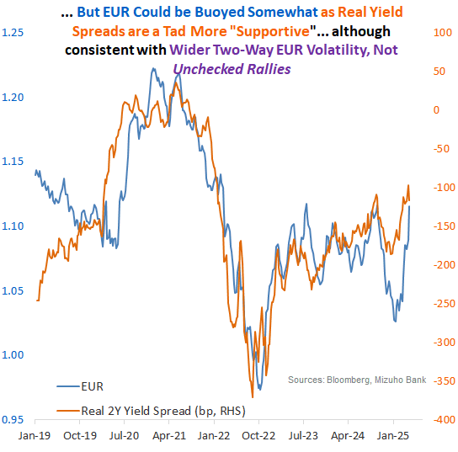
Appendix: EUR is Compromised. So, USD May be Tempered

Slide 28
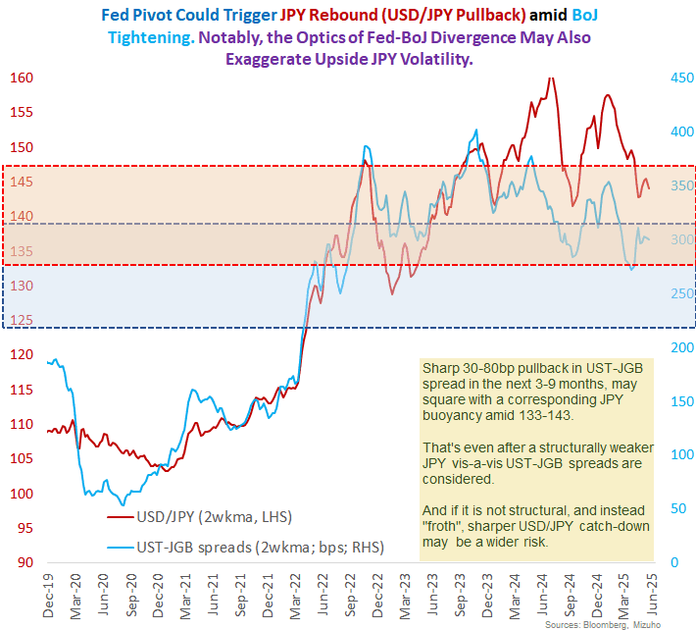
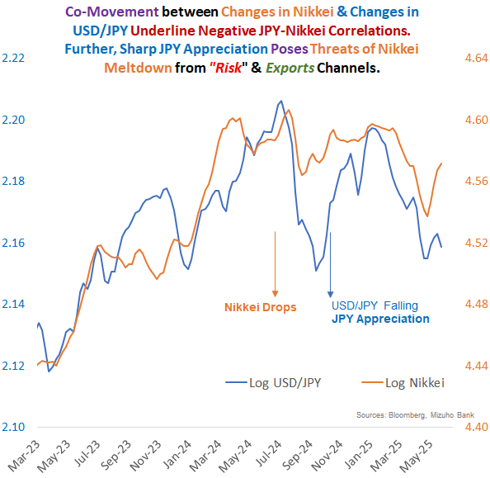
Appendix: JPY-BoJ Risks: Trump 2.0 Heightens Inherent Volatility
“JPY Problem with a Fed Solution” Distorted by Trump 2.0 Disruptions
Fed Doubt & Trade pain may inflict bouts of JPY sell-off initially

Slide 29
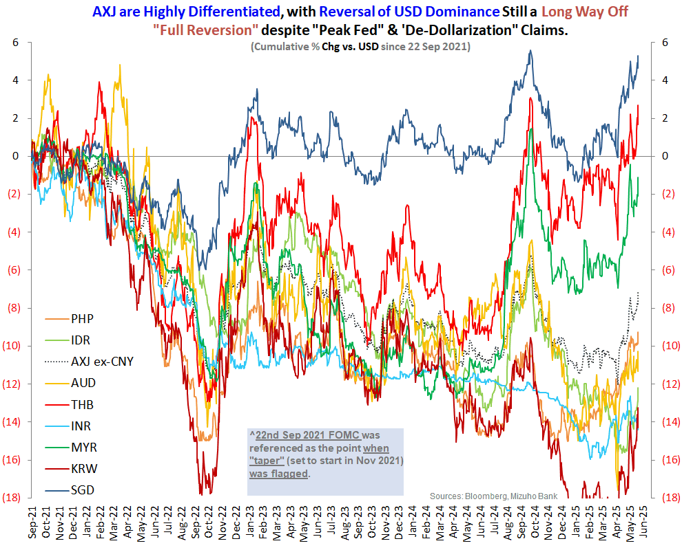
Appendix: AXJ Risks & Outlook (Cont’d)
Confusion & Complacency: The real danger as such is that markets mistake fortuitous FX dynamics for rightful, guaranteed, AXJ relief. First, there is confusion about USD dynamics amid.0 geoeconomic risks. Whether it is merely assuming level shocks to make adjustments for tariff self-harm, attendant dovish Fed calibrations and some interim weakening of haven flows. Or in fact, FX mechanics have durably shifted and USD is irredeemably subordinated to AXJ on tariff-induced risks. Persistent trade- and China-linked vulnerabilities in Asia warn against, complacency about passing storms is not an option. Instead, acute trade uncertainties and geopolitical antagonism flag potential AXJ volatility.
CNH Cover & Correlations: More complex CNH-AXJ dynamics further obfuscates the AXJ view. This is a result of intense US-China risks that require extraordinary policy bracing by the PBoC. Hence, a relatively steady CNH against a bearish USD [Box 1] resulted in AXJ outperforming CNH considerably. But in the context of temporarily looser CNH-AXJ correlations. So, a reinstatement of CNH-AXJ co-movement could revive more two-way AXJ risks; beyond scope for CNH catch-up with AXJ further down the line.
Fits & Starts: This sets AXJ up for fits and starts of rallies and retreats in response to Trump 2.0 headlines. Outsized moves, exceptionally wide ranges and sudden inflections are all par for the bumpy course. Through all the volatility, opportunism masquerading as optimism could flatter AXJ upside. But trade exposures and fiscal strains, which could accentuate latent pressures from central bank policy dilemmas.

Slide 30
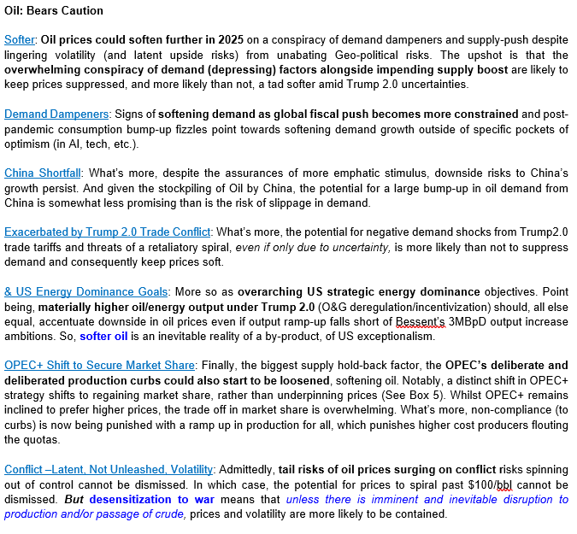
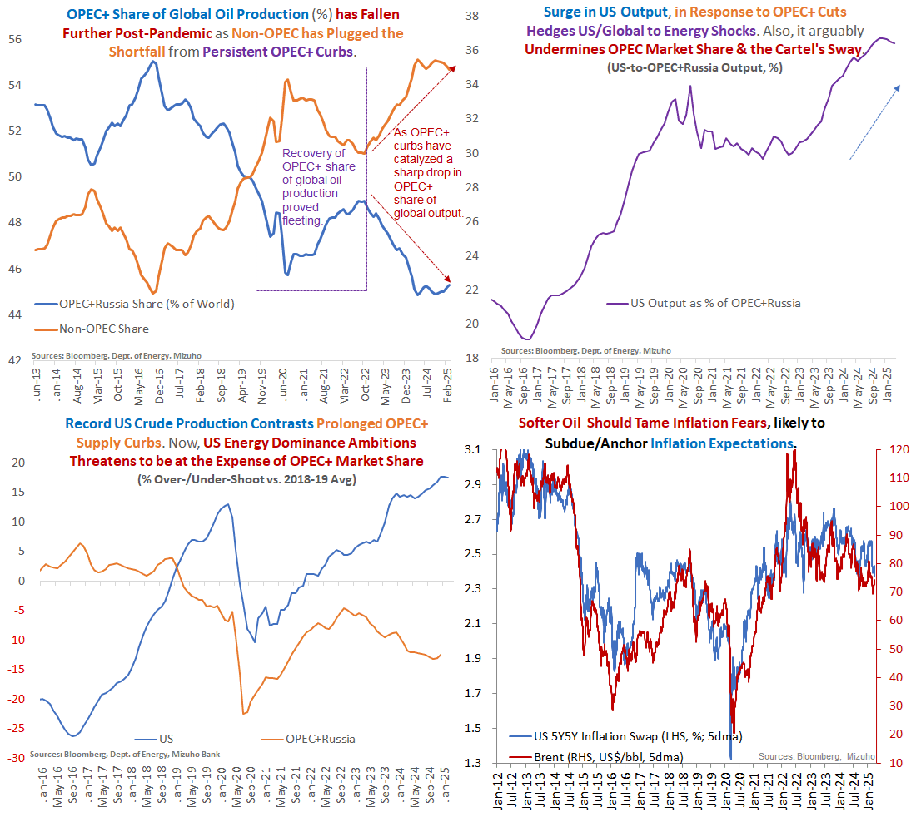
Appendix: Oil: Bearish Outcome Despite Conflict Risks

